Slide 1
NEW MEXICO PHARMACIST’S PRESCRIPTIVE AUTHORITY IMMUNIZATION CERTIFICATION 2021

Slide 2
Prescriptive Authority
Training sponsors
UNM COP
NMPhA
NM Pharmaceutical Care Foundation
Presented & Developed by:
Michel Disco, RPh
Amy Bachyrycz, Pharm.D., RPh
Joe Anderson, Pharm.D., RPh
Caroline Montoya, CNP
Bernadette Johnson, Pharm.D., RPh

Slide 3
DISCLOSURE
The presenter of this program has no financial conflict or interest with the manufacturer of any product named during this presentation.

Slide 4
CLASS
Vaccine Preventable Diseases/Principles - email w link
Storage and handling - discussion
Childhood Schedule - cases
Nuts and Bolts of Practice - email with link
Protocol/Regulations - the law
Injection techniques – practice
To submit:
Eval Form(s)
Home Study (70% or better required)
Technique Form
CPR card
Post Quiz (70% or better required)

Slide 5
ROLE OF the PHARMACIST
ADVOCATE -
Immunization educate and advocate
FACILITATOR -
Host immunization clinics
IMMUNIZER -
DO IT/ENJOY IT!!

Slide 6
VACCINES ARE DRUGS
Pharmacists are responsible for drugs
Pharmaceutical care – responsible for patients’ health and outcomes
Cure of disease
Elimination/reduction of symptoms
Arresting or slowing disease process
Preventable disease or symptoms
Notes:
Why the pharmacist???

Slide 7
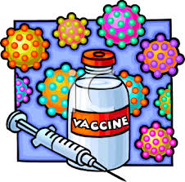
Vaccine-Preventable Infectious Diseases

Slide 8
Objectives
Describe the principles of active and passive immunity.
Identify the differences in immunologic response and contraindications between live attenuated and inactivated vaccines.
Identify the recommended vaccines for vaccine-preventable diseases for both children and adults.
Develop a vaccination plan, given a patient’s age, immunization history, and medical history.
Educate a patient or caretaker on the benefits and risks associated with vaccines.
Distinguish between appropriate and inappropriate reasons for deferring vaccination.
Recognize possible adverse reactions.

Slide 9
VACCINES THAT WILL BE COVERED
Influenza
Measles, Mumps, and Rubella
Varicella
Herpes Zoster
Diptheria, Tetanus, and Pertussis
Pneumococcal
Meningococcal
Rotavirus
Inactivated Poliovirus
Human Papillomavirus
Hepatitis A and B
Haemophilus Influenzae type b
Rabies
Others

Slide 10
Preventing Disease
Sanitation (PPE)
Immunization
Notes:
The two most effective means of preventing disease and death from infectious diseases

Slide 11
Morbidity Comparison in U.S.
DISEASE | PRE-VACCINE ERA (Cases/Year) | Cases in 2006
Diptheria | 175,885 | 0
Measles | 503,282 | 55
Mumps | 152,209 | 6,534
Pertussis | 147,271 | 15,632
Paralytic Polio | 16,316 | 0
Rubella | 47,745 | 11
Tetanus | 1,314 | 41
Notes:
Over 41,00 cases in 2012

Slide 12
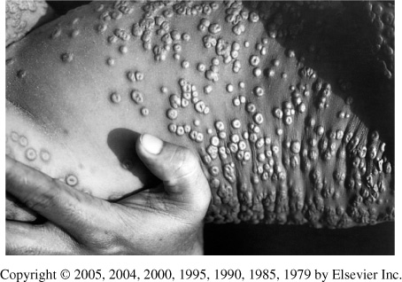
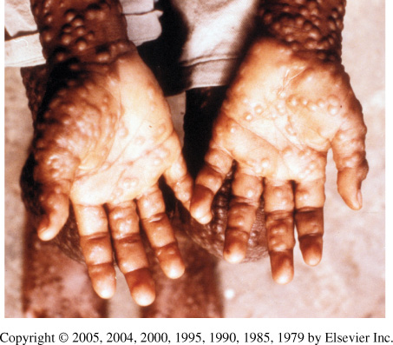
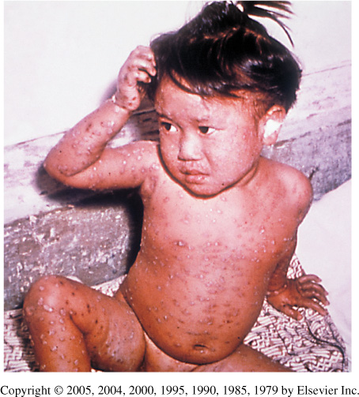
Smallpox
Notes:
12

Slide 13
Smallpox
Global Eradication Program in 1966
Last case reported in U.S. was in 1949
Routine vaccination discontinued 1972
Last indigenous case reported on earth was in 1977

Slide 14
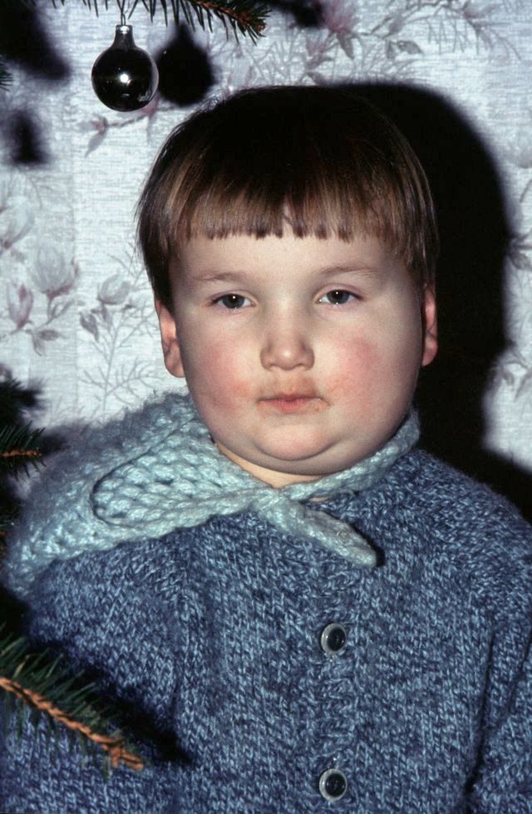
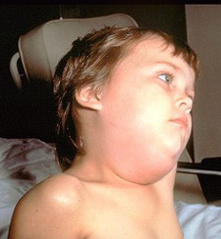
MUMPS
Notes:
14

Slide 15
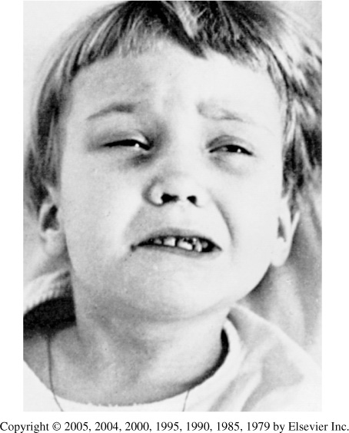
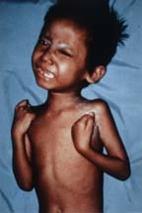
TETANUS
Notes:
15

Slide 16
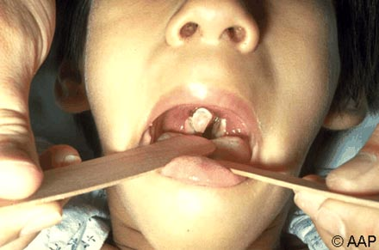
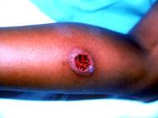
DIPTHERIA
Notes:
16

Slide 17
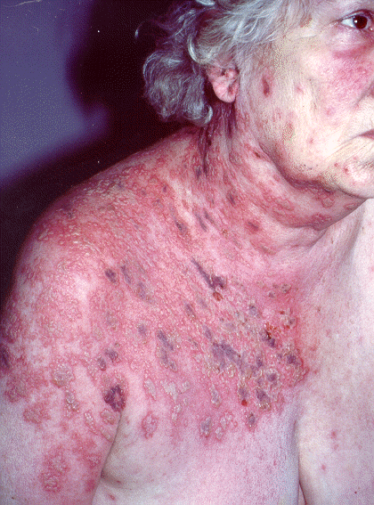
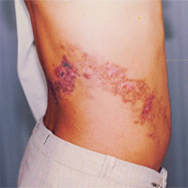
HERPES ZOSTER
Notes:
17

Slide 18
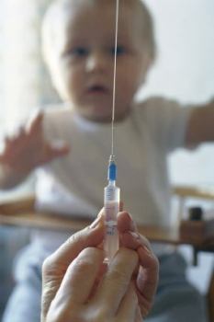
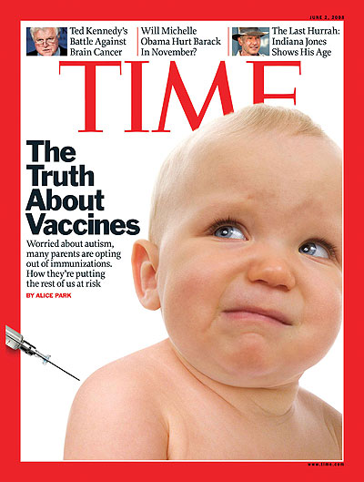
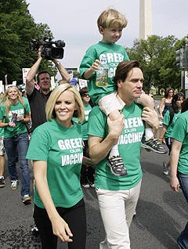
Vaccines and Media

Slide 19
Myth or Reality
“Vaccine-preventable diseases have been virtually eliminated from the U.S., so my child does not need to be vaccinated.”
Some vaccine preventable diseases are no longer endemic in the U.S.
These diseases may still be prevalent or even epidemic in other parts of the world.
Outbreaks in the U.S. are often associated with foreign travel.
Without vaccination, few cases could quickly become tens or hundreds of thousands.

Slide 20
Myth or Reality
“Aborted fetuses are used to make vaccines.”
Varicella, rubella, hepatitis A, and one rabies vaccine are made in fetal embryo fibroblast cells.
Obtained from therapeutic termination of two pregnancies in 1960s.
These same embryonic cells are used today.
Rubella vaccine prevents congenital abnormalities and miscarriages.

Slide 21
True or False
The amount of aluminum found in vaccines is similar to the amount found in 1 liter of infant formula?
True
False
True. Aluminum is used as an adjuvant in some vaccines and is closely monitored by the FDA.

Slide 22
Addressing Parents Concerns
Establish rapport
Be open and honest
Identify concerns
Identify their sources of information
Be prepared to respond with evidence-based information
Appeal to civic duty and risk

Slide 23
Community Benefit
Untreated children become threat to others
Some individuals cannot be vaccinated and rely on ‘herd immunity’
Even with a fully immunized population, infection is still possible
Costs on community

Slide 24
Pharmacists’ Responsibility
Promote vaccination – Public Health issue
Ensure proper storage and administration
Observe correct timing and appropriate intervals of vaccinations
Follow contraindications and precautions

Slide 25
Resources
CDC vaccine safety - www.cdc.gov/vaccines
Flu info - http://www.flu.gov/
Local flu info - www.tricore.org
Immunization Action Coalition - www.immunize.org
American Academy of Pediatrics - www.cispimmunize.org
Children’s Hospital of Philidelphia – www.chop.edu
Vaccine Adverse Event Reporting System (VAERS) - http://vaers.hhs.gov/

Slide 26
Adverse Event Reporting
Vaccine Adverse Event Reporting System (VAERS)
FDA and CDC
Voluntary reporting (by anyone)
Adverse reaction
Side effect caused by vaccine
Adverse event
Temporal event following vaccination
An adverse event can be an adverse reaction
Vaccine Injury Compensation Program (1986)
Routinely recommended childhood vaccines
Notes:
NM laws – must report to BOP if hurt “Significant Adverse Drug Event”
MedWatch

Slide 27
Principles of Immunity

Slide 28
Principles of Immunity
* Immune System
Distinguishes self from non-self.
Ability to recognize and eliminate infectious agents.

Slide 29
Principles of Immunity
Antigen:
A live or inactivated substance that is capable of inducing immune response
Antibody:
Protein molecules produced by the B lymphocytes that assist in the elimination of antigens

Slide 30
Principles of Immunity
Passive Immunity
Transferred protection from exogenous source
Maternal/transplacental
Blood products
Temporary (wanes with time)

Slide 31
Principles of Immunity
Active Immunity
Produced protection by person’s own immune system
Exposure to infectious disease
Vaccination
Live attenuated vaccine
Inactivated vaccine
Usually more permanent

Slide 32
Active Immune Response to Primary Exposure
Primary Response
Innate immune response (rapid)
Adaptive response (delayed)
Antibody titers peak around 2-6 weeks post-exposure
Titers fall gradually with memory B-cells being produced

Slide 33
Active Immune Response to Secondary Exposure
Secondary Response
Delayed response
Memory cells rapidly make antibodies
Host often unaware that exposure ever occurred

Slide 34
Antibody Production following Vaccination

Slide 35
Vaccination Principles
Successful vaccination relies on active immunity of individual
Immunologic response is similar to natural infection (without risk of disease)
Response and persistence of protection is determined by several factors:
Live attenuated vs inactivated
Host characteristics and immune status
Administration

Slide 36
Immunizing Agents
Immunoglobulins (acute protection)
Vaccines (viral or bacterial)
Live attenuated vaccine
Inactivated vaccine
Whole
Fractional
Protein (toxoid or subunit)
Polysaccharide-based (pure or conjugate)

Slide 37
Immunizing Agents - Components
Suspending fluid
Typically sterile water or saline
Preservatives, stabilizers, and antibiotics
Used to prevent contamination or to stabilize the antigen
Includes such materials as:
Mercurials (thimerosal)
Gelatin
Specific antibiotics (neomycin)
Adjuvants
Typically aluminum salts
Added to inactive vaccines to enhance immune response
Notes:
Menactra

Slide 38
Live Attenuated Vaccines
Weakened form of infectious agent
Does not cause disease
Requires replication to produce a sufficient response
Most resembles the immune response produced by natural infection
Usually effective with one dose (unless oral)
May be contraindicated in:
Immunosuppressed patients
Pregnant women

Slide 39
Available Live Virus Vaccines
Bacterial
BCG
Typhoid (oral)
Plague*
Viral
Measles/Mumps/Rubella
Varicella/Zoster (old vaccine)
Rotavirus
Influenza (Intranasal LAIV)
Yellow Fever
Vaccinia (smallpox)
Oral polio (OPV)*
*Not available in US

Slide 40
Herpes Zoster vaccine
Which vaccine is used in adults and at what age is the vaccine administered?
RZV vaccine is used in adults 50 years or older (2 shot series: 0 &6-12 months.)

Slide 41
Inactivated Vaccines
Contains fractional antigen or whole dead infectious agent
Does not cause disease
Generally not as effective as live vaccines
Larger doses
Multiple doses (3-5)
Boosters may be necessary
May administer to immunosuppressed patients and pregnant women
Circulating maternal antibody does not interfere with vaccine

Slide 42
Available Inactivated Vaccines
Viral
Whole
Polio
Rabies
Hepatitis A
Japanese encephalitis
Fractional
Hepatitis B
Influenza
Human papillomavirus
Anthrax
Bacterial
Whole
Cholera*
Plague*
Pertussis*
Fractional
Acellular pertussis
Pneumococcal (PPV, PCV)
Meningococcal (MPSV, MCV)
Typhoid Vi
Haemophilus influenzae type B
Diptheria toxoid
Tetanus toxoid
*Not available in US

Slide 43
Pure Polysaccharide Vaccines
Not consistently immunogenic in children <2 years of age
Induce T-cell-independent immune response
Antibody with less functional activity
No booster response
Immunogenicity improved by conjugation

Slide 44
Polysaccharide Conjugate Vaccines
Stimulates T-cell-dependent immunity
Enhanced antibody production, especially in young children
Repeat doses elicit booster response

Slide 45
Immunization Schedules
Children and Adolescent Schedule (age and indication)
Revised and Available – January of each year
Collaborative effort of:
Advisory Committee on Immunization Practices (ACIP)
American Academy of Pediatrics
American Academy of Family Physicians
Adult Schedule (age and indication)
Revised and available – January of each year
Collaborative effort of:
Advisory Committee on Immunization Practices (ACIP)
American Academy of Family Physicians
American College of Physicians
American College of Obstetricians and Gynecologists

Slide 46
Immunization Schedule for Ages 0-18 Years - combined
What vaccinations should be given within the first year of life? Are these live attenuated or inactivated vaccines?
Hep B, RV, DTaP, Hib, PCV, IPV, influenza (All inactivated)
The 4th dose of DTaP may be administered as early as age 12 months, provided what (stated in footnote)?
6 months have elapsed since the third dose
How many doses are in the MMR series? Is this a live attenuated or inactivated vaccine?
2 doses (Live vaccine administered after 1 year old)

Slide 47
Immunization Schedule for Ages 0-18 Years
What is the pediatric version of Tdap?
DTaP
What is the minimum age for administration of HPV vaccination?
9 years old

Slide 48
Immunization Schedule for Adults
How often should the Td booster be given?
Every 10 years, first booster should be Tdap
What is the maximum age of administration for HPV vaccination?
26 years old (45 years old with shared clinical decision making)
Which vaccinations are contraindicated in pregnant women and immunocompromised patients?
Live vaccines
For example,
MMR (or MMRV), Varicella, Zoster

Slide 49
Administration
Simultaneous administration is recommended
No contraindications for any vaccines
Increases likelihood of receiving all vaccines
We are NOT ‘overloading’ the immune system
If two LIVE vaccines are not administered simultaneously, they should be given at least 4 weeks apart (does not apply to inactivated)

Slide 50
Administration
Dosing intervals
Do not administer before the minimum recommended AGE
Do not administer before the minimum recommended INTERVAL
Minimum interval is determined by the component with the longest required interval
Increasing the interval between doses in a series does not diminish response – DO NOT RESTART SERIES

Slide 51
Some vaccines cannot be administered during the first year of life because:
the infant’s immune system will be overwhelmed if he/she receives too many vaccinations.
circulating maternal antibodies inactivate the vaccine antigen.
administration increases the infant’s risk for autism.
the infant may develop the disease from the vaccine.

Slide 52
Contraindications or Precautions
Severe allergic reaction to vaccine or component
Encephalopathy occurring within 7 days of pertussis-containing vaccine
Conditions that increase chance of serious reaction or may compromise ability to produce immune response
Immunosuppression
Pregnancy
Severe illness (Delay)
Recent administration of blood product (Delay live vaccines)

Slide 53
Invalid Contraindications
Antibiotic therapy
Breastfeeding
Premature birth
Mild disease – low-grade fever, URI, otitis media, mild diarrhea
Pregnancy or immunosuppression in household
Warfarin

Slide 54
Adverse Reactions
Local – pain, swelling, redness (common with inactivated)
Systemic – fever, malaise, headache
Allergic reaction
Syncope most common in adolescents – have them wait 20 min

Slide 55
A 4-year old girl presents at your pharmacy influenza clinic with a non-productive cough. She has no other symptoms and has never received an influenza vaccine in the past. She recently received her 5th DTaP vaccination 3 weeks ago and has no other contraindications to vaccination. You:
a. Delay the vaccination until the patient is feeling better.
b. Delay the vaccination for one week, because patient received her DTaP shot three weeks ago.
c. Give her an influenza vaccination and tell her to return in 4 weeks for a second.
d. None of the above

Slide 56
Diseases and Vaccines

Slide 57
Influenza

Slide 58
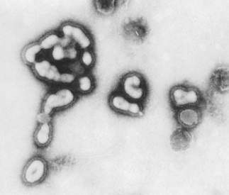
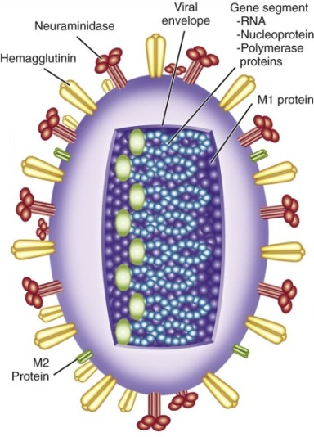
Influenza
Single-stranded RNA genome
Classified into three distinct types on the basis of antigenic differences:
Influenza A – responsible for pandemics
Hemagglutinin
Neuraminidase
Influenza B
Influenza C

Slide 59
Influenza
Epidemic: Outbreak confined to one location (e.g., city, town, country)
Pandemic: Severe outbreaks that rapidly progress to involve all parts of the world

Slide 60
Influenza
Antigenic variation occurs frequently
Drift (epidemics) – minor changes like point mutations
Shift (pandemics) – major genetic changes resulting in alterations of antigen structure usually caused by reassortment
Explains why influenza continues to be a major epidemic disease of humans
Severity is dependent upon:
Antigenic variation
Transmission capability

Slide 61
Influenza Vaccines
Inactivated (IIV)
intramuscular
trivalent
Mainly quadrivalent
duration of immunity 1 year or less
Live attenuated vaccine (LAIV)
intranasal
quadrivalent
duration of immunity at least 1 year

Slide 62
FluBlok
Recombinant Influenza Vaccine (RIV3)
Uses a baculovirus vector (virus which infects insects)
Approved for persons 18 through 49 years of age
No egg protein

Slide 63
Flucelvax
Inactivated Influenza Vaccine manufactured by Novartis IIV3
No longer contains any egg
Quadrivalent
Grown in Madin-Darby Canine Kidney Cells
Approved for persons ≥ 4 years old

Slide 64
Choice of Influenza Vaccine
The choice should primarily be driven by the age-indication and contraindications and precautions
No current preference for quadrivalent vs trivalent
No current preference for high-dose vs standard dose
No current preference for IIV vs LAIV in any age group for whom either is indicated

Slide 65
Inactivated Influenza Vaccine Contraindications and Precautions
Contraindication:
severe allergic reaction to a vaccine component (e.g., latex) or following a prior dose of vaccine
Precautions:
moderate or severe acute illness
history of Guillian-Barré syndrome within 6 weeks following a previous dose of IIV

Slide 66
Severe Allergy to Egg
Most influenza vaccine available will be produced in hen’s eggs
ovalbumin concentrations up to 1.4 mcg per mL
In clinical studies of egg-allergic persons IIV was tolerated without serious reactions
Flucelvax not manufactured in egg (MDCK cells)
FluBlok not manufactured in eggs (baculovirus vector)

Slide 67
Influenza Vaccination – egg allergy
Addition of the following:
For individuals with no known history of exposure to egg, but who are suspected of being egg-allergic on the basis of previously performed allergy testing:
Consultation with a physician with expertise in the management of allergic conditions should be obtained prior to vaccination
Pharmacists are not trained to desensitize…

Slide 68
Seasonal Vaccine
Side effects:
Injection site reactions
Muscle aches and fatigue
Fever
Nausea
Headache
Contains egg components, trace amounts of neomycin, gelatin, and arginine

Slide 69
Seasonal Flu Target Groups
No target groups this year – everyone over the age of 6 months

Slide 70
MMR-MMRV
Measles
Mumps
Rubella (German Measles)
Varicella

Slide 71
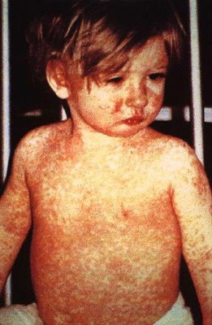
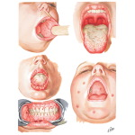
Measles
Rubeolla virus (not to be confused with rubella)
Respiratory transmission
Presentation:
Cough, coryza (runny nose), conjunctivitis
Stepwise increase in temperature to 103°F or higher
Koplik spots
Maculopapular rash
1,000,000 children still die worldwide
Measles may be more severe in adults

Slide 72
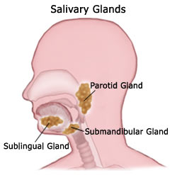
Mumps
Paramyxovirus
Respiratory transmission
Presentation:
Lower respiratory infection
Swelling and tenderness of salivary glands (parotitis in 30-40%)
Occurs primarily in school-aged children and adolescents
Course of infection rarely exceeds two weeks
Complications: arthralgias, orchitis, death (usually from encephalitis)

Slide 73
Mumps Resurgence
Previous outbreaks in 1987 and 1988
2006 was the largest mumps epidemic in past 20 years
5783 cases in 45 states and the District of Columbia
Majority reported in 7 midwest states
Majority were college students who had received at least 1 dose of vaccination
Attributed to waning immunity group and crowding

Slide 74
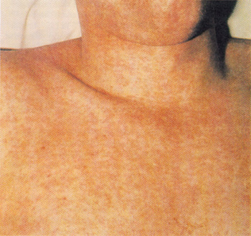
Rubella
Togavirus
Humans are only reservoir
Respiratory transmission
Presentation:
Mild illness
Rash that is more pronounced on face, but doesn’t coalesce like measles
No longer endemic in US
Biggest concern is in regards to Congenital Rubella Syndrome (CRS)

Slide 75
Congenital Rubella Syndrome
Mother may be asymptomatic
Infection during first trimester is most severe
Permanent complications of CRS
Deafness, cataracts, heart defects (triad)
Bone alterations
Mental retardation
Liver and spleen damage
Premature delivery
Miscarriage

Slide 76
Varicella/Zoster
Herpesvirus
Humans are only reservoir
Highly contagious
Transmitted by direct contact with lesions

Slide 77
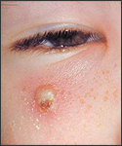
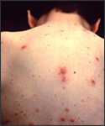
Varicella (Chickenpox)
Primary infection results in varicella
Pruritic vesicles concentrated on trunk
13% of individuals have more than one primary infection
Asymptomatic primary infections unusual
Complications:
Lesion infections
Encephalitis
Pneumonia
Congenital Varicella Syndrome (CVS)
Death - Adults are 25% more likely to die from varicella

Slide 78
Herpes Zoster (Shingles)
Recurrent infection results in herpes zoster
Reactivation of latent varicella
Unilateral vesicular rash and pain on singular dermatome
Can occur decades after initial infection
Generally associated with aging or immunosuppression
Lifetime risk of 20 %
50% of Individuals > 80 years will develop zoster

Slide 79
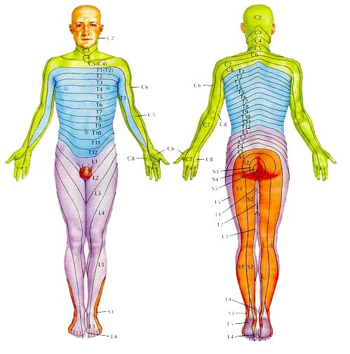
Herpes Zoster

Slide 80
Zoster Complications
Post-herpetic neuralgia (PHN)
No effective treatment for pain
Depression
Sleep disturbances
Opthalmic zoster (blindness)
Dissemination into CNS, lungs, liver, and pancreas

Slide 81
MMR-MMRV Vaccine
Live virus components
Single primary dose
Second dose is given to ensure close to 100% immunity
Damaged vaccine
Present maternal antibody
No more than 2 doses/lifetime
Single antigens are available through Merck

Slide 82
Varicella and Zoster Vaccines
All vaccines contain Oka-Merck vaccine strain
Varicella
Varivax® (1400 pfu)
MMRV or Pro-quad® (9,800 pfu)
2 doses given 12-15 months and 4-6 years
Notes:
82

Slide 83
Evidence of Immunity
Born before 1966
Vaccination documentation
History documented by healthcare provider
Laboratory evidence
Current: 2 doses or titer (UNMH)

Slide 84
Herpes Zoster Vaccine
Single dose for > 50 years
Unknown if additional doses will be needed
Should be given whether or not individual reports prior episode of shingles
Do not need to screen for varicella disease or vaccine
No guidelines for immunocompromised or pregnant patients
Notes:
84

Slide 85
Shingrix vs. Zostavax
Differences
Storage
Number of doses
Site of administration
Revaccination
Age recommendation
Health recommendation
Type of vaccine

Slide 86
What are the contraindications for the MMR-MMRV vaccine?
I. Contraindicated in pregnant women
II. Contraindicated in patients with allergy to vaccine components (egg allergy, neomycin, gelatin)
III. Contraindicated in severely immunocompromised patients
I only
III only
I and II
II and III
I, II, and III
Notes:
86

Slide 87
Contraindications
Allergy
Pregnancy
Immunosuppression
Administer to HIV-infected children with CD4 counts >15%
Administer to HIV-infected adults with CD4 counts >200cells/mm3
Coadministration of recent blood products
Notes:
87

Slide 88
MMR-MMRV Vaccine in Pregnancy
321 women vaccinated
324 live births
No observed CRS
95% confidence limits 0%-1.2%

Slide 89
MMR-MMRV Vaccine Adverse Reactions
Live – attenuated vaccines mimic s/s of infection
Common:
Rash or zoster (measles, rubella, varicella)
Joint symptoms (mumps, rubella)
Rare:
Thrombocytopenia (rubella)
Parotitis (mumps)
Deafness (mumps)
Encephalopathy (measles, mumps, rubella)

Slide 90
MMR Vaccine and Autism
Flawed Wakefield studies suggested that MMR caused intestinal inflammation that allowed absorption of proteins that are harmful to the brain
Numerous studies that reject causal role
Signs and symptoms may be temporal (diagnosis of autism often made in second year of life)
CDC, Vaccine Injury Compensation Program, and Institute of Medicine do not support the association
Autism has both genetic and environmental component

Slide 91
Which of the following are false?
The MMRV vaccine contains live attenuated virus components of measles, mumps, rubella, and varicella.
The MMRV vaccine may prevent CRS.
The second dose of MMRV ensures nearly 100% immunity.
The first dose of MMRV vaccine should be given at 6 months of age.

Slide 92
Live vaccines
Please list the live vaccines that are recommended in both the childhood and adult schedules. When should patients receive these vaccines?
Influenza nasal spray yearly (age 2-49)
Measles, Mumps, Rubella at age 1 and before entering school between ages 4-6
Varicella at age 1 and before entering school between the ages of 4-6
Yellow Fever (not listed on schedule, traveling only)
Rotavirus (no for adults)

Slide 93
A parent refuses the MMR vaccine because the parent does not want their child exposed to mercury (thimerosal) for fear that it will cause autism is there child. What can you tell this parent to encourage them to have their child vaccinated?
Ask them where they obtained their information.
Let them know that MMR does not contain thimerosal.
The Institute of Medicine conducted several studies and found no correlation between the MMR vaccine and autism.
CDC and Vaccine Injury Compensation Program also do not support the association.
Appeal to their civic duty to the community.
Remind them that their child will be at risk for these diseases.

Slide 94
Name three things that can affect vaccine response and persistence of protection.
Type of vaccine (live or inactivated)
Host characteristics and immune status
Administration and storage

Slide 95
Which type of vaccine is not consistently immunogenic in children <2 years of age?
Pure polysaccharide vaccines

Slide 96
Why are aluminum salts added to inactivated vaccines?
They are adjuvants that increase the rate of response and the duration of immunity

Slide 97
If two LIVE vaccines are not administered simultaneously, how long should you delay vaccination with the 2nd LIVE vaccine? And why?
4 weeks because the second vaccine will not induce an effective response

Slide 98
Which of the following is a TRUE contraindication to vaccination?
Severe illness
Premature birth
Breastfeeding
Warfarin therapy

Slide 99
DTaP – DT – Td – Tdap
Diphtheria
Tetanus
Pertussis

Slide 100
DTaP-DT-Td-Tdap
Diphtheria and Tetanus Toxoids
DT = pediatric
Follows DTaP schedule
For individuals that have contraindication to pertussis
Td = adult (every 10 years after Tdap)
Diphtheria, Tetanus, and Acellular Pertussis
DTaP = pediatric
Tdap = adult (1st booster)

Slide 101
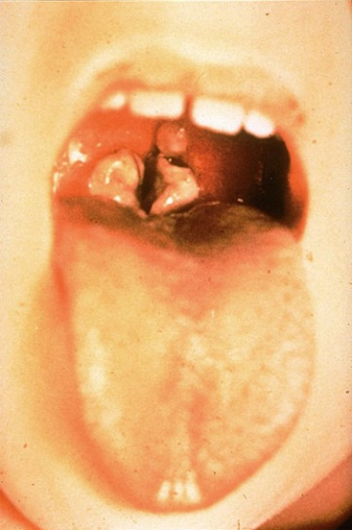
Diphtheria
Corynebacterium diptheriae
Transmitted by droplet spread or direct contact with cutaneous infection
Some strains are able to produce diptheria toxin
Infects mucous membranes
Presents as pharyngitis (membraneous) or tonsillitis
Fever not high but patient appears toxic

Slide 102
Diptheria Complications
Respiratory obstruction
Myocarditis and heart failure
CNS complications including neuritis and paralysis

Slide 103
Tetanus
Clostridium tetani
Found in soil and animal feces
Acquired through surgery, puncture, laceration, wound, IVDU, tattoo, diabetes-related infections (rusty nail)
Incubation period of 4 days-several weeks
Minimal or no inflammation at primary site of infection
Neurotoxin results in unopposed firing of motor neurons

Slide 104
Tetanus Complications
Pulmonary embolism
Aspiration pneumonia
Fractures
Death (25% mortality) – respiratory failure

Slide 105
Diptheria and Tetanus Toxoids
Inactivated toxins
Aluminum-precipitated (or adsorbed) preparation is more immunogenic
Prevents disease, not acquisition or carriage

Slide 106
Diptheria and Tetanus Toxoids
Available in combination, not as single antigen:
Diptheria, tetanus, and acellular pertussis
Diptheria and tetanus
Adult formulations contain lower concentrations of diptheria toxoid (to prevent local reactions)
Reported local site reactions higher with each additional dose

Slide 107
Pertussis
Bordetella pertussis
Humans are only reservoir for disease
Spread by airborne droplets
Highly contagious with no strong seasonal pattern
Presents as URI
Milder in adolescents/adults

Slide 108
Pertussis – ‘100 Day Cough’
Catarrhal stage
1-2 weeks cough gradually worsens
Maximum communicability
Paroxysmal cough
1-6 weeks
Local tissue damage with thick mucous production
‘Whooping’ cough
Cyanosis, vomiting
Antibiotics have little effect on course of disease by this stage
Convalescence
Gradually improves over weeks to months
Complications: seizures, cerebral bleeding, encephalopathy, death

Slide 109
Pertussis Vaccine
1930s available as whole cell vaccine
Associated with greater side effects and seizures
No longer distributed in U.S.
Acellular vaccine
Purified components of Bordetella pertussis and detoxified pertussis toxin
Efficacy is comparable to whole cell vaccine but with decreased side effects

Slide 110
Pertussis Vaccine
Precautions
Temperature greater than 40.5°C within 48 hours of prior dose without identifiable cause
Convulsions occurring within 3 days
May use acetaminophen 15mg/kg at time of vaccination, then Q4h for 24h
Contraindications
Encephalopathy within the 7 days following previous administration

Slide 111
DTaP-DT-Td-Tdap
Childrens formulations: DTaP and DT
Boosters: Tdap, Td
Adult formulations contain lower concentrations of diptheria toxoid and acellular pertussis vaccine
Reported local site reactions higher with age and each additional dose

Slide 112
DTaP
Approved for children 6 weeks through 6 years
Number of doses depends on child’s age at the first dose
If <12 months, 4 doses are recommended
If >12 months, 3 doses are recommended
1st booster at 4-6 years: DTaP
2nd booster at ages 11-12 years: Tdap
Following boosters: Tdap once for adolescent, then once as adult, then Td every 10 years

Slide 113
An 11-year old patient is in your clinic to receive his tetanus/diptheria booster. He received his DTaP series at 13 months, 14 months, 15 months, and a DTaP booster at 4 years old. He had no reaction to his previous vaccination. What do you want to give him today? When should he come back for his booster and which formulation should he receive?
Tdap
Tdap in 10 years, then Td or Tdap every 10 years thereafter

Slide 114
Pneumococcal Disease
Streptococcus pneumoniae
90 serotypes
Type-specific antibody protection

Slide 115
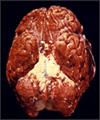
Pneumococcal Meningitis
Most common cause of bacterial meningitis
High fatality rates (80%) in children <2 years old and adults >65 years old

Slide 116
Pneumococcal Pneumonia
Most common complication
100,000-135,000 cases requiring hospitalization per year
Responsible for up to 30% of CAP and 50% of HAP

Slide 117
Pneumococcal Vaccine
23-valent polysaccharide vaccine (PPSV)
13-valent polysaccharide conjugate vaccine (PCV) – the former vaccine was 7-valent
Prevnar-13

Slide 118
Pneumococcal Polysaccharide Vaccine (PPSV)
23 serotypes account for 88% of pneumococcal disease
Schedule is one dose for ages > 65
High risk patients may receive 1 dose with selective revaccination (>5 years)
Duration of immunity is at least 6 years
NOT EFFECTIVE IN CHILDREN <2 YEARS

Slide 119
Pneumococcal Conjugated Vaccine (PCV)
Covers 13 serotypes of S. pneumoniae
Conjugated to nontoxic diptheria toxin
Conjugation improves immunologic response in children <2 years old
No special contraindications or adverse reactions

Slide 120
Pneumococcal Conjugate Vaccine (PCV)
Approved in children 6 weeks-9 years old
Risk is greatest <24 months
ACIP recommends ages 6 weeks – 59 months
3-dose series recommended at 2, 4, 6 months
First dose may be given as early as 6 weeks
Booster given at 12-15 months
Unvaccinated children >7 months of age require less doses
Everyone age 65 and older once
Available resources per CDC and MMWR

Slide 121
You are administering the 4th pneumococcal vaccine to a 12-month old little girl and you realize that you gave her the pure polysaccharide pneumococcal vaccine instead of the conjugated vaccine. You:
You record this PPSV dose as her 4th dose to complete her pneumococcal series.
You tell her to come back for her PCV, but she must wait 4 weeks.
You administer the PCV today.
You administer an additional PPSV at age 2.

Slide 122
Meningococcal Disease
Neisseria meningitidis
13 serotypes
5 serotypes cause 90% of cases (A, B, C, Y, and W-135)
Respiratory transmission
Less common in U.S. but associated with high mortality (9-12%)
Symptoms progress rapidly and can lead to death within 24-48 hours

Slide 123
Clinical Manifestations of Neisseria meningitidis

Slide 124
Individuals at Risk for Neisseria meningitidis Infection
Persons with anatomic or functional asplenia
Persons with terminal complement deficiency
Laboratory personnel exposed to N. meningitidis
College freshmen
Military recruits
Foreign travelers

Slide 125
Meningococcal Vaccines
Quadrivalent polysaccharide vaccine
Quadrivalent conjugated-polysaccharide vaccine

Slide 126
Meningococcal Polysaccharide Vaccine (MPSV)
Quadrivalent polysaccharide vaccine (A, C, Y, W-135)
MPSV contains thimerosal
Approved for individuals >2 years of age
80-90% effective
No longer routinely used
Duration of immunity is short (<5 years)

Slide 127
Meningococcal Conjugate Vaccine (MCV)
Quadrivalent polysaccharide vaccine (A, C, Y, W-135) conjugated to inactivated diptheria toxin (2005)
>90% effective with single dose
Routinely recommended for 11-18 year olds
Revaccination not currently recommended unless in high-risk group

Slide 128
Rotavirus Gastroenteritis
Most common cause of severe dehydrating gastroenteritis in children
Almost all children have been infected by 5 years of age
Five strains account for 90% of isolates (G1-4, G9)
1st infection after 3 months of age is the most severe with temperatures >102F
GI symptoms generally resolve in 3-7 days
Low mortality but high healthcare burden

Slide 129
Rotavirus Vaccine- RotaTeq®
Live, oral vaccine
Contains five re-assortment rotaviruses
Nonhuman rotaviruses used
Manipulated to express human rotavirus antigens on surface
Have low pathogenicity for humans
Replicate, but do not cause disease

Slide 130
Rotavirus Vaccine- RotaTeq®
3-dose series beginning at about 2 months of age
Vaccination should not be initiated for infants older than 15 weeks
ACIP recommends immunization of all infants without a contraindication
No special contraindications or adverse reactions

Slide 131
Which vaccine is ineffective in children under 2 years of age?
PPV (Pneumococcal polysaccharide vaccine)
PCV (Pneumococcal conjugate vaccine)
Rotavirus vaccine

Slide 132
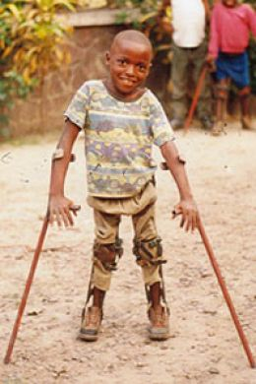
Poliomyelitis
Enterovirus with three distinct serotypes (1,2,3)
Oral-fecal transmission
Immunity to one does not protect against the others
Most infections are asymptomatic
Infection spreads to CNS causing destruction of motor neurons

Slide 133
Paralytic Polio
Some or all motor function may be recovered
1:200 develop permanent paralysis (usually asymmetric)
Sensory function remains intact
Severity increases with age
Fatal in 2-5% of cases

Slide 134
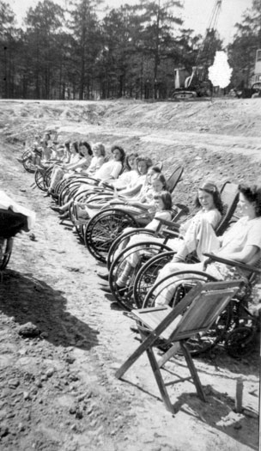
Polio Epidemic in U.S.
1920s outbreaks crippled and killed thousands, with the epidemic peaking in 1952 (57,628 cases)
1955 vaccine was developed and reduced incidence by 90% within 2 years
Eradicated in the U.S.
Hundreds of new cases are still reported each year worldwide
Will be the 2nd virus eradicated from the planet by vaccine

Slide 135
The ‘Iron Lung’

Slide 136
Polio Vaccine
1955 Inactivated vaccine (IPV)
1963 Oral Polio Vaccine (OPV)
1979 Last case of ‘wild virus’ reported
1987 Enhanced IPV (Original IPV taken off the market)
2000 OPV use discontinued in U.S.
2004 Last imported case

Slide 137
Inactivated Polio Vaccine
IPV contains 3 viruses
No special contraindications
IPV is safe (if not the safest vaccine)
OPV still widely used outside of U.S.

Slide 138
Inactivated Polio Vaccine
Children
99% effective after 3 doses
4th dose given as booster given before school entry
Adults who are not vaccinated
Not recommended unless traveling to polio-endemic areas
Only require 3 dose series of same dose
Any 4 dose combination of IPV and OPV may be used

Slide 139
Human Papillomavirus (HPV)
More than 100 types of HPV
Transmitted through direct skin-to-skin contact
Over 40 types infect mucosal surfaces, including anogenital epithelium
Most common sexually transmitted infection
20,000,000 Americans currently infected with HPV
Up to 30% are infected with multiple strains

Slide 140
Human Papillomavirus (HPV)
Certain strains increase risk for cancer
“High-risk” oncogenic strains (16,18)
“Low-risk” oncogenic strains (6, 11)
Approximately 11,000 women diagnosed with cancer in 2007 (3500 deaths)
Most individuals are able to clear infection
70% become HPV DNA negative within one year
90% become HPV DNA negative within two years

Slide 141
Quadrivalent HPV Vaccine
Inactivated vaccine
Protects against nine HPV types (most common examples - 6,11,16,18)
3-dose series ideally received before sexually active (0,2, 6 months) – unless first shot received before age 15, then 2-dose series
Strain are responsible for 70% of cervical cancers (types 16, 18) and 90% of genital warts (types 6, 11)

Slide 142
Quadrivalent HPV Vaccine
FDA Approval and ACIP approval
2006 for women 9-26 years old for genital warts and cervical cancer
2009 for men 9-26 years old for genital warts and anal cancers
Cervical cancer screen recommendations have not changed

Slide 143
Quadrivalent HPV Vaccine
Studied in 11,000 females (ages 9-26)
100% effective in preventing cervical precancers
>95% effective in preventing vulvar and vaginal precancers and genital warts
Duration of protection unknown
No serious side effects
Efficacy studies in males is ongoing

Slide 144
Way back when… VAERS Reporting
26,ooo,ooo doses have been dispensed
15,037 VAERS reports
Non-serious (93%)
Syncope requiring patients to wait 15 minutes
Serious (7%)
Blood clots - Majority had risk factors (e.g. oral contraceptives
Deaths – 44 reports with no pattern that would suggest they were caused by the vaccine

Slide 145
HPV Vaccine Contraindications
Severe allergic reaction to a vaccine component or following a prior dose
Defer in pregnancy even if series was already initiated

Slide 146
Hepatitis A Vaccine
2-dose series
Pediatric dose for 0-18 years of age
Adult dose for > 19 years of age
Recommended for children, and also adults that are high-risk:
International travelers
MSM
IVDU
Occupational risk
Chronic liver disease
Available in single or combo formulations

Slide 147
Hepatitis B Vaccine
3-dose series
Pediatric dose for 0-19 years of age
Adult dose for > 20 years of age
Recommended for children, and also adults that are high-risk:
MSM
Heterosexuals with multiple partners
Persons diagnosed with STD
Prostitutes
IVDU
Inmates of long-term correctional facilities
Healthcare workers
Available in single or combo formulations that are interchangeable
No need for booster

Slide 148
Hepatitis A/B Coformulation - Twinrix®
3-dose series approved for >18 years
Each contains pediatric dose of hepatitis A
Twinrix® in combination with hepatitis A vaccine
2 Twinrix® + 1 hepatitis A
1 Twinrix + 2 hepatitis A

Slide 149
Haemophilus influenzae Type B Vaccine
Available in single or combo formulations (DTaP-Hib or Hepatitis B-Hib)
All vaccines are interchangeable for primary series and booster dose
3-dose series with one booster
Children who fall behind may not need all of the remaining doses
Not recommended in children >59 months unless high risk:
Asplenic
Immunosuppressed
HSCT

Slide 150
Rabies
Post-Exposure
Pre-Exposure – now recommended
Veterinarians
Forest workers
Zoo workers

Slide 151
Cases

Slide 152
Case #1
RS is a 3-year-old male adopted from Russia.
He is seeing you in clinic for the first time in November. He appears healthy today.
PMH: HIV+ with CD4 of 13%. He has no history of chickenpox.
Vaccination history:
BCG at birth
OPV at birth, 1, 3, 4 months
DPT at birth, 1month, and 3 months
Measles vaccine at 10 months
1st dose of seasonal influenza vaccine 5 weeks ago, 1st time patient has ever received influenza
Completed Hib and PCV vaccine at 2, 4, 6, and 12 months

Slide 153
Case #1
What vaccinations does RS need today?
Hepatitis B #1 (#2 in 4 weeks)
DTaP #2 (#3 in 4 weeks)
IPV #3 (# 4 at 4-6 years of age)
Influenza #2 (will need 1 annually there after)
MMR #1 (#2 at 4-6 years of age)
Varicella #1 (#2 next at 4-6 years of age)
Hepatitis A #1 (#2 in 6 months)

Slide 154
Case #1
Does he have any contraindications to the vaccinations that he will need today?
MMR, Varicella, and live seasonal flu
May administer when CD4 >15%
When should RS return to clinic and what vaccinations will he need at her next visit?
4 weeks to receive hepatitis B #2, DTaP #3

Slide 155
Case #2
MR is a 25-year-old female nurse that was just hired to work in the UNMH emergency department this October. There has been a recent reported pertussis outbreak in community served by hospital since her hire and several cases have been seen in ED. Two hospital staff have been diagnosed with pertussis in the last month.
She is seeing you at the employee health clinic for the first time. She appears healthy today.
PHM: No significant PMH. Chickenpox at age 5, with no documentation.
Vaccination history:
IPV completed at age 4
MMR completed at age 4
Diptheria, tetanus, and pertusis
Temp of 105°F following 1st dose of DTP at 2 months of age.
Completed series with pediatric DT at age 4
Adult Td booster 16 months ago
Hepatitis A and B completed September 2007
Influenza in 2007

Slide 156
Case #2
What vaccinations does MR need today?
HPV #1 (#2 in 2 months)
Tdap booster with tylenol (booster in 10 years)
Influenza (should receive annually)
Varicella??
Does she have any contraindications to the vaccinations that she will need today?
No, prior history is considered a precaution.
Risk as provider during outbreak outweighs risk of side effect.
10 years is recommended interval to decrease the local reactions.

Slide 157
Case #2
When should MR return to clinic and what vaccinations will she need at her next visit?
2 Months for HPV #2
Varicella potentially - serotesting needs to be completed for confirmation of varicella protection

Slide 158
Case #3
Your 16-year old patient returns home from summer camp, where a bunkmate was sent to the hospital for invasive meningococcal disease. You proceed to: (select all that apply)
A. Monitor the patient for illness. Advise the family to watch patient closely for symptoms such as fever, aches, chills and rash for at least 10 days since last exposure to the ill bunkmate.
B. Review the patient’s immunization status, and, if not yet received, immunize the patient with quadrivalent meningococcal conjugate vaccine; two doses are recommended, the first at 11 or 12 years of age, with a booster dose at age 16.
C. Offer the patient a brief course of an appropriate antibiotic to further reduce the risk of contracting meningococcal disease.
D. If the patient was previously immunized, reassure the patient and family that no other vaccines or antibiotic prophylaxis is not needed.

Slide 159
Case #3 Answers:
A, B, and C are correct.
D is incorrect. Current meningococcal conjugate vaccines are not designed to protect against serogroup B meningococcus, associated with 30% of cases in California. Also, confirmed exposures, there will not be time for active immunity with vaccines, so passive immunity or antibiotic prophylaxis should be used.

