Slide 1
An Overview of Opioid Use Disorders and Medication Assisted Treatment in Chronic Pain Conditions
Patricia Pade, MD FASAM

Slide 2
D
I have no conflicts of interest to disclose.

Slide 3
Objectives
To provide a summary of the history and epidemiology of the current opioid crisis.
To describe the neurobiology of opioid use disorders (OUD) and medications utilized to treat.
To describe the implementation and outcomes related to OUD treatment in a primary care setting.

Slide 4
Historical Background and Epidemiology
116 million people in the US suffer with pain – which is more than diabetes, cancer and heart disease combined¹
1 in 5 adults have chronic pain²
1 in 14 adults have “high impact” pain²
Annual health care costs – expenses, lost wages, productivity loss estimated to be $635 billion¹
Notes:
High impact pain severely interferes with daily function.

Slide 5
Opioid Use
Response to the Recognition of Chronic Pain in the Mid-90s
Use of opioids increased substantially over the past 25 years despite limited evidence for efficacy in chronic non-cancer pain ^{3,4}
Rise in opioids utilization corresponds to rise in opioid abuse and dependence – rates of opioid misuse (includes abuse and dependence as well as recreational use) estimated between 18 to 41% ⁵ and aberrant medication behavior as high as 50% ⁶
Prescriptions for opioids:
1991 – 76 million
2011 – 219 million⁷

Slide 6
Fatal Drug Poisoning
Between 1999 and 2002, the number of opioid analgesic poisonings on death certificates rose 91.2%
In 2014 – 19,000 overdose deaths in the United States related to prescription opioids.
CDC MMWR Nov 4, 2011 60(43) 1487-1492
Paulozzi, L.J., Budnitz, D.S., Xi, Y, 2006. Increasing deaths from opioid analgesics in the United States. Pharmacoedidemiology and Drug Safety 15, 613-7.
Califf RM, Woodcock J, Ostroff S, 2016. A Proactive Response to Prescription Opioid Abuse. DOI:10. 1056/NEJMar1601307.

Slide 7
Recognition of opioid overdose - Interventions
CDC recognized crisis – 2007
DEA shutters a number of pain clinics
States developed PMP
Health plans instituted new rules for opioids
Medical boards increased investigations
CDC issued further guidelines in 2016 which were interpreted often as mandates.
Decreased initiation of opioids and often patients who were receiving long term chronic opioid therapy were abruptly cut off.
PO Coffin, AM Barreveld. N Engl J Med 2022;386:611-613.

Slide 8
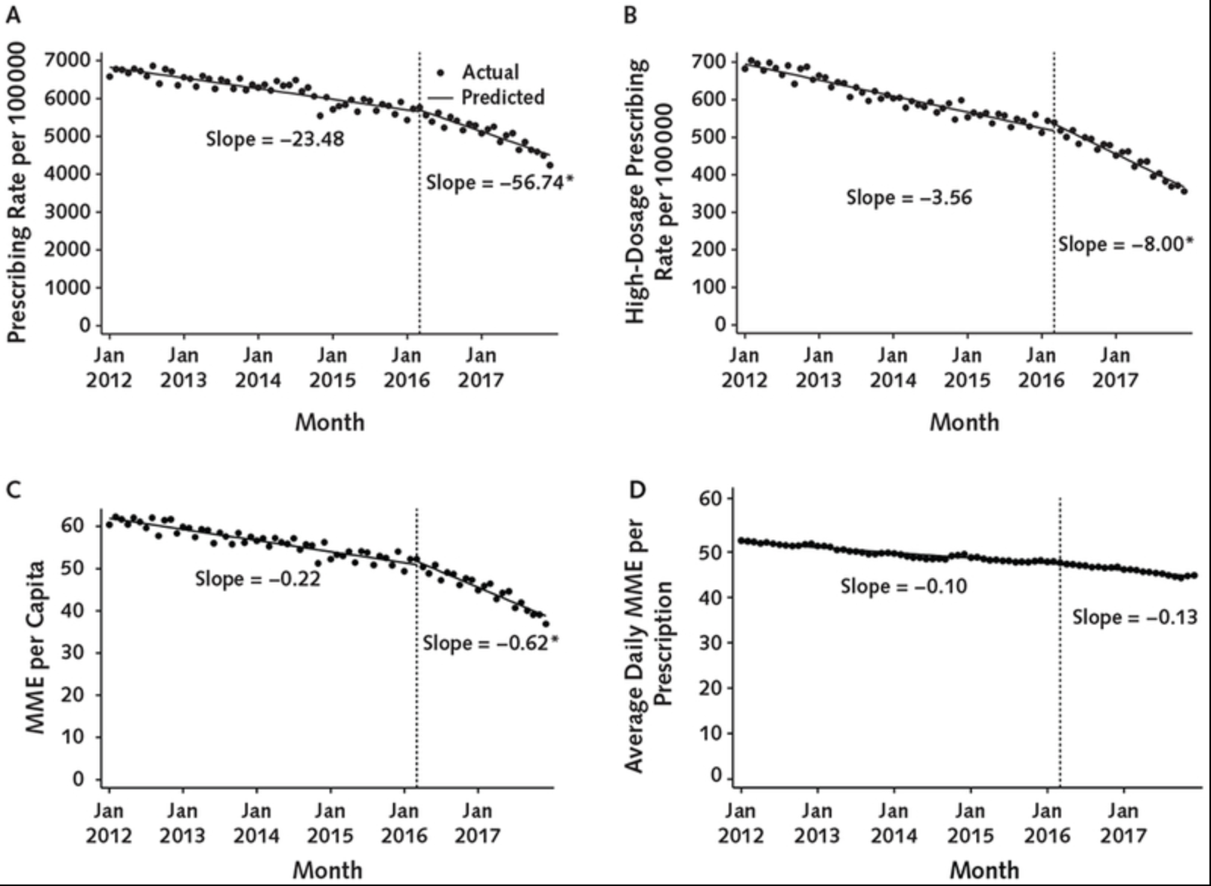
Rates of Prescribing⁸

Slide 9
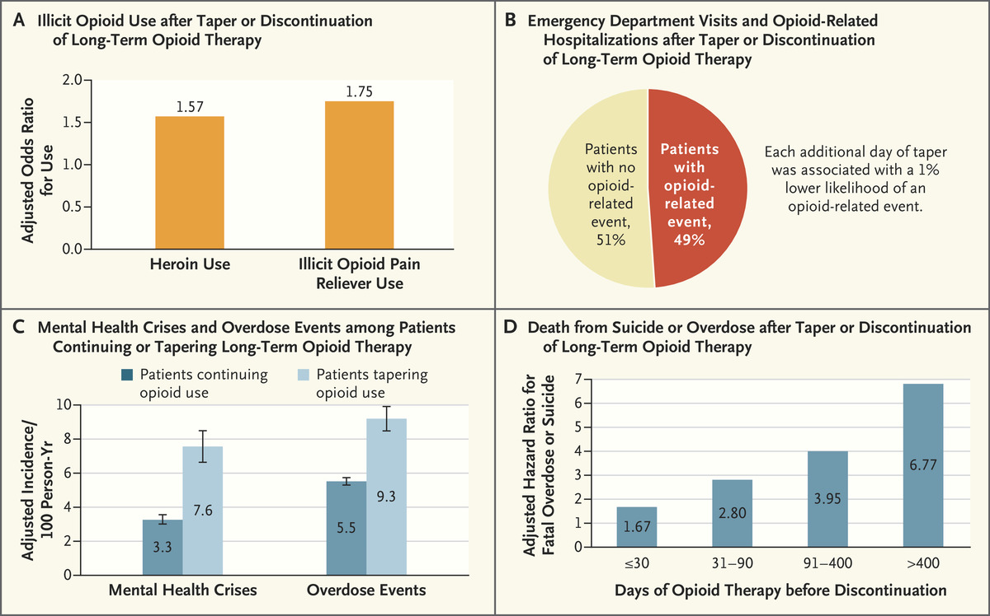

Risks Conferred by Tapering or Discontinuing Long-Term Opioid Therapy.
PO Coffin, AM Barreveld. N Engl J Med 2022;386:611-613.
Notes:
Risks Conferred by Tapering or Discontinuing Long-Term Opioid Therapy. Among patients who have their long-term opioid therapy discontinued or tapered, there is an increased risk of illicit opioid use (Panel A), a high incidence of emergency department visits and opioid-related hospitalizations (Panel B), an increased incidence of mental health crises and overdose events (Panel C), and an increased risk of death from suicide or overdose (Panel D). 𝙸 bars in Panel C indicate 95% confidence intervals. Data are from Coffin et al.,² Mark and Parish,³ Agnoli et al.,⁴ and Oliva et al.⁵

Slide 10
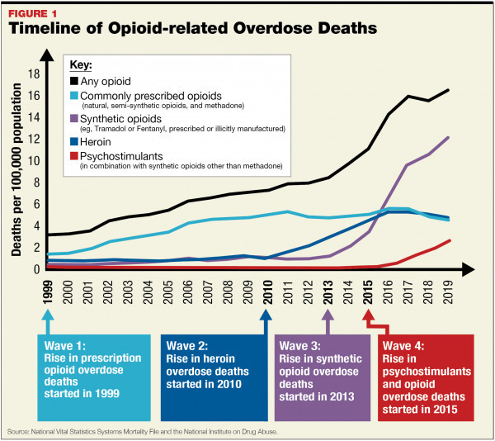
Rise of Overdose Deaths

Slide 11
Current Situation – 4th Wave
”Legacy Patients” who have been prescribed COT – can’t get providers to continue medications
We are now dealing with synthetic opioids that are 100-1000 x the potency of morphine
High potency synthetic opioids are now evolving, less detectable and mixed with other substances which are increasing the OD potential – ie methamphetamine, xylazine, benzodiazepines

Slide 12
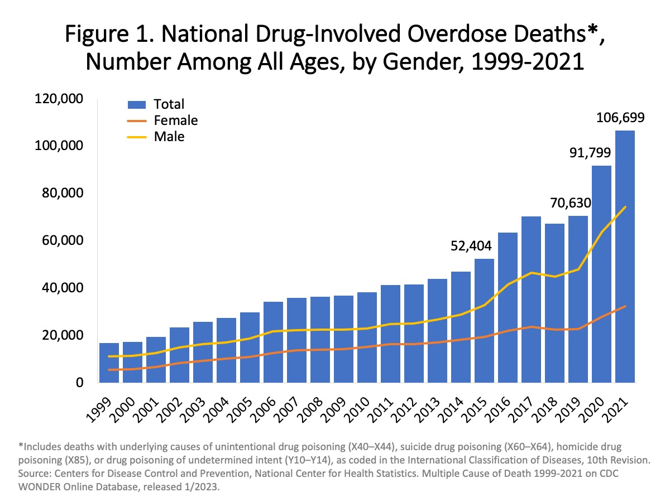
And Oh, by the way:
There were 111,355 overdose deaths in the 12-month period ending April 2023, compared with 110,394 deaths in the 12-month period ending March 2022.

Slide 13
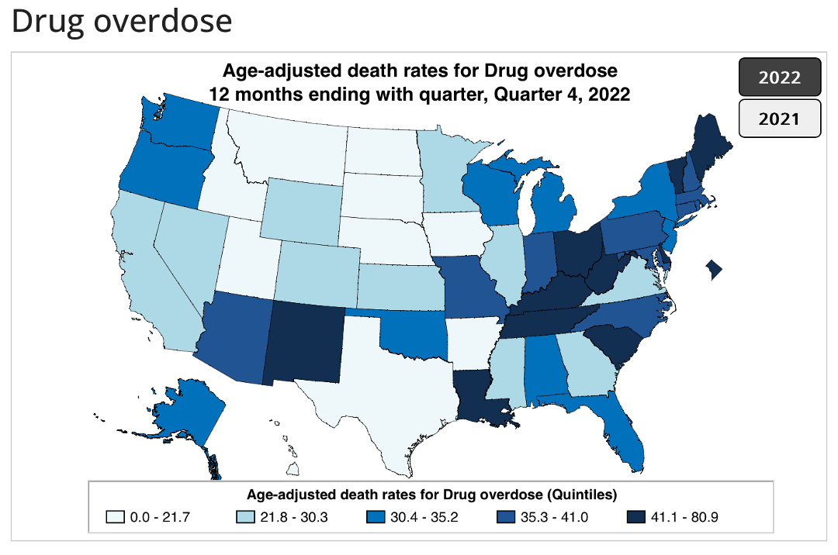
New Mexico Ranks 5th highest in country
Ahmad FB, Cisewski JA. Quarterly provisional estimates for selected indicators of mortality, 2022-Quarter 1, 2023. National Center for Health Statistics. National Vital Statistics System, Vital Statistics Rapid Release Program. 2023

Slide 14
Opioid Use Disorder (OUD) and
Addiction

Slide 15
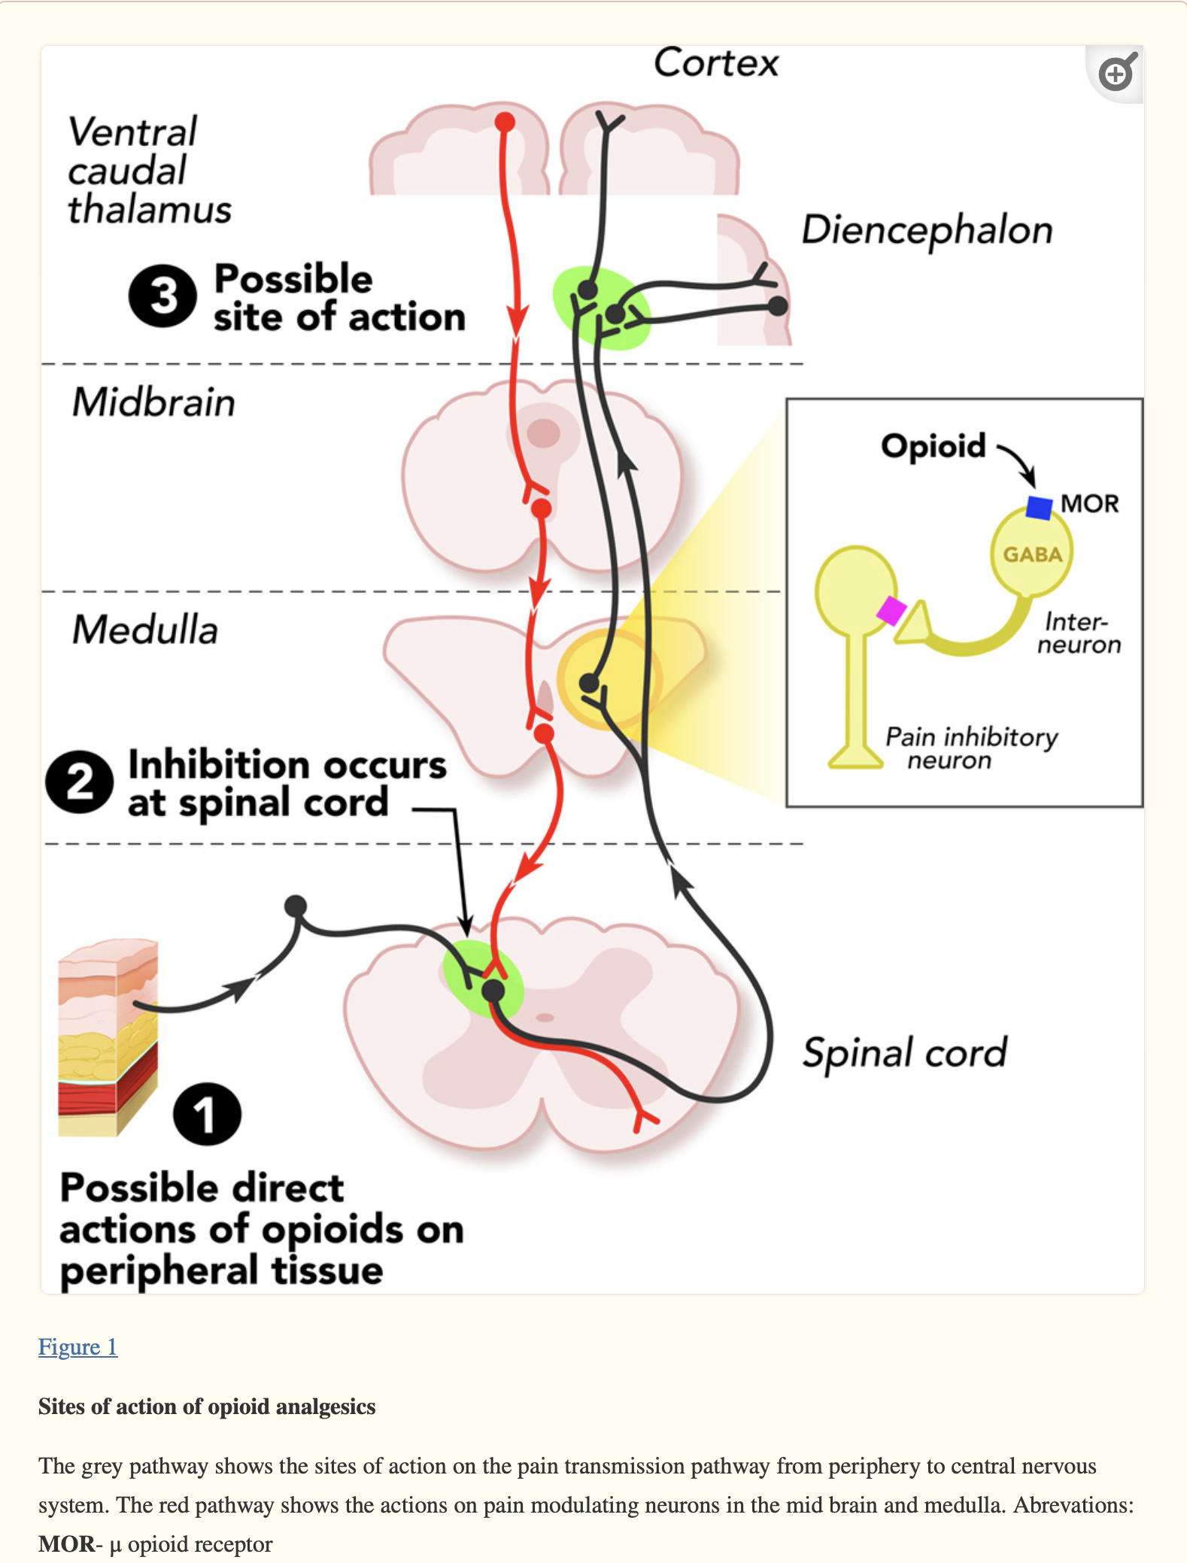
Opioid receptors/activity involved in Pain
Four classes of opioid receptors:
mu*
delta
kappa
opioid receptor like
Al-Hasani R, Bruchas MR. Molecular mechanisms of opioid receptor-dependent signaling and behavior. Anesthesiology. 2011 Dec;115(6):1363-81. doi: 10.1097/ALN.0b013e318238bba6. PMID: 22020140; PMCID: PMC3698859.

Slide 16
Wise and Robble, Dopamine and Addiction, Ann. Rev. Psychol 2020 (71): 79-106
SAMHSA Buprenorphine training course 2011

Slide 17
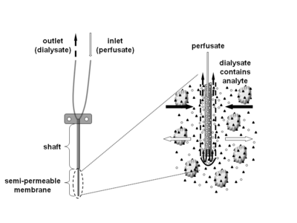
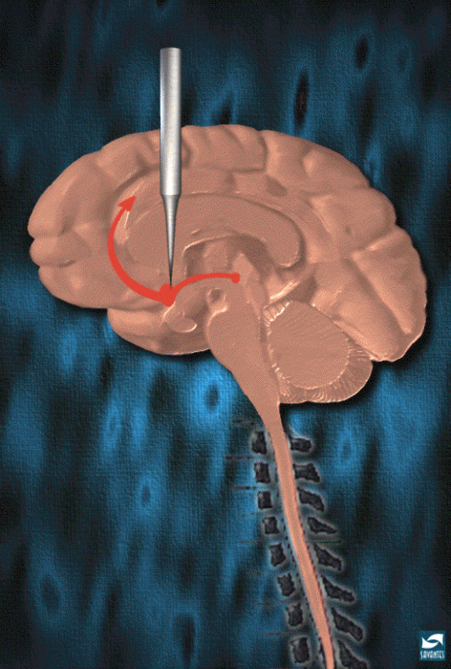
Discovery of reward pathway
Dopamine was measured – with significant elevations in the area of the probe with electrical stimulation.
NINIDA

Slide 18

Activation of the reward pathway – these release dopamine in the reward pathway.

Slide 19

Natural Rewards Elevate Dopamine Levels
Food
Sex
200
200
NAc shell
150
150
% of Basal DA Output
DA Concentration (% Baseline)
100
100
Empty
50
Box Feeding
Female Present
0
0
60
120
180
Sample
Number
1
2
3
4
5
6
7
8
Time (min)
Di Chiara et al., Neuroscience, 1999.,Fiorino and Phillips, J. Neuroscience, 1997.
Notes:
19
Natural rewards stimulate dopamine neurotransmission. Eating something that you enjoy or being stimulated sexually can cause dopamine levels to increase. In these graphs, dopamine is being measured inside the brains of animals. Its increase is shown in response to food or sex cues. This basic mechanism of controlled dopamine release and reuptake has been carefully shaped and calibrated by evolution to reward normal activities critical for our survival.

Slide 20
Drugs Elevate Dopamine Levels More or For Longer
COCAINE
1100
AMPHETAMINE
400
COCAINE
1000
900
800
300
700
% of Basal Release
600
% of Basal Release
500
200
400
300
200
100
100
0
0
0
1
2
3
4
5
0
1
2
3
4
5
Hrs. after amphetamine
Hrs. after cocaine
250
250
NICOTINE
MORPHINE
200
200
% of Basal Release
150
% of Basal Release
150
100
100
0
0
0
1
2
3
0
1
2
3
4
5
Source: Di Chiara and ImperaDi Chiara G, Imperato A. Drugs abused by humans preferentially increase synaptic dopamine concentrations in the mesolimbic system of freely moving rats. Proc Natl Acad Sci U S A. 1988 Jul;85(14):5274-8. doi: 10.1073/pnas.85.14.5274. PMID: 2899326; PMCID: PMC281732to
Hrs. after nicotine
Hrs. after morphine

Slide 21
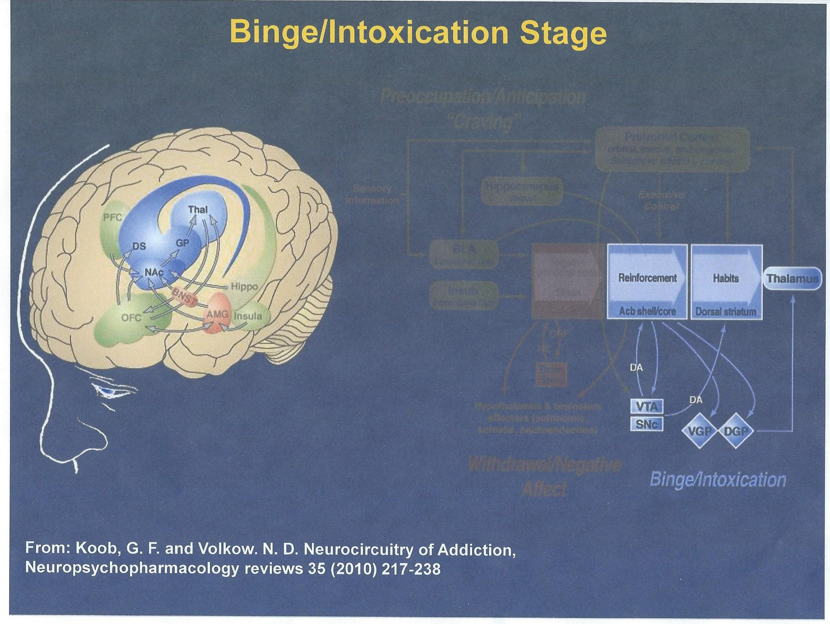
Binge Intoxication stage

Slide 22
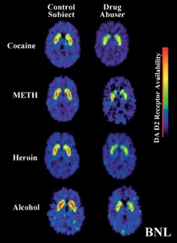
The Brain’s adjustment for homeostasis – downregulation of receptors
Volkow, N., Fowler, J., Wang, GJ. et al. Dopamine in drug abuse and addiction: results from imaging studies and treatment implications. Mol Psychiatry 9, 557–569 (2004). https://doi.org/10.1038/sj.mp.4001507

Slide 23
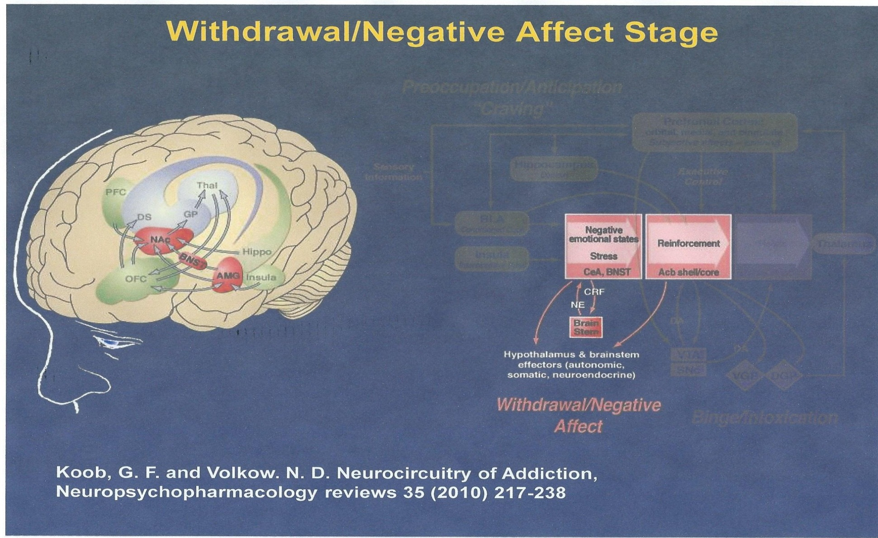
The Dark side of addiction: Withdrawal/ Negative affect/ compulsive use.

Slide 24
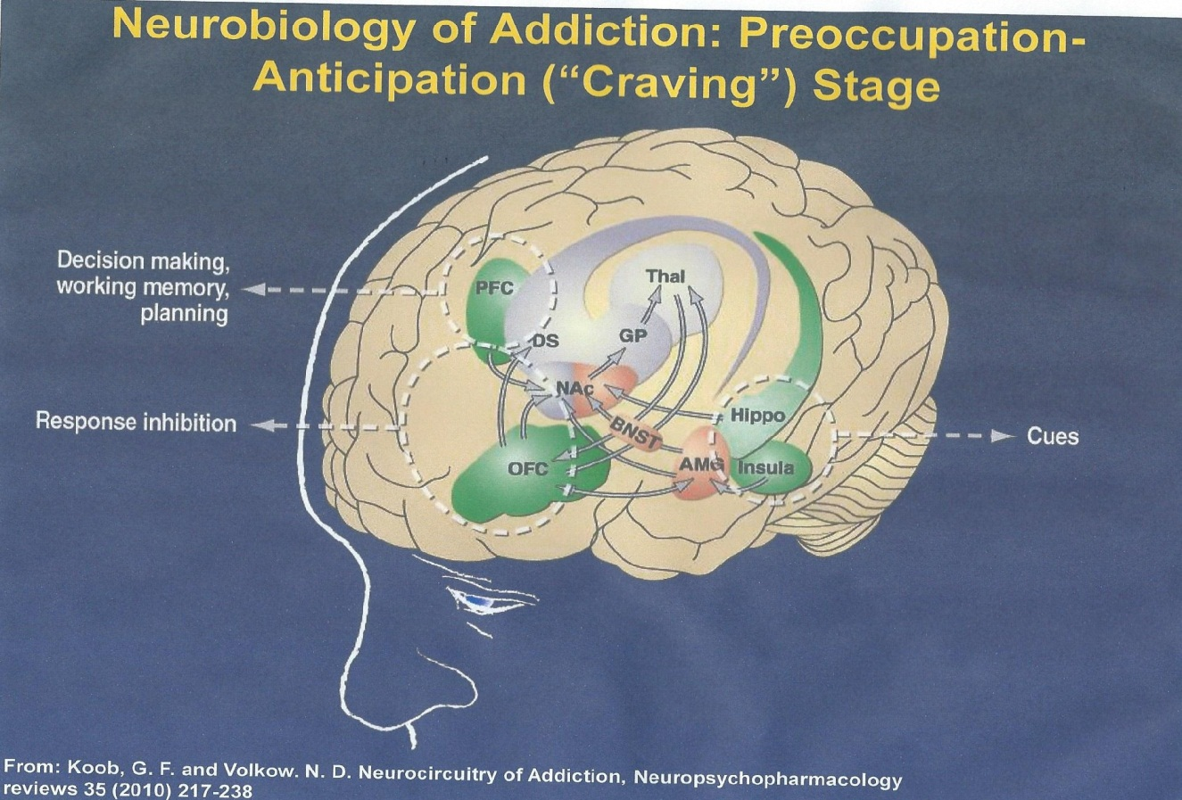
Impairment of executive function the third stage
PFC and Orbital Frontal Cortex are involved in telling right from wrong, putting the brakes on bad behavior and inhibiting harmful behavior. In addiction these are impaired. Glutamate, is also released by the areas which are cue driven, and stimulates dopamine.

Slide 25

What this addiction cycle looks like
Acute Use
Chronic Use
Medication Assisted
Therapy
Euphoria
Normal
Withdrawal
Tolerance & Physical Dependence
Notes:
Role of MAT: when you have cravings, you increase the risk of relapse. This is a concept we will be returning to throughout the presentation.

Slide 26
Definition of Addiction – ASAM adopted in 2017
Addiction is a treatable, chronic medical disease involving complex interactions among brain circuits, genetics, the environment and an individual’s life experience.
People with addiction use substances or engage in behaviors that become compulsive and continue despite harmful consequences.
Prevention and treatment approaches are generally as successful as those for other chronic diseases.
American Society of Addiction Medicine. (2011). Public policy state- ment: Definition of addiction. Chevy Chase, MD: Author. Retrieved from http://www.asam.org/quality-practice/definiti on-of-addiction

Slide 27
DSM-5 Criteria - OUD
Opioids taken in larger amounts, longer than intended
Unsuccessful efforts to cut down or control use
A great deal of time spent obtaining, using, or recovering from use
Craving
Recurrent use results in failure to fulfill work, home, school obligations
Continued use resulting in interpersonal/social problems
Recurrent use in hazardous situations
Important social, occupational or recreational activities are reduced due to use
Continues use despite knowledge of physical, psychological problems related to use
Tolerance and withdrawal: NOT criteria if opioids are used solely under appropriate medical supervision
SEVERITY:
Mild (2-3)
Moderate (4-5)
Severe (≥6)
Notes:
What are the 4 Cs?
Tolerance and withdrawal
OVEREALL treatment strategy: multimodal approach where MAT is 1 component

Slide 28
Pharmacology of opioids
And Medications used for OUD

Slide 29
Full opioid agonist:
μ
μ
receptor
Full agonist
opioid
receptor
Full agonist binding activates the μ opioid receptor
Additive effect when combined with other full agonists
Is highly reinforcing and has higher potential for abuse
Abrupt discontinuation will result in withdrawal
Hydrocodone, hydromorphone, morphine, heroin, methadone⁸

Slide 30

Opioid Efficacy in Chronic Pain
Most literature surveys & uncontrolled case series
RCTs are short duration <4 months with small sample sizes <300 pts
Mostly pharmaceutical company sponsored
Pain relief modest
Limited functional improvement
Balantyne JC, Mao J. NEJM 2003
Kalso E et al. Pain 2004
Eisenberg E et al. JAMA. 2005
Furlan AD et al. CMAJ 2006
Martell BA et al. Ann Intern Med 2007
Notes:
9 nociceptic/inflammatory pain, 4 neuropathic pain 1 mixed pain
(up to MSO₄ 180 mg equivalents)
A RCT placebo controlled long term won’t happen, a 3 year trial in which half the patients get treatment while the other half receive placebo will be rife with ethical problems

Slide 31

Variability in Response to Opioids
Mu Receptor
  G protein-coupled receptor family, signal via second messenger (cAMP)
  >100 polymorphisms in the human MOR gene
  Mu receptor subtypes
    Not all patients respond to same opioid in same way
    Not all pain responds to same opioid in the same way
    Incomplete cross-tolerance between opioids

Slide 32
The Good and Bad about Methadone
Good
Bad
Inexpensive
Long acting to treat OUD
No significant toxic metabolites
No accumulation in renal disease
NMDA antagonist
Treatment in a structured setting
Have shown: reduction in illicit use, criminal activity, HIV infection, overdose, improvement in health, retention in treatment and suicide rates
Highly variable metabolism
Unpredictable half-life
Conversion to other opioids is a challenge/unpredictable equipotency
QTc prolongation
Multiple drug interactions
Sleep apnea/respiratory suppression
Limits geographically to clinic
Stigma
Perceived as outside the medical mainstream
Miller, S et al, ASAM Principles of Addiction Medicine, sixth edition 2019, chapter 57

Slide 33
Partial opioid agonist: Buprenorphine
μ
receptor
partial agonist
μ
opioid
receptor
Partial agonist binding activates the μ opioid receptor and kappa antagonist
Competitive agonist with high binding affinity/slow disassociation
Is less reinforcing than full agonists (lower risk for abuse)
Abrupt discontinuation will result in withdrawal
Available as sublingual, buccal, transdermal, and injection
Notes:
Kappa antagonism provides a benefit for blocking dynorphins, reducing stress induced drug seeking and alleviating depression

Slide 34
The Use of Buprenorphine/Naloxone to treat co-occurring pain and opioid dependence
Buprenorphine/Naloxone:
  Partial opioid agonist
In 2002, Drug Abuse Treatment Act approved sublingual formulations of buprenorphine for treating opioid addiction
Effectively treats opioid addiction by reducing illicit opioid use, improving treatment retention (55-60%)⁹, and increasing negative urine toxicology screens¹⁰
Buprenorphine is considered to produce analgesia at least 30 times the potency of morphine.¹¹
Mainstreaming Addiction Treatment Act of 2022 expanded ability of all healthcare providers with standard controlled substance license to prescribe buprenorphine eliminating the X-waiver.¹²

Slide 35
Opioid antagonists:
Naloxone and Naltrexone*
μ
receptor
antagonist
μ
opioid
receptor
Antagonist binding to the μ opioid receptor occupies without activating
Is not reinforcing
Blocks abused opioid agonist binding
Notes:
IV vs PO and LA IM
Naloxone in Suboxone

Slide 36
Naltrexone
Opioid antagonist
  Binds competitively, but blocks opioid effect
As oral tablet usual dose is 50 mg daily
  t ½ = 14 hours, 50% blockade gone after 72 hours
Comes in depo form – 380 mg IM every 4 weeks
  Peak plasma concentration in 2-3 days, declines in 15 days
Blocks opioid analgesia – blockade can be overcome with 6-20x the usual dose of opioids without significant respiratory depression
Will not be effective for pain control
Decreases cravings and useful in stable patients for relapse prevention.
Alford, D, Managing Acute and Chronic Pain in Patients on MAT, PCSS-Mat Webinarm Aug. 12, 2014
Notes:
On the converse, naltrexone will do nothing for pain. Remember naloxone is only IV and has a very short t1/2 in comparison to naltrexone.
Also used for maintenance of alcohol cessation so may be ideal for some patient with comorbid UDs

Slide 37
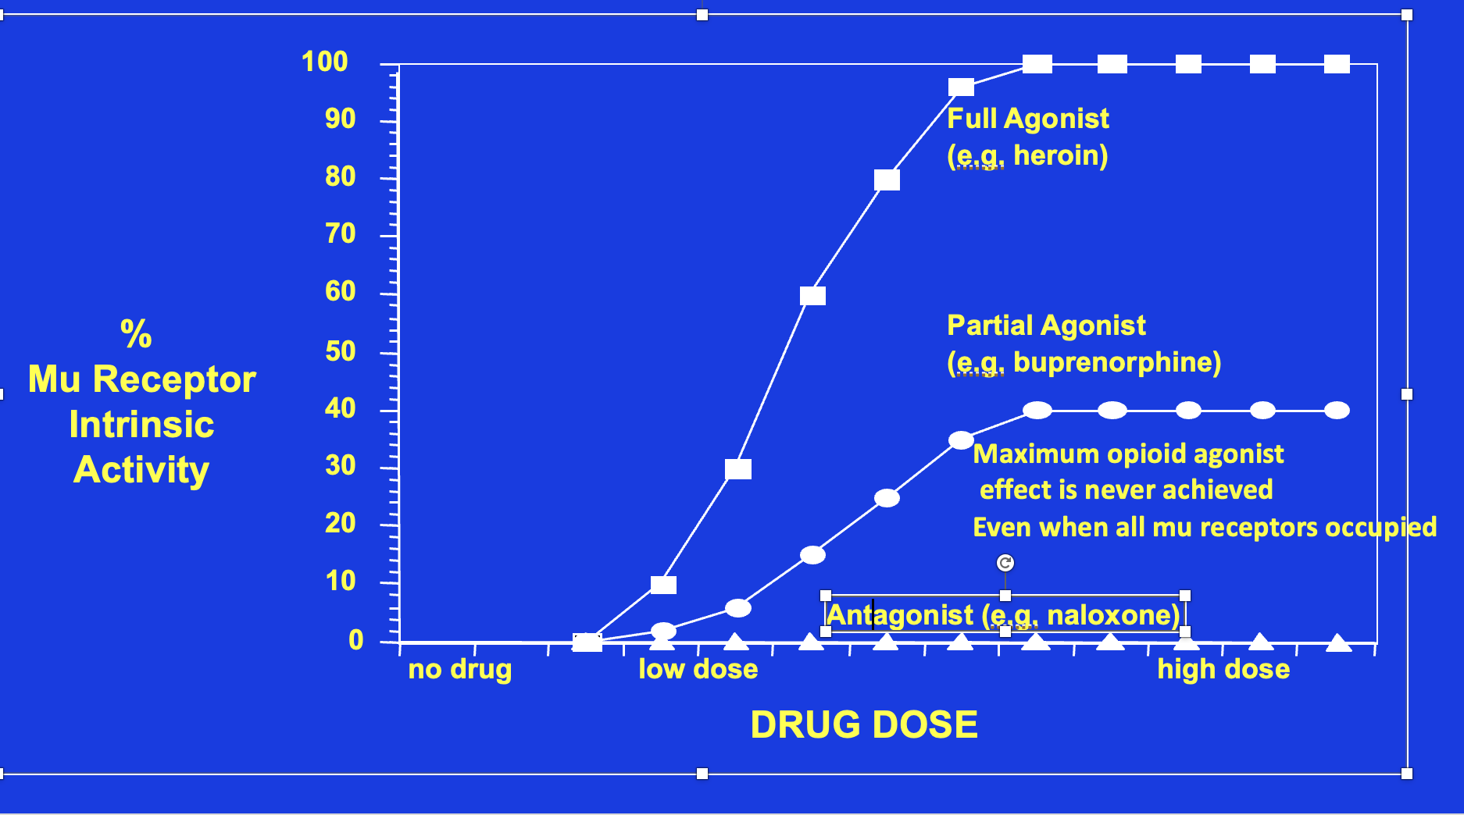

Opioid effect vs dose

Slide 38
The following slides are from my previous work at both the New Mexico VA Hospital and University of Colorado.
This work was published in 2012 and also presented at ASAM national conference in 2015.
Pade PA, Cardon KE, Hoffman RM, Geppert CM. Prescription opioid abuse, chronic pain, and primary care: a Co-occurring Disorders Clinic in the chronic disease model. J Subst Abuse Treat. 2012 Dec;43(4):446-50. doi: 10.1016/j.jsat.2012.08.010. Epub 2012 Sep 11. PMID: 22980449.

Slide 39
Today’s Problems with Treatment Delivery
Providers:
Addiction providers uncomfortable treating pain
Pain Management providers uncomfortable treating addiction
PCPs uncomfortable treating both and PCPs prescribe the opioids
Lack of training of providers in addiction
Regulations surrounding opioids
Perceive patients as difficult and time-consuming.
Patients
Stigmatization to addiction
Believe pain is primary problem not addiction
Fear their pain will not be addressed
SUD programmatic treatment is overwhelming
Not ready for treatment
Many will agree to treatment in Primary Care but are reluctant to go psychiatric facility.

Slide 40
Improvement Change:
Creation of Co-occurring Disorders Clinic (CODC)
Establishment of unique clinic within Ambulatory Care Service to evaluate, treat, manage and monitor co-morbid pain and addiction:
  High risk opioid patients
    history of substance use disorder
    family history of substance use disorder
    younger age
    psychiatric illness
  Noncompliant patients
  Complex pain regimens
  Prescribed high dose opioids

Slide 41
CCODC Clinical Activities
Pain Medication Assessment
Substance Use Disorder Assessment
Psychiatric Assessment
Opioid use Risk Assessment
Opioid use Monitoring
Buprenorphine/Naloxone treatment for opioid dependence
Complex Pain Medication Management
Adjuvant treatments: TENS units, intra-articular injections, trigger point injections
Motivational Interviewing
Supportive Counseling
Overdose counseling and Narcan training

Slide 42
Opioid Risk Assessment And Monitoring
Risk:
Detailed History, Physical Exam and Chart Review
Screening tools: SOAPP, BPI, ORT, DIRE instrument administration
Collateral information with patient consent
Monitoring: Frequency of visits determined by risk
Extensive urine toxicology screening
State Prescription Monitoring Program Access and Query with consent
Detail chart review
COMM instrument administration

Slide 43
CODC Data and Outcomes
Over 1.5 years

Slide 44
Participant Opioid of Choice (OOC)
9 (10.2%)
2 (2.3%)
14 (16%)
fentanyl
heroin
methadone
12 (13.6%)
hydrocodone
morphine
oxycodone
7 (8%)
44 (50%)

Slide 45
Average duration of opioid use
By age group
By opioid of choice
Average: 111.9 Months
Range: 7-360 Months

Slide 46
Dosage in morphine mg equivalents/day
By age group
By opioid of choice
Maximum dose
(morphine mg equivalents/day)
Average dose
(morphine mg equivalents/day)
Average: 174 morphine
mg equivalents/day
Range: 30-1290 morphine mg equivalents/day
Opioid of choice

Slide 47
Participant Outcomes
1 (1.1%)
1 (1.1%)
4 (4.5%)
5 (5.8%)
2 (2.3%)
4 (5%)
ACTIVE
70 (79%)

Slide 48
Outcomes: Pain scores before and after buprenorphine treatment
BEFORE
AFTER
Mean score:
6.2
Mean score:
5.4
Average difference:
.74
Pain scores DECREASED after buprenorphine treatment. A comparison of these scores indicates that this difference is statistically significant (P value < 0.001)

Slide 49
Two Last Thoughts
Stigma
SUDs as a pediatric disease
Effects chronic pain patients and people with SUD
Leads to poor outcomes and not getting effective treatment.
Systemic issue in the health professions
Median age of initial use of substances in adults is 16.
Earlier onset of substance use predicts greater addiction severity and morbidity.
Please tell your patients to safely secure all controlled substances!
NIDA. 2022, June 1. Stigma and Discrimination. Retrieved from https://nida.nih.gov/research-topics/stigma-discrimination on 2024, January 6
Chambers, R. A., Taylor, J. R., & Potenza, M. N. (2003). Develop- mental neurocircuitry of motivation in adolescence: A critical period of addiction vulnerability. The American Journal of Psy- chiatry, 160(6), 1041-1052.

Slide 50
References
Institute of Medicine(IOM), Relieving Pain in America: A Blueprint for Transforming Prevention, Care, Education and Research. The National Academies Press 2011 Washington DC.
Zelaya, CE, Dahlmer JM et al, Chronic Pain and high-impact chronic pain among US adults, 2019. NCHS Data Brief 2020l 390:1-8. PMID 33151145
IMS’s Source Prescription Audit (SPA) & Vector One®: National (VONA)
Chabal, C., M. K. Erjavec, et al. (1997). "Prescription opiate abuse in chronic pain patients: clinical criteria, incidence, and predictors." Clin J Pain 13(2): 150-155.
Caudill-Slosberg MA, Schwartz LM, Woloshin S. Office visits and analgesic prescriptions for musculoskeletal pain in US: 1980 vs. 2000. Pain 2004;109:514-9.
The SUD-QUERI Executive Committee, "Improving Access to Opioid Agonist Therapy,", QUERI Update, VA Office of Research and Development and HSR&D Quality Enhancement Research Initiative, June 2012.
Bohnert M, Valenstein M, Bair M, Ganoczy D, McCarthy J, Ilgen M, Blow F. Association between opioid prescribing patterns and opioid overdose-related deaths. JAMA 2011;305(13):1315-1321.
Bohnert, Aet al; Opioid prescribing in ;the US before and after the CDC’s 2016 opioid guidelines for prescribing opioids for chronic pain. Ann of Internal Medicine 2018; 169:367-75. PMD: 30167651.
Fudala PJ, Bridge TP, Herbert S, et al. Office-based treatment of opiate addiction with a sublingual-tablet formulation of buprenorphine and naloxone. N Engl J Med 2003;349:949-58.
O'Connor PG, Oliveto AH, Shi JM, et al. A randomized trial of buprenorphine maintenance for heroin dependence in primary care clinic for substance users versus a methadone clinic. Am J Med 1998;105:100-5.
Johnson RE, Fudala PJ, Payne R. Buprenorphine: considerations for pain management. J Pain Symptom Manage 2005;29:297-326.
12. Kumar R, Viswanath O, Saadabadi A. Buprenorphine. [Updated 2023 Nov 30]. In: StatPearls [Internet]. Treasure Island (FL): StatPearls Publishing; 2023 Jan-. Available from: https://www.ncbi.nlm.nih.gov/books/NBK459126/

