Slide 1
Medication Errors, Pharmacy-Related Crimes and the Drug Overdose Epidemic
Kris Mossberg, State Drug Inspector

Slide 2
MEDICATION ERROR REPORTING
Critical in preventing future medication errors
Most Boards of Pharmacy require hospitals & medical facilities (including pharmacies) to report med errors
NMBOP requires reporting of significant adverse drug events
"Significant Adverse Drug Event" a drug related incident that results in harm to the patient.

Slide 3
16.19.25 ADVERSE DRUG EVENT
Incident - a drug that is dispensed in error, that is administered and results in harm, injury or death
Harm - temporary or permanent impairment requiring intervention
The Pharmacist in Charge shall:
A. Develop and implement written error prevention procedures as part of the Policy and Procedures Manual.
B. Report incidents, including relevant status updates, to the Board on Board approved forms within fifteen (15) days of discovery.
“Significant Adverse Drug Event Reporting Form”
The Board shall:
A. Maintain confidentiality of information relating to the reporter and the patient identifiers.
B. Compile and publish, in the newsletter and on the Board web site, report information and prevention recommendations.
C. Assure reports are used in a constructive and non-punitive manner.
Notes:
"Significant Adverse Drug Event" means a drug related incident that results in harm to the patient.
Intervention = doctor visit, labs or hospitalization

Slide 4
MEDICATION ERRORS
BOP receives sworn Complaints Alleging Misfilled Prescriptions.
Not generated from Adverse Drug Event Reports.
Most of these would not have occurred if the pharmacist complied with BOP requirements for:
Prospective Drug Review
Counseling

Slide 5
Prospective drug review
(1) Prior to dispensing any prescription, a pharmacist shall review the patient profile for the purpose of identifying:
(a) clinical abuse/misuse;
(b) therapeutic duplication;
(c) drug-disease contraindications;
(d) drug-drug interactions;
(e) incorrect drug dosage;
(f) incorrect duration of drug treatment;
(g) drug-allergy interactions;
(h) appropriate medication indication.
Source: NMAC 16.19.4.16 (D)

Slide 6
ONLY THE RPh CAN COUNSEL
All clerks and technicians are taught that if there is a question regarding a prescription, the RPh (or intern) must take the question.

Slide 7
MEDICATION ERROR REDUCTION: PATIENT COUNSELING
Patients need to know:
The name of the medication
How to take it
What it’s for
If the medication looks different, talk to the pharmacist
http://www.fda.gov/ForConsumers/ConsumerUpdates/ucm096403.htm accessed 6/3/16

Slide 8
PATIENT COUNSELING
Estimate: half of medication-related deaths could have been prevented by appropriate and timely counseling .*
Show the patient the drug while asking:
Tell me what you take this drug for?
Tell me how you take the medication?
-how often, and
-directions for taking the medication
http://www.uspharmacist.com/continuing_education/ceviewtest/lessonid/105916
*Abood RR. Errors in pharmacy practice. US Pharm. 1996;21(3):122-130.
Notes:
Open ended questions, what and how are most effective (Moore 2010)
Moore M, Tschannen-Moran B. Coaching Psychology Manual. Baltimore: Lippincott Williams & Wilkins, 2010.

Slide 9
REMEMBER THE PATIENT
Patients provide a major safety check
Counseling – not a “veiled offer”
Wrong patient errors: Not opening the bag at the point of sale
Risk of dispensing a correctly filled Rx to the wrong patient at POS – about 6 per month per (community) pharmacy
https://www.ismp.org/newsletters/acutecare/showarticle.aspx?id=91 10/9/2014, accessed 6/3/2016

Slide 10
“To Err is Human” Building a Safer Health System
the majority of medical errors are caused by faulty systems, processes, and conditions that:
lead people to make mistakes
fail to prevent mistakes
When an error occurs, blaming an individual does little to make the system safer and prevent someone else from committing the same error.

Slide 11
When an error occurs
Be compassionate
ISMP persistent safety gaffe #4 respond with empathy and concern
Evaluate and address medication use system issues
Root cause analysis
https://www.ismp.org/newsletters/acutecare/showarticle.aspx?id=91
Notes:
Respond with empathy and concern

Slide 12
Root cause analysis (RCA):
Process for identifying the basic or causal factors that underlie variation in performance, including the occurrence or risk of occurrence of a sentinel event.
Focus is on systems and processes, not individual performance
Identifying root causes illuminates significant, underlying, fundamental conditions that increase the risk of adverse consequences.
RCA facilitates system evaluation, analysis of need for corrective action, tracking and trending

Slide 13
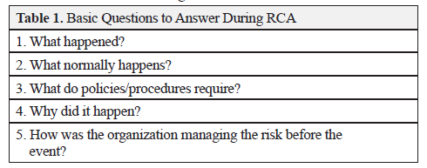
Source: NM Board of Pharmacy newsletter March 2013
Notes:
The difference between “What normally happens?” and “What do the policies and procedures require?” (Question 3) helps determine the reliability of processes and how often staff cut corners to get the work done.

Slide 14
Case Study:
Patient experienced sudden shortness of breath, chest pain (breathing worsened pain), dizziness, lightheadedness, anxiety and heart palpitations
Patient went to ER, treated for a submassive pulmonary embolism.
Admitted and Discharged after 5 days with prescriptions for atorvastatin 80 mg, Toprol XL 25 mg, lisinopril 5 mg and apixaban (Eliquis) 5 mg
Hospital sent Rxs electronically to pharmacy
Notes:
Treatment guidelines for Pulmonary Embolism with Eliquis (apixiban): 5 mg - 2 tabs PO bid x 7 days followed by 1 tab PO bid x 7 days (#42 equals a two week supply)

Slide 15
Case Study continued:
Pharmacist dispensed medications and counseled patient.
Patient received an automated message that a prescription was ready 5 days later.
Went to pharmacy and received apixaban prescription. Claimed not aware of apixaban Rx.
Physician upset and contacted pharmacy about delay. RPh said did not dispense apixaban because did not have full quantity to fill Rx and patient said he would wait.

Slide 16
Case Study continued:
Pharmacist’s actions appropriate? Was this a misfilled prescription?
Does patient have enough knowledge of medications to know which are critical? What does the pharmacist have?
Pharmacist’s other options.
- Partial fill…what else?
Notes:
May not be a misfilled prescription, per se, but it is a medication error (error of omission)
Other Rph options – transfer prescription, obtain medication from another pharmacy, call prescriber for alternate therapy
Other Rxs – [DOACs] - Dabigatran etexilate (Pradaxa), rivaroxaban (Xarelto); [LMWHs] – enoxaparin (Lovenox), dalteparin (Fragmin)
Factor Xa inhibitor - Fondaparinux (Arixtra)

Slide 17
FDA Guidance – Insanitary Conditions
Putting on gowning apparel in a way that may cause the gowning apparel to become contaminated
Leaving the cleanroom and re-entering from a non-classified area without first replacing gowning apparel
Performing aseptic manipulations outside of a certified ISO 5 area
Failing to disinfect containers of sterile drug components or supplies immediately prior to opening
Lack of adequate routine environmental monitoring - nonviable airborne particulate sampling; viable airborne sampling; and surface sampling, including but not limited to equipment, work surfaces, and room surfaces
Notes:
To protect the public health, both FDA and state regulatory agencies may take action when compounding facilities produce drugs under insanitary conditions.
The list on these next two slides comes from a guidance document issued by the FDA to help compounding facilities identify insanitary conditions so that they can implement appropriate corrective actions. This guidance is also intended to help state regulatory agencies understand some examples of what FDA has considered to be insanitary conditions that could cause a drug to become contaminated or rendered injurious to health. This is just a partial list of items from the guidance document.
If more than 5% of pharmacy dispensing is compounded sterile preparations sent out of state then you have to license as an outsourcing facility and are subject to FDA inspections.

Slide 18
Insanitary Conditions - Continued
Lack of adequate personnel sampling (including glove fingertip sampling)
Lack of routine certification of the ISO 5 area, including smoke studies performed under dynamic conditions
Lack of HEPA-filtered air, or inadequate HEPA filter coverage or airflow, over the critical area
Buffer room or ISO 5 areas that contain overhangs or ledges capable of collecting dust (pipes and window sills)
Failing to appropriately and regularly clean and disinfect (or sterilize) equipment located in the ISO 5 area
Lack of disinfection of equipment and/or supplies at each transition from areas of lower quality air to areas of higher quality

Slide 19
Serious conditions - FDA recommendation includes immediate recall and cease sterile operations
Vermin (e.g., insects, rodents) or other animals (e.g., dogs) in ISO 5 areas or areas immediately accessible to production
Visible microbial growth (e.g., bacteria, mold) in the ISO 5 area or in immediately adjacent areas
Sources of non-microbial contamination in the ISO 5 area (e.g., rust, glass shavings, hairs, paint chips)
Performing aseptic manipulations outside of a certified ISO 5 area
Personnel aseptic practices that are a contamination hazard to an exposed sterile drug product or its constituent sterile components
Exposing sterile drugs and materials to lower than ISO 5 quality air for any length of time. (i.e. exposing partially stoppered drug products or stock solutions in a container/closure system that is not fully closed)
Notes:
Above is a list of insanitary conditions that FDA considers to be particularly serious. If any one of these conditions exists, FDA strongly recommends that a compounding facility immediately initiate a recall of purportedly sterile drugs and cease sterile operations until the condition has been corrected.

Slide 20
Serious conditions - FDA recommendation includes immediate recall and cease sterile operations
Cleanroom areas with unsealed or loose ceiling tiles
Production of drugs while construction is underway in an adjacent area
Consistent and frequent pressure reversals from areas of less clean air to areas of higher cleanliness
Using a filter for the purposes of product sterilization that is not appropriately graded for sterilization, not appropriate for pharmaceutical use, or used in excess of its volume or pressure capacity
Using parameters for sterilization (e.g., temperature, pressure, time) that are not lethal to resistant microorganisms

Slide 21
Pharmacy Crimes

Slide 22
Rogue Online Pharmacies
Consumer protection program operated by NABP:
Discovered:
40,000 websites fail to comply with NABP patient safety and pharmacy practice standards or applicable laws
95% of websites offering prescription-only drugs online operate illegally
89% of illegal online pharmacies did not require a prescription
Notes:
Safe.pharmacy replaced Awarxe. Safe.pharmacy is the name of the program and the website address. If consumers click the “Buy Safely” tab at the top of the first page they get to the Buy Safely search engine and list – see next slide.

Slide 23
Search engine for name of website or download an excel list
Notes:
If consumers click the “Buy Safely” tab at the top of the first page they get to this page. This page has a search engine if the consumer has a pharmacy website they want to look up or they can just download the website list. Either way the consumer will be able to find a reputable online pharmacy website.

Slide 24
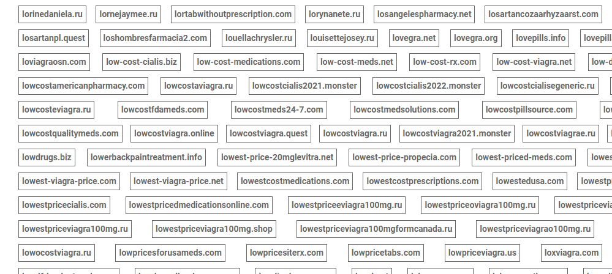
Rogue Online Pharmacies Also: A List of Not Recommended Sites
Not Recommended Sites - Safe.Pharmacy
Extensive list
Notes:
Buried in the Safe.Pharmacy website is a link to the not recommended page full of thousands of names of not recommended/bad online pharmacies.

Slide 25
Diversion
What is diversion?
Definition: Transfer of a prescription drug from a lawful to an unlawful channel of distribution or use.

Slide 26
PMP
A RPh Shall request and review a PMP report if (at least 1 year time period):
PERSON EXHIBITS POTENTIAL ABUSE/MISUSE OF OPIATES
OVER-UTILIZATION
EARLY REFILLS
MULTIPLE PRESCRIBERS
SEDATED/INTOXICATED
UNFAMILIAR PATIENT
PAYING CASH INSTEAD OF INSURANCE

Slide 27
PMP
A RPh Shall request and review a PMP report if (at least 1 year time period):
OPIATE Rx FROM UNFAMILIAR PRACTITIONER
OUT OF STATE OR USUAL GEOGRAPHIC AREA
OPIATE Rx FROM UNFAMILIAR PATIENT
OUTSIDE USUAL PHARMACY GEOGRAPHIC PATIENT POPULATION AREA

Slide 28
PMP
A RPh Shall request and review a PMP report if (at least 1 year time period):
INITIAL RX FOR ANY LONG-ACTING OPIOID FORMULATION
INCLUDES ORAL AND TRANSDERMAL DOSAGE FORMS
BECOME AWARE PATIENT IS RECEIVING AN OPIOID CONCURRENTLY WITH A BENZODIAZEPINE OR CARISOPRODOL.
PMP reports shall be reviewed a minimum of once every three months during the continuous use of opioids for each established patient

Slide 29
Pharmacy Robberies Albuquerque
April 29, 2015 - Six Albuquerque Residents Indicted on Federal Robbery, Firearms, and Prescription Drug Trafficking Crimes Arising Out of Pharmacy Robberies –FBI.gov
3 fugitives at time of indictment
Last suspect (Blake Gallardo) was arrested June 11, 2015
Stole over 68,000 tablets of oxycodone

Slide 30
Pharmacy Safety

Slide 31
Scam Phone Calls – BOP, DEA, FBI or other LE
Callers identifying themselves as Board of Pharmacy Investigators, Inspectors or Agents
Callers “spoofing” the Board of Pharmacy phone number
Told licensees they are under investigation and their license may be suspended or arrest warrant was issued and they demand money. Also, inquired about their wholesale distributors.
NMBOP will never contact licensees by telephone to demand money or payment of any form.
Notes:
Callers asked for wholesaler account numbers and say that the BOP uses this for notification of recalls. We don’t send out recall notifications and won’t just call and ask for a wholesaler and especially a whole account number out of the blue.

Slide 32
Scam Phone Calls
Do not give them money!
Do not give them any information!
Contact an inspector or e-mail pharmacy.board@rld.nm.gov to inquire if there is an official investigation being conducted
If the caller is stating they are from the DEA, you can report the scam using the DEA Extortion Scam Online Reporting Form
If the caller is stating they are from the FBI, you can report the scam using the FBI Internet Crime Complaint Reporting Form
If the phone number of the caller appears to be a New Mexico Board of Pharmacy telephone number, you can report the scam using the Federal Communications Commission Consumer Complaint Form

Slide 33
United States Drug Overdose Epidemic

Slide 34
Notes:
The above graph illustrates all causes of drug overdose death in the United States – opioids, stimulant, illicit and prescription drug sources.
In 2021, the drug overdose deaths in the United States were 16% higher than the rate in 2020.
69% of cases occurred among males (yellow line). Synthetic opioids other than methadone (primarily fentanyl) were the main driver of drug overdose deaths with a 7.5-fold increase from 2015 to 2021 (Figure 2).
Source: Drug Overdose Death Rates | National Institute on Drug Abuse (NIDA) (nih.gov) February 9, 2023, based on data from CDC WONDER online database

Slide 35
Notes:
Overall, drug overdose deaths rose from 2019 to 2021 with more than 106,000 drug overdose deaths reported in 2021. Deaths involving synthetic opioids other than methadone (primarily fentanyl) continued to rise with 70,601 overdose deaths reported in 2021. Overdose deaths involving stimulants, including cocaine or psychostimulants with abuse potential (primarily methamphetamine), also continued to increase in 2021. In the U.S., there were 32,537 overdose deaths in 2021 involving psychostimulants with abuse potential. From 2019 to 2021, cocaine-involved deaths rose nearly 54% to 24,486 deaths.
Source: Drug Overdose Death Rates | National Institute on Drug Abuse (NIDA) (nih.gov) February 9, 2023, based on data from CDC WONDER online database

Slide 36
Notes:
Any opioid includes prescription opioids (natural and semi-synthetic opioids and methadone), heroin, and synthetic opioids other than methadone (primarily fentanyl). Opioid-involved overdose deaths rose from 21,089 in 2010 to 47,600 in 2017 and remained steady through 2019. This was followed by a significant increase in 2020 with 68,630 reported deaths and again in 2021 with 80,411 reported overdose deaths. The bars are overlaid by lines showing the number of deaths by gender from 1999 to 2021. More than 70% of deaths occurred among males.
Source: Drug Overdose Death Rates | National Institute on Drug Abuse (NIDA) (nih.gov) February 9, 2023, based on data from CDC WONDER online database

Slide 37
Notes:
Drug overdose deaths involving prescription opioids rose from 3,442 in 1999 to 17,029 in 2017. From 2017 to 2019, the number of deaths declined to 14,139. This was followed by a slight increase in 2020, with 16,416 reported deaths. In 2021, the number of reported deaths involving prescription opioids totaled 16,706. The bars are overlaid by a line showing the number of deaths involving prescription opioids in combination with synthetic opioids other than methadone (primarily fentanyl) from 1999 to 2021.
Source: Drug Overdose Death Rates | National Institute on Drug Abuse (NIDA) (nih.gov) February 9, 2023, based on data from CDC WONDER online database

Slide 38
Notes:
Drug overdose deaths involving heroin rose from 1,960 in 1999 to 15,482 in 2017 before trending down to 13,165 deaths in 2020 and 9,173 deaths in 2021. The bars are overlaid by lines showing the number of deaths involving heroin in combination with synthetic opioids other than methadone (primarily fentanyl) or without any other opioid from 1999 to 2021.
Source: Drug Overdose Death Rates | National Institute on Drug Abuse (NIDA) (nih.gov) February 9, 2023, based on data from CDC WONDER online database

Slide 39
Notes:
Psychostimulants in this graph is primarily methamphetamine. Drug overdose deaths rose significantly from 12,122 in 2015 to 53,495 in 2021. The bars are overlaid by lines showing the number of deaths involving stimulants in combination with synthetic opioids other than methadone (primarily fentanyl) or without any opioid. The number of deaths involving stimulants has increased steadily since 2014 regardless of opioid involvement.
Source: Drug Overdose Death Rates | National Institute on Drug Abuse (NIDA) (nih.gov) February 9, 2023, based on data from CDC WONDER online database

Slide 40
Notes:
Drug overdose deaths involving benzodiazepines steadily increased from 1,135 in 1999 to 11,537 in 2017 and declined to 9,711 in 2019. Between 2019 and 2021, deaths rose again to 12,499. The bars are overlaid by lines showing the number of deaths involving benzodiazepines in combination with synthetic opioids other than methadone (primarily fentanyl) or without any opioid.
Source: Drug Overdose Death Rates | National Institute on Drug Abuse (NIDA) (nih.gov) February 9, 2023, based on data from CDC WONDER online database

Slide 41
Notes:
Drug overdose deaths involving antidepressants rose steadily from 1,749 in 1999 to 5,269 in 2017. Since then, deaths have slightly risen with 5,859 in 2021. The bars are overlaid by lines showing the number of deaths involving antidepressants in combination with synthetic opioids other than methadone (primarily fentanyl) or without any opioid involvement.
Source: Drug Overdose Death Rates | National Institute on Drug Abuse (NIDA) (nih.gov) February 9, 2023, based on data from CDC WONDER online database

Slide 42
Notes:
Rate for males is significantly higher than for females for all years.
From 2020 through 2021, the age-adjusted rate of drug overdose deaths for males increased 14% from 39.5 to 45.1, and the rate for females increased 15% from 17.1 to 19.6.
Among the total population, the age-adjusted rate of drug overdose deaths increased from 6.8 in 2001 to 11.5 in 2006, was stable from 2006 through 2013, then increased from 13.8 in 2013 to 32.4 in 2021; from 2020 through 2021, the rate increased 14%, from 28.3 to 32.4

Slide 43
Notes:
Except for those aged 15–24, rates in 2021 were significantly higher than in 2020 for all age groups.
35-44 yrs old had the highest rates in 2020 and 2021.
Adults aged 65 and over experienced the largest percentage increase in drug overdose death rates from 2020 through 2021, with a 28% increase.

Slide 44
Notes:
Except for non-Hispanic Asian people, rates in 2021 were significantly higher than in 2020 for all race and Hispanic-origin groups.
Non-Hispanic American Indian or Alaska Native peoples had the highest rates in 2020 and 2021.
Non-Hispanic Asian people had the lowest rates in 2020 and 2021.

Slide 45
http://www.cdc.gov/drugoverdose/epidemic/riskfactors.html

Slide 46
New Mexico Drug Overdose Epidemic

Slide 47
Notes:
2022 rates are similar to 2021 for both NM and the US
NM ranks 7th among states in 2022 (provisional data, but not likely to change), with a rate well above the national rate;
The drug overdose death rate was fairly stable averaging around 24.5 and rising slowly from 2007 to 2018
The influx of methamphetamine beginning in 2017 and (especially) fentanyl in 2019-21 drove the rate up

Slide 48
Drug Overdose Information and Statistics
The State of New Mexico compared to the United States average
In 2016, New Mexico had the twelfth highest drug overdose death rate (25.2 deaths per 100,000 age-adjusted population).
In 2017, New Mexico had the seventeenth highest drug overdose death rate (24.8 deaths per 100,000 age-adjusted population).
In 2018, New Mexico had the sixteenth highest drug overdose death rate (26.7 deaths per 100,000 age-adjusted population).
In 2019, New Mexico had the twelfth highest drug overdose death rate (30.2 deaths per 100,000 age-adjusted population).
In 2020, New Mexico had the eleventh highest drug overdose death rate (39.0 per 100,000) based on current data.
In 2021, New Mexico had the sixth highest drug overdose death rate (based on provisional data)
https://www.cdc.gov/drugoverdose/data/statedeaths/drug-overdose-death-2015.html
https://www.cdc.gov/drugoverdose/data/statedeaths/drug-overdose-death-2019.html
2020 Drug Overdose Death Rates | Drug Overdose | CDC Injury Center
Notes:
NM ranks 6th among states in 2021 (provisional data, but not likely to change), with a rate well above the national rate; first time in the top 10 since 2015 (7th) per James Davis, MA , Epidemiology and Response Division, New Mexico Dept. of Health

Slide 49
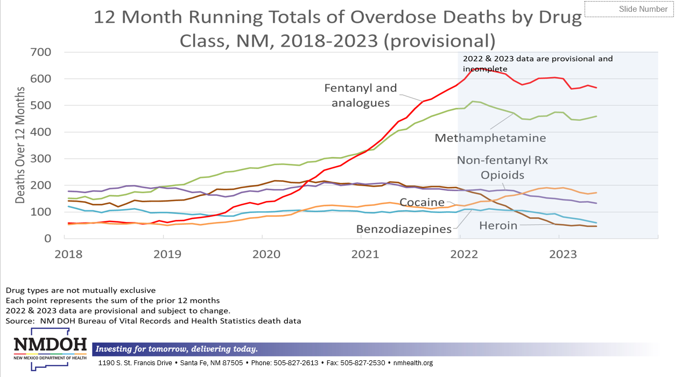
Notes:
Methamphetamine stepped up in 2017 and again in 2018 to become the leading drug problem.
Fentanyl took off in 2019, and more so in 2020 and eclipsed methamphetamine in early 2021
Overall overdose deaths have plateaued in 2022-23 after a peak in early 2022
Deaths involving more than one drug are counted more than once in this graph
The shaded area is provisional data and is subject to change.– per James Davis, MA, Epidemiology and Response Division, New Mexico Dept. of Health
Almost all of the fentanyl involved in overdose death is illicitly manufactured. That said toxicology can’t really tell the difference – per James Davis, Prescription Drug Overdose Prevention Epidemiologist, New Mexico Dept. of Health
Can confidently say methamphetamine is illicit per Jim Davis, DOH (2019). This meth is very potent, very pure and is psychoactive because it is the D-isomer meth.

Slide 50
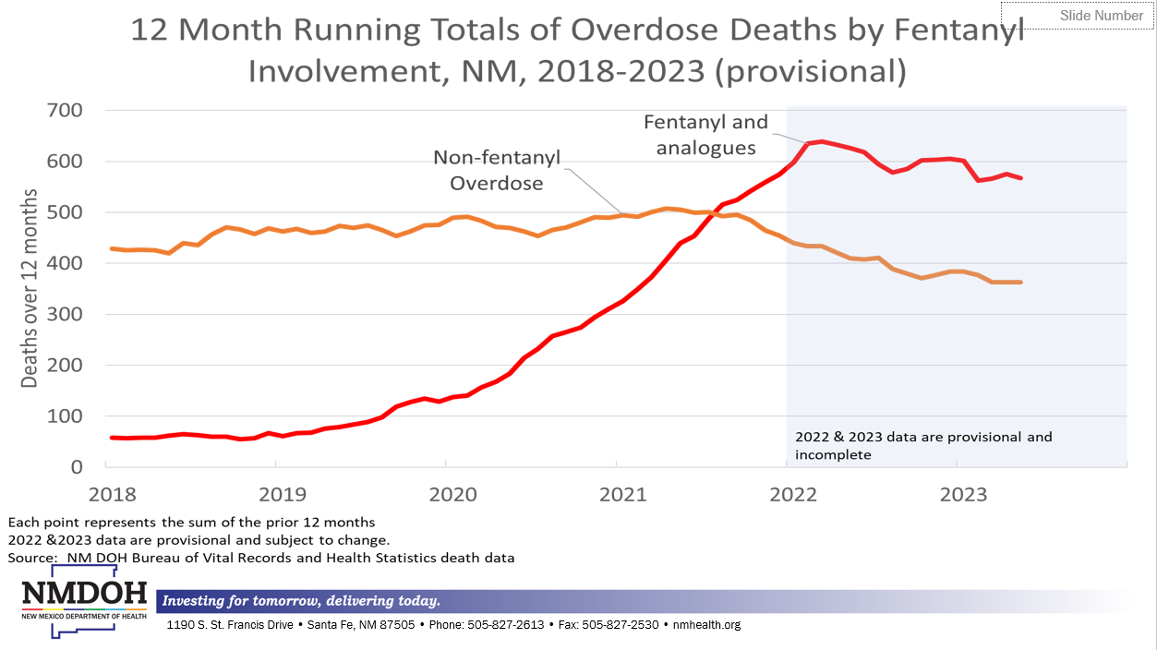
Notes:
Deaths involving fentanyl may also have involved other drugs
No apparent effect of pandemic restrictions beginning March 2020 on either fentanyl or non-fentanyl overdose deaths
Drop in non-fentanyl overdose starting in October 2021 may reflect fentanyl crowding out other drugs, especially heroin
It’s at the end of the run, in provisional data, so we’ll need to wait and see how it changes

Slide 51
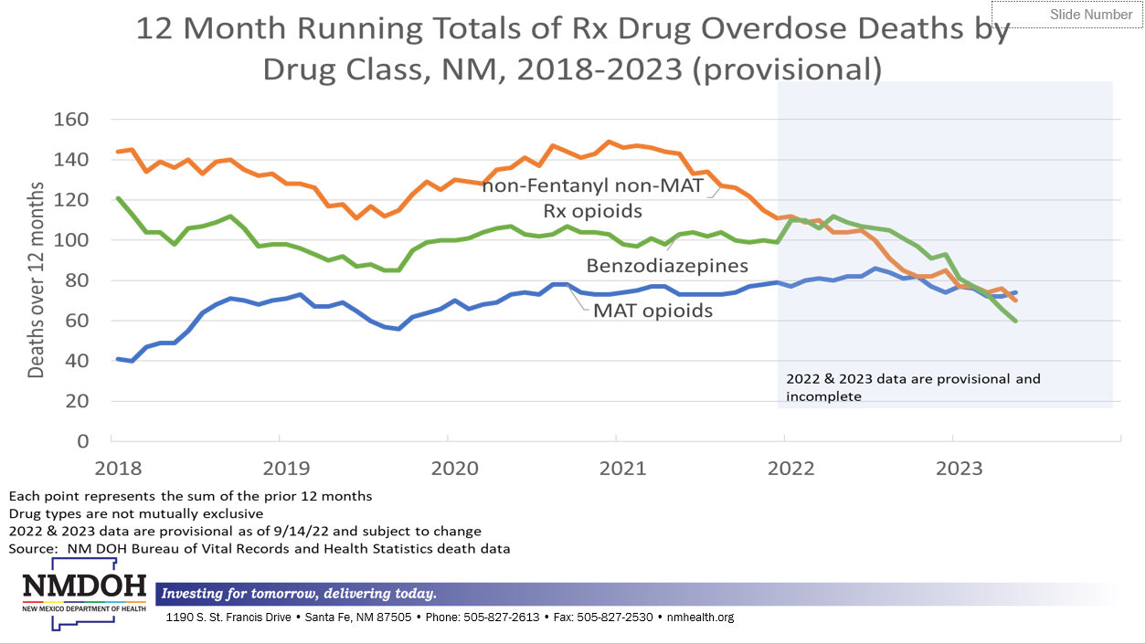
Notes:
The increase in overdose deaths involving non-fentanyl Rx opioids in 2020 appears to be a reflection of the increase in overdose deaths involving fentanyl. The increase in the number of these deaths that also involved fentanyl was far greater than the increase in the number of these deaths that involved any other drug.

Slide 52
Notes:
Fentanyl was involved in over 600 deaths – more than 10x methadone
Oxycodone and alprazolam are common on this list
Gabapentin is not a controlled substance but it is reported to the PMP as of 2023. Defined as a “drug of concern”.

Slide 53
FDA Gabapentinoid Warning! - 12/19/2019
Serious Breathing Difficulties may occur in patients using gabapentin or pregabalin who have respiratory risk factors.
Risk Factors include:
Use of opioid pain medications
Use of CNS depressants – anti-anxiety meds, antidepressants, antihistamines
COPD or other underlying respiratory disease
Elderly patient
FDA advice for HCPs - start gabapentinoids at lowest dose possible and monitor for symptoms of respiratory depression and sedation when co-prescribed with an opioid or other CNS depressant
Notes:
Keep FDA advice in mind when evaluating for drug–drug and drug-disease interactions

Slide 54
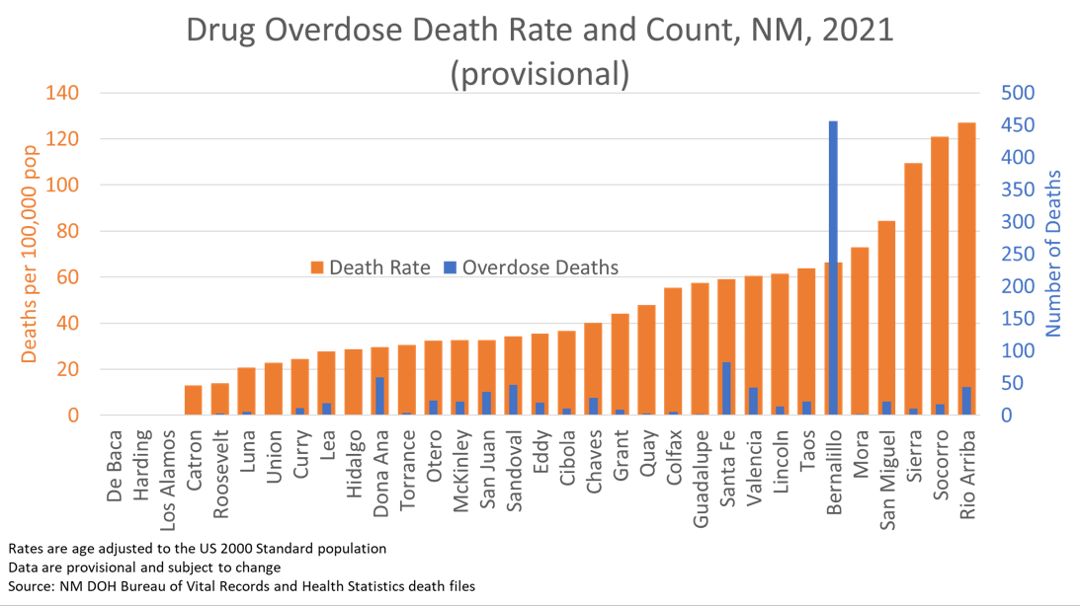
Notes:
The statewide rate is 52.
The large population in Bernalillo County means that a middling rate represents a large number of deaths

Slide 55
Deaths = per 100,000
Source:
Notes:
Deaths are per 100,000

Slide 56
High Risk Prescribing Patterns
Long term use of opioids (≥ 90 days)
High doses of opioids (≥ 90 MME/day)
Overlapping prescriptions of opioids from different prescribers
Multiple Provider Episodes ( MPE: Doctor and pharmacy shopping)
The combination of opioids and sedative-hypnotics
The combination of opioids, benzodiazepines and muscle relaxants

Slide 57
Notes:
With the addition of gabapentin, gabapentinoids are the second largest drug category in terms of number of patients.
The number of patients with concurrent opioids and gabapentinoids is higher than the number with concurrent opioids & benzodiazepines

Slide 58
Notes:
The rate of decline slowed sharply after 2020Q2 and the seasonality vanished

Slide 59
Notes:
The declines in MME and DME did not slow as much as the declines in patients, indicating that the slowdown was among patients with low quantities

Slide 60
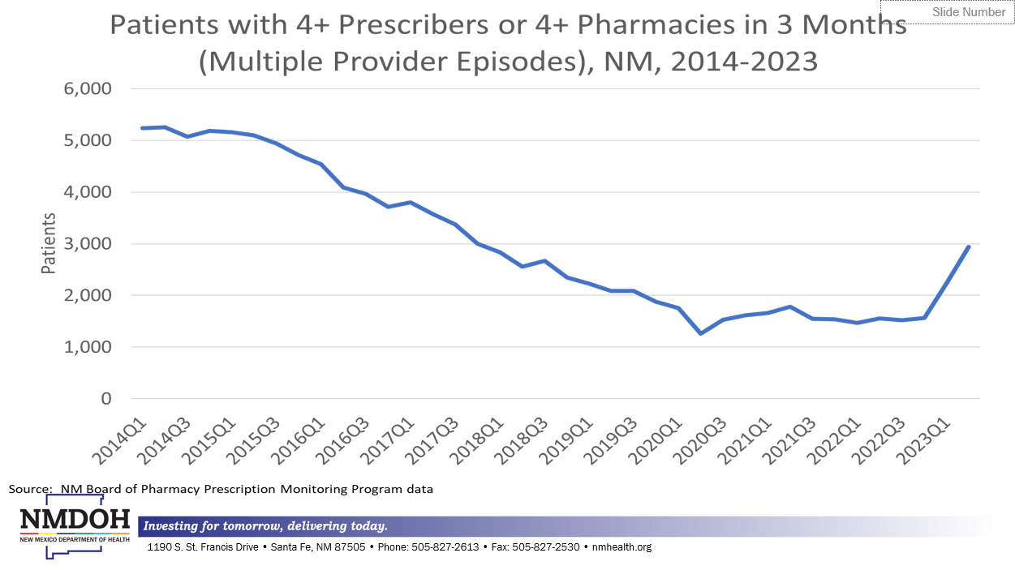
Notes:
Change in way in which CS were counted was made in 2020Q3 – added misc, barbiturates, some stimulants; increased the numbers of patients and prescribers.
That change makes it hard to interpret any effect of the pandemic. The addition of gabapentin in 2023 increased the number of patients and the number with multiple provider episodes.
Jim Davis also mentioned that drug shortages and staff shortages is also a factor in more providers and more pharmacies being used to fill prescriptions than before.

Slide 61
Notes:
High doses, chronic use, overlapping prescriptions from different prescribers, concurrent opioids and benzodiazepines and
Multiple prescriber episodes have been shown in the literature to be associated with a higher risk of overdose death
High-dose prescriptions have continued to decline, with the rate of decline in opioids slowing after 2020Q2
We don’t expect any of these measures to go to zero, but some measures probably still have some distance to fall.

Slide 62
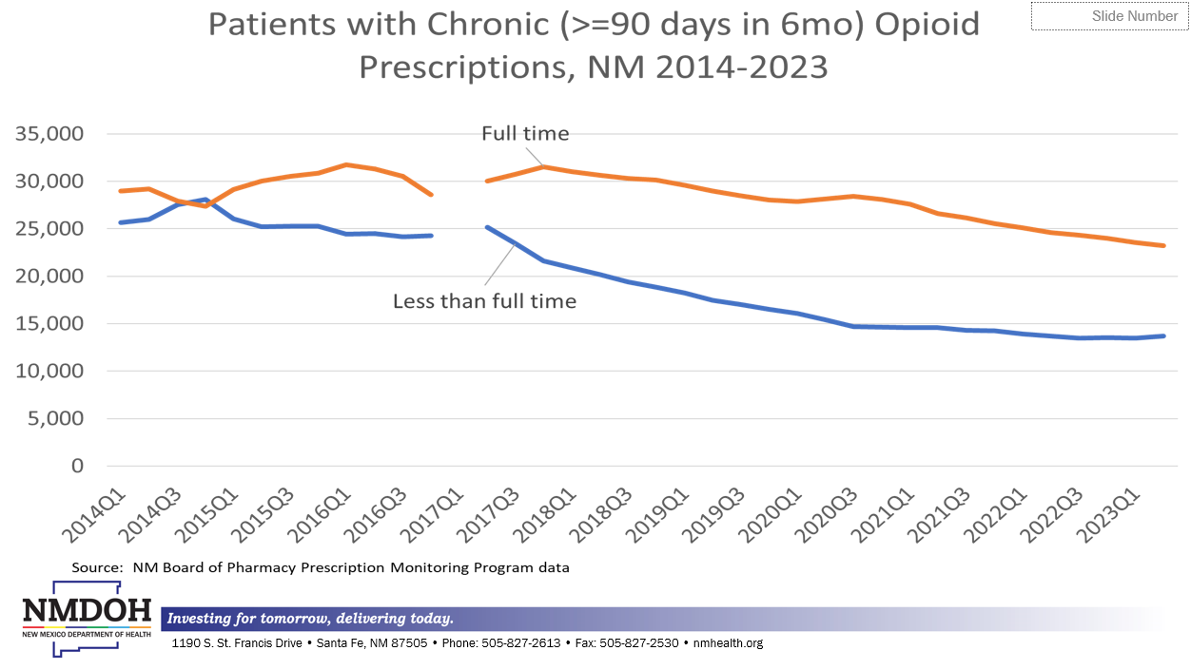
Notes:
The gap is due to changes around the platform change in October 2016 which resulted in the addition of a large number of patients and a gap in PMP request data
The number of patients with chronic opioid prescriptions continues to decline. There is a slowing of the decline in the “less than full time” category. We don’t want to see sharp drops in the number of chronic patients.
Full-time chronic patients are those who had coverage (days of supply) for at least 90% of the days in 6 months. Less than full-time chronic patients are those who had at least 90 days of supply in 6 months, but for less than 90% of the days.

Slide 63
Notes:
Overlaps of at least 10 days.
The decline in the opioids froze after 2020Q2; Benzodiazepines continued down, although more slowly than prior to 2020Q2

Slide 64
Notes:
The decline slowed in mid 2019, but has continued

Slide 65
Notes:
PMP reports are being requested on almost half of new opioid patients with 4+ days of supply. This could improve.

Slide 66
Notes:
For chronic opioid patients, providers are requesting PMP reports on more than 80%; more the 60% for benzodiazepine patients.

Slide 67
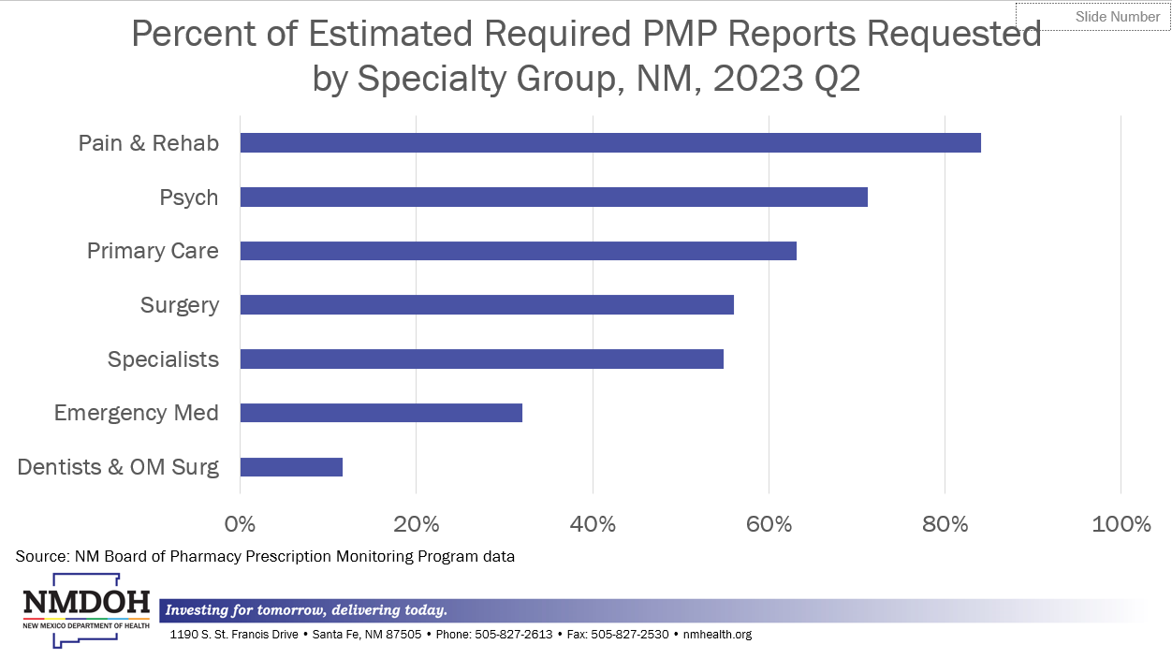
Notes:
Among prescribers with at least 20 controlled substance patients
The collapse into groups obscures some differences among specialties.
Only 11 dentists & om surgeons (N=174) were flagged for checking fewer than 50% - only about 7-8% of their patients require PMP checks.
Primary care does most opioid prescribing (60% of patients and 77% of MME) and most benzo prescribing (69% of patients and 60% of DME)

Slide 68
SAMHSA & FindTreatment.gov
Notes:
From the Substance Abuse and Mental Health Services Administration website you can access findtreatment.gov which has a facility locator program for substance use, mental health, buprenorphine practitioners, opioid treatment programs and health care centers

Slide 69
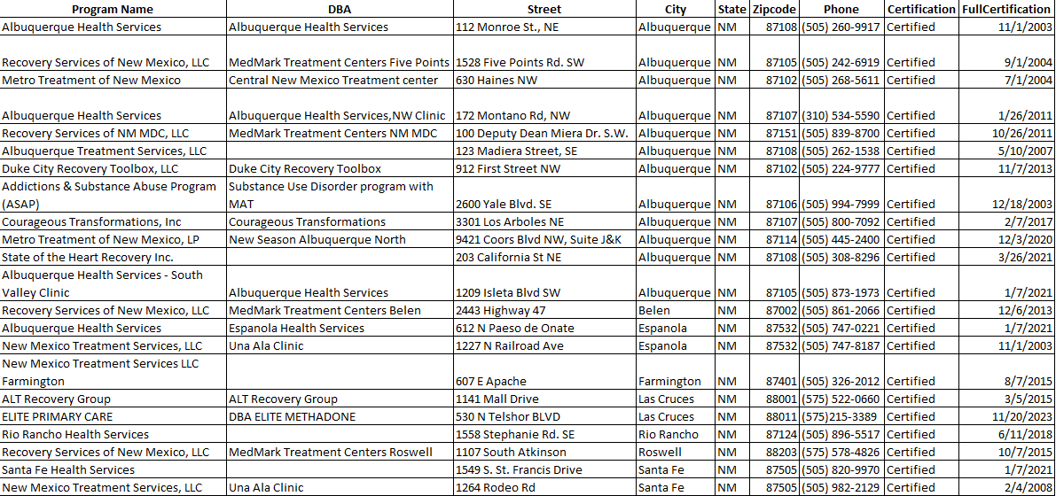
Samhsa-Certified Opioid Treatment Programs
From SAMHSA OTP Directory 11/28/2023

