Slide 1
Overview of CGM & Diabetes Pump Products
MAYA HARDMAN, PHARMD, PHC, AAHIVP, BC-ADM
SATURDAY, JANUARY 20, 2024

Slide 2
Learning Objectives
DEFINE & DIFFERENTIATE
COMPARE & CONTRAST
APPLY
LOCATE
DIFFERENT TYPES OF DIABETES
CONTINUOUS GLUCOSE MONITORS & INSULIN PUMPS
KNOWLEDGE OF DIFFERENT CLASSES OF INSULIN
RESOURCES FOR CONTINUOUS GLUCOSE MONITORS & INSULIN PUMPS

Slide 3
OBJECTIVE 1: DEFINE & DIFFERENTIATE
TYPES OF DIABETES
TYPES OF MONITORING
TYPES OF INSULIN PUMPS

Slide 4
TYPES OF DIABETES
1
1.5
2
TYPE 1 DIABETES
Type 1.5 diabetes
Type 2 diabetes
Insulin deficiency
combination of T1DM and T2DM
insulin resistance

Slide 5
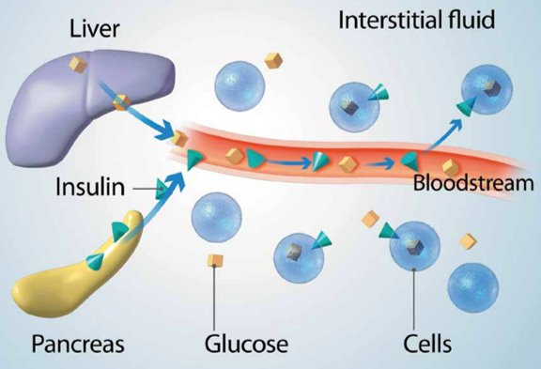
Insulin pharmacology review
Insulin In The Body:
Hormone produced by the pancreas to transport glucose into cells for energy
Diabetes can alter insulin production/function:
Type 1 diabetes: ~0 insulin
Type 2 diabetes: insulin resistance
Source: Medtronic – Basics of Insulin Pump Therapy

Slide 6
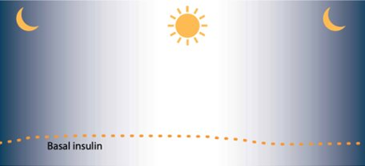
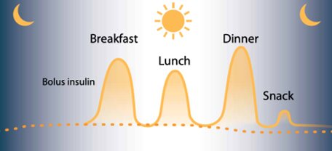
Insulin pharmacology review
Insulin Requirements:
The body has 2 insulin “modes”
Basal: minimum insulin required to throughout day, regardless of meals
Bolus: insulin required to bring glucose back to normal range after spiking
Source: Medtronic – Basics of Insulin Pump Therapy

Slide 7
OBJECTIVE 1: DEFINE & DIFFERENTIATE
TYPES OF DIABETES
TYPES OF MONITORING
TYPES OF INSULIN PUMPS

Slide 8
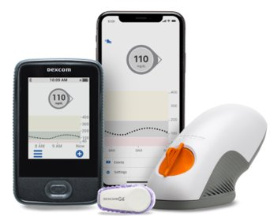
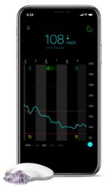
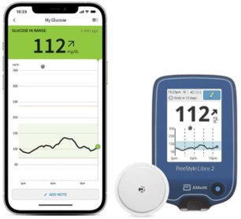
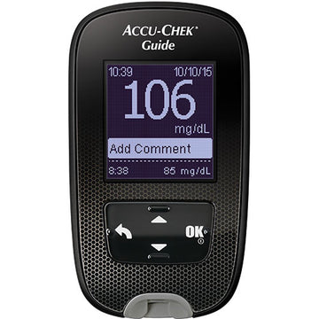
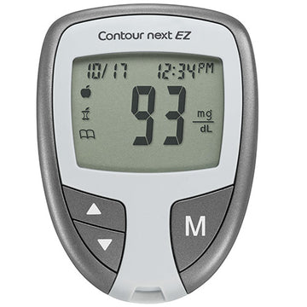
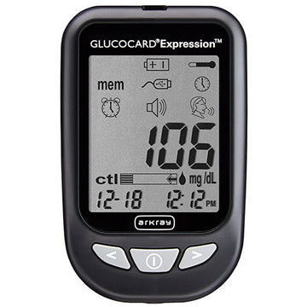
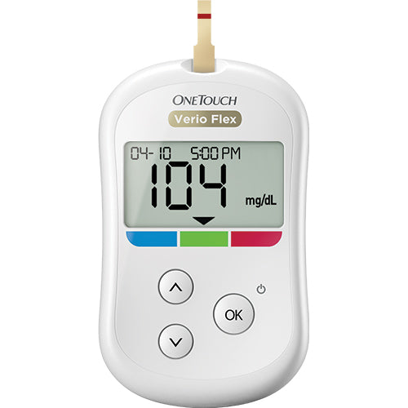
TYPES OF MONITORING
BLOOD GLUCOSE MONITORING (BGM):
Continuous glucose monitoring (CGM):
Considered the "traditional" form of monitoring
Capillary blood glucose reading
One point in time
~15 min lag from food ingestion
"Newer" form of monitoring
Interstitial fluid glucose reading
Point in time plus trends
~15 min lag from capillary reading
Source: ADA Consumer Guide

Slide 9
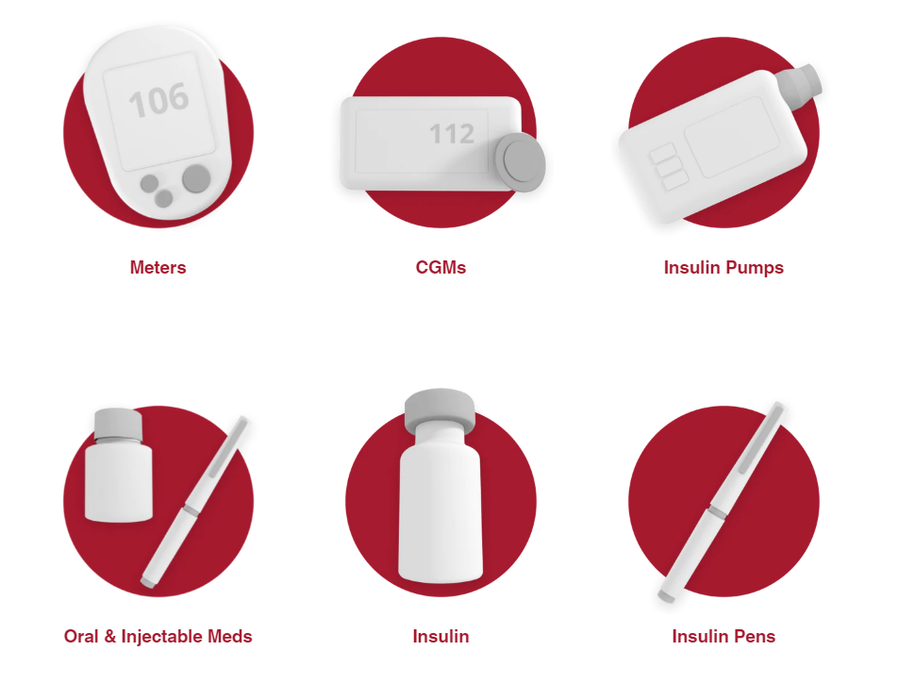
BLOOD GLUCOSE MONITORING
Important Considerations:
Insurance coverage & cost
Strips & lancets
Frequency of testing
Ease of use
Visual/auditory features
Reminders
Batteries required
Sharing capabilities
Source: ADA Consumer Guide

Slide 10
Continuous GLUCOSE MONITORING
Important Considerations:
Insurance coverage & cost
Ease of use
Frequency of sensor change
Visual/auditory features
Warm up period
Source: Danatech

Slide 11
OBJECTIVE 1: DEFINE & DIFFERENTIATE
TYPES OF DIABETES
TYPES OF MONITORING
TYPES OF INSULIN PUMPS

Slide 12
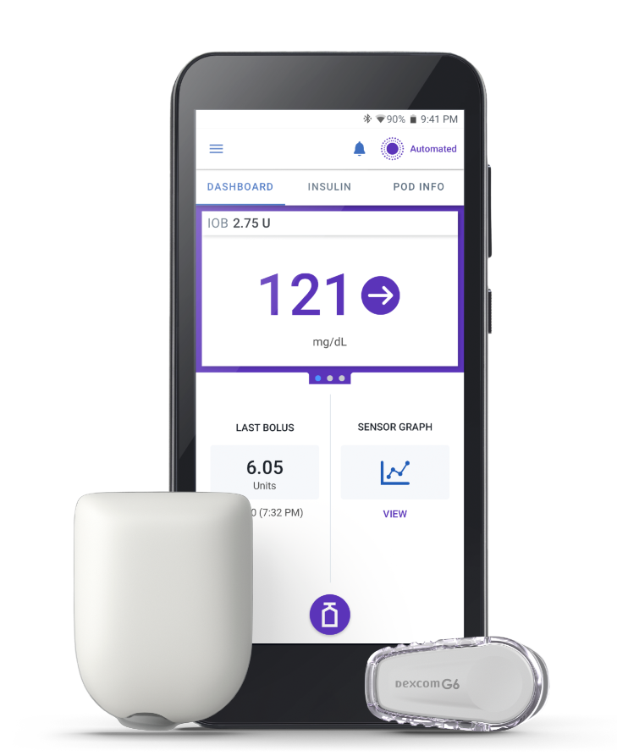
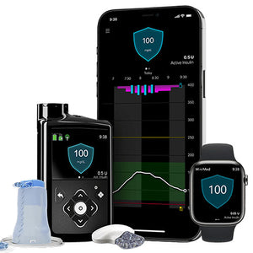
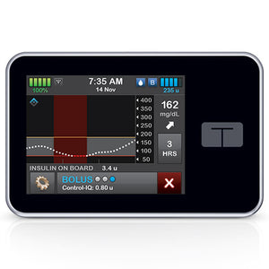
TYPES OF INSULIN PUMPS
Traditional:
Automated Delivery:
Delivers a set basal rate every hour; programable & adjustable
Boluses can be delivered for carb and/or corrections
Delivers basal rate every hour, variable based on CGM values
Boluses:
Automated for predicted/actual hyperglycemia
Carb and/or correction
Auto suspension for hypoglycemia
Source: ADA Consumer Guide

Slide 13
OBJECTIVE 2: compare & CONTRAST
CONTINUOUS GLUCOSE MONITORS
INSULIN PUMPS

Slide 14
CGM COMPARISON:
PRODUCT | DURATION | WARM-UP | MARD | WATER | rtCGM | SITE | PUMPS? | CALIBRATION
DEXCOM G7 (DME & Rx) | 10 DAYS #3 = 30DS | 30 MIN | 8.2% | ≤8 FEET, ≤24 HRS | EVERY 5 MIN | ARM & BUTTOCKS* | YES | OPTIONAL
FREESTYLE LIBRE 3 (DME & Rx) | 14 DAYS #2 = 28DS | 1 HR | 7.9% | ≤3 FEET, ≤30 MIN | EVERY 1 MIN | ARM | IN PROCESS | N/A
GUARDIAN (DME) | 7 DAYS #4 = 28DS | 2 HR | 9% - 10.5% | ≤8 FEET, ≤30 MIN | EVERY 5 MIN | ARM & ABDOMEN | YES | 2x DAILY
MARD = mean absolute relative difference, rtCGM = real time CGM
Source: ADA Consumer Guide, DiabetesWise Pro Device Library

Slide 15
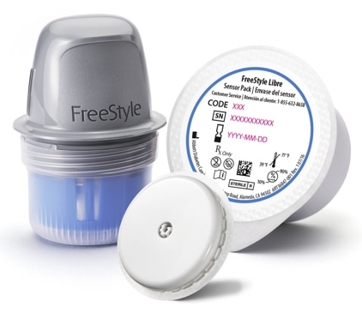
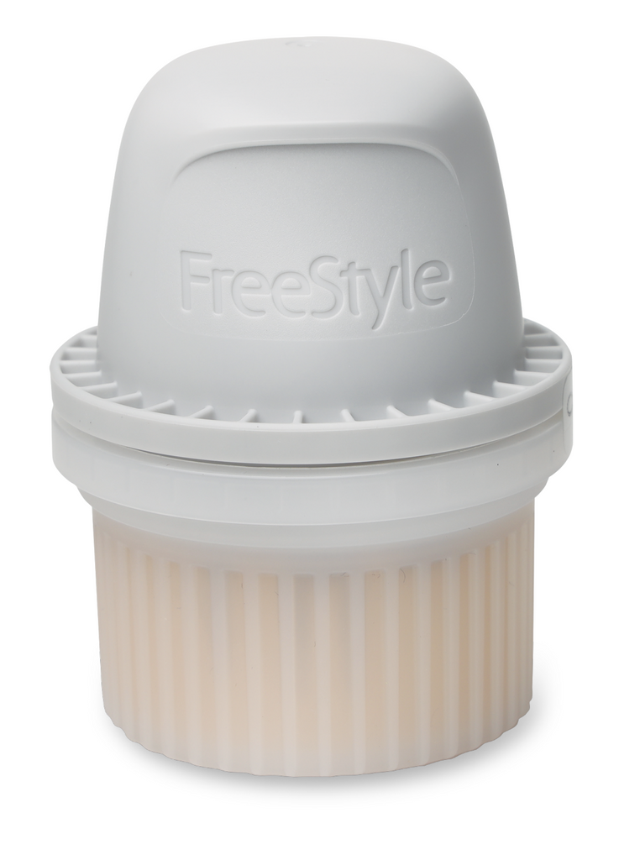
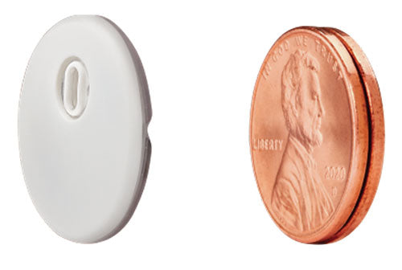
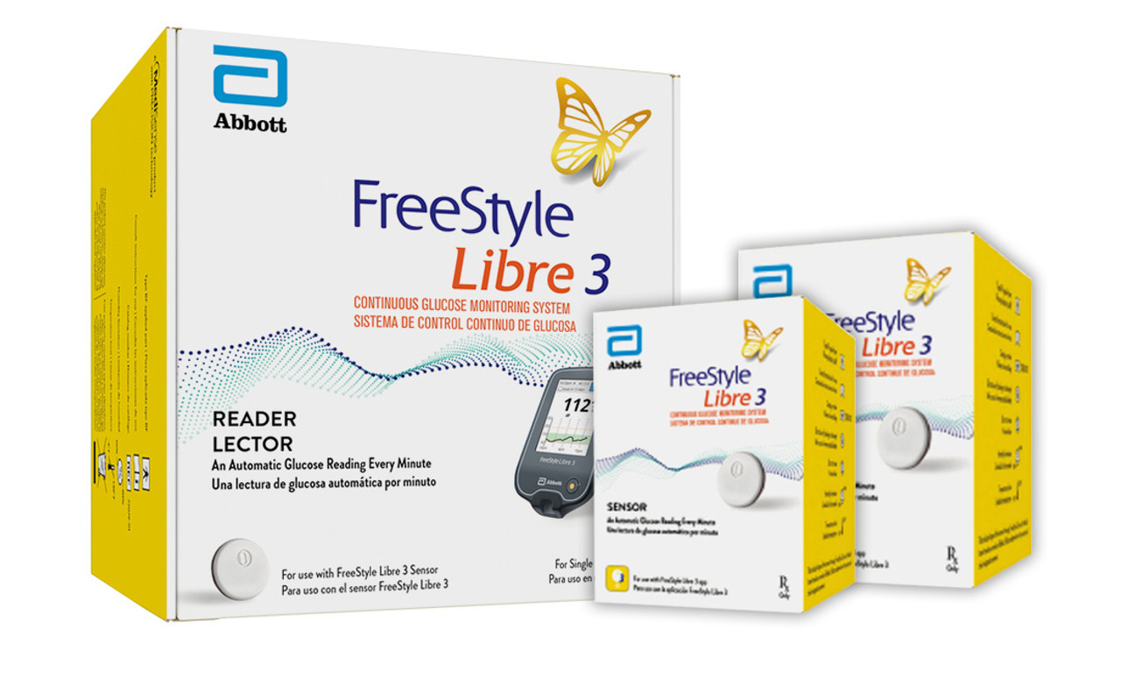

Slide 16
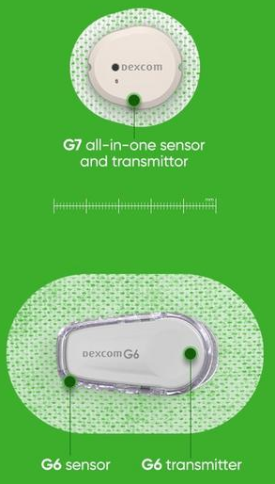
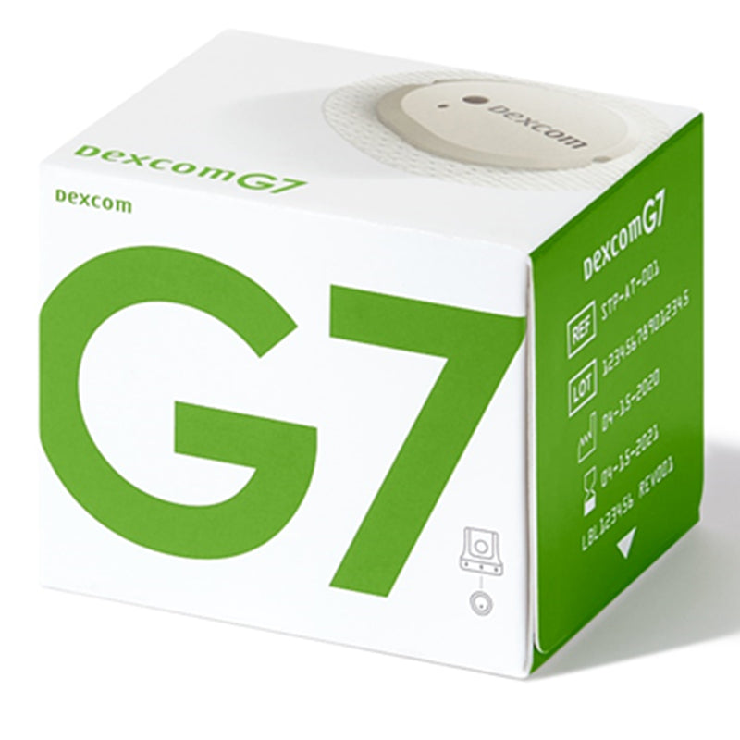

Slide 17
OBJECTIVE 2: compare & CONTRAST
CONTINUOUS GLUCOSE MONITORS
INSULIN PUMPS

Slide 18
INSULIN PUMP COMPARISON:
PRODUCT | FREQUENCY | COST | TUBES? | WATER | SITE | CONNECTED DEVICES | APPROVED INSULINS
OMNIPOD DASH (Rx ONLY) | UP TO 200 UNITS Q3D | $$ | NO | ≤25 FEET, ≤60 MIN | ARM, STOMACH, THIGH, BUTTOCKS | CONTOUR NEXT, IPHONE APP, FAMILY SHARING | NOVOLOG, HUMALOG, FIASP, LYUMJEV, APIDRA*
MEDTRONIC 630G (DME ONLY) | UP TO 300 UNITS Q3D | $$$$ | YES | NO* | STOMACH, LEG, BUTTOCKS | CONTOUR NEXT, ENLITE CGM | HUMALOG, NOVOLOG
Source: ADA Consumer Guide, DiabetesWise Pro Device Library

Slide 19
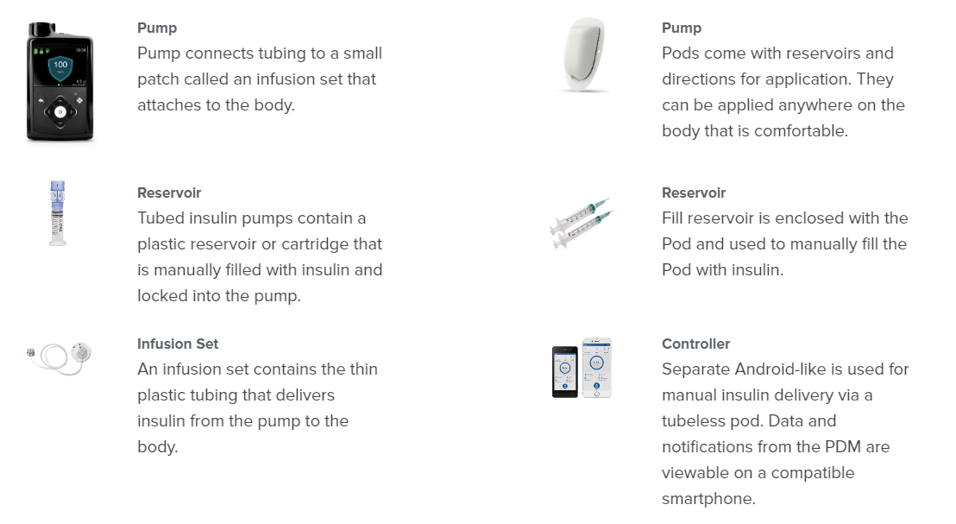
Source: ADA Consumer Guide

Slide 20
INSULIN PUMP COMPARISON:
PRODUCT | FREQUENCY | COST | TUBES? | WATER | SITE | CONNECTED DEVICES | APPROVED INSULINS
OMNIPOD 5 (Rx ONLY) | UP TO 200 UNITS Q3D | $$ | NO | ≤25 FEET, ≤60 MIN | ARM, STOMACH, THIGH, BUTTOCKS | DEXCOM G6 | NOVOLOG, HUMALOG
MEDTRONIC 780G (DME ONLY) | UP TO 300 UNITS Q3D | $$$$ | YES | NO* | STOMACH, LEG, BUTTOCKS | GUARDIAN | HUMALOG, NOVOLOG
TANDEM T-SLIM X2 (DME ONLY) | UP TO 300 UNITS Q3D | $$$$ | YES | NO* | STOMACH, LEG, BUTTOCKS | DEXCOM G6, DEXCOM G7, IPHONE APP, LIBRE 2+ | HUMALOG, NOVOLOG
Source: ADA Consumer Guide, DiabetesWise Pro Device Library

Slide 21
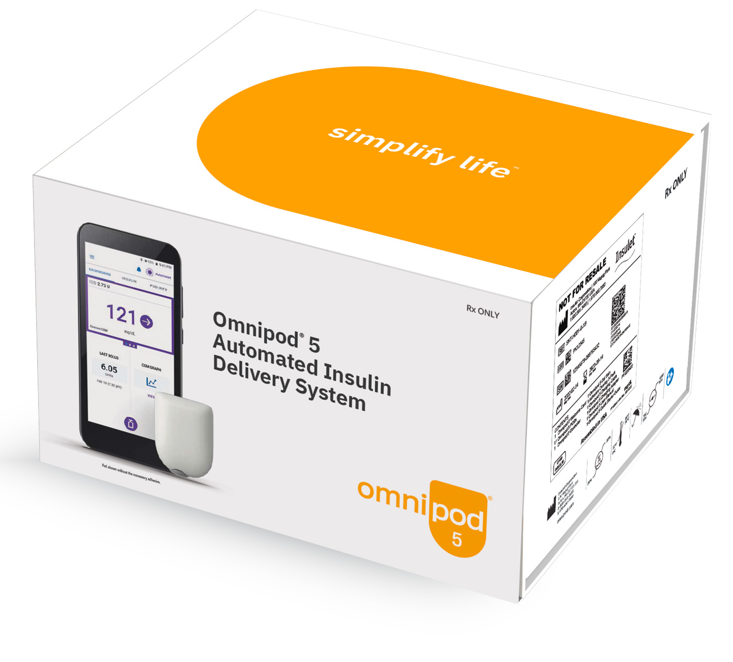
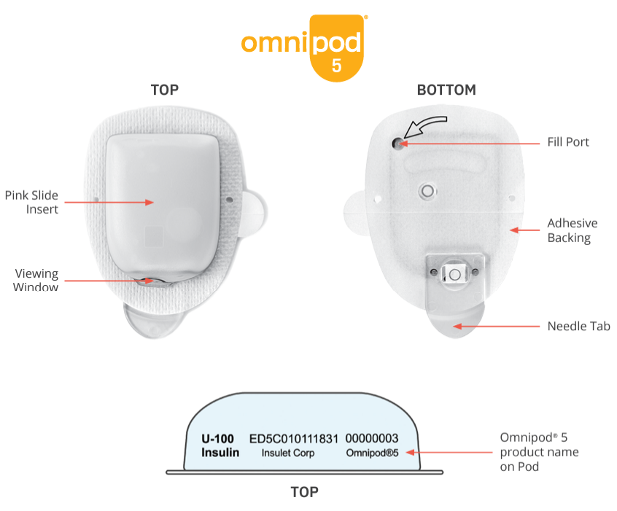
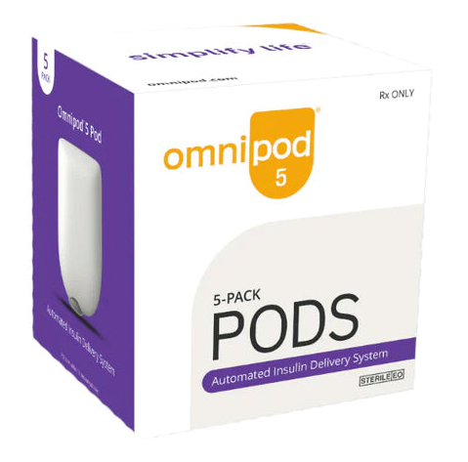
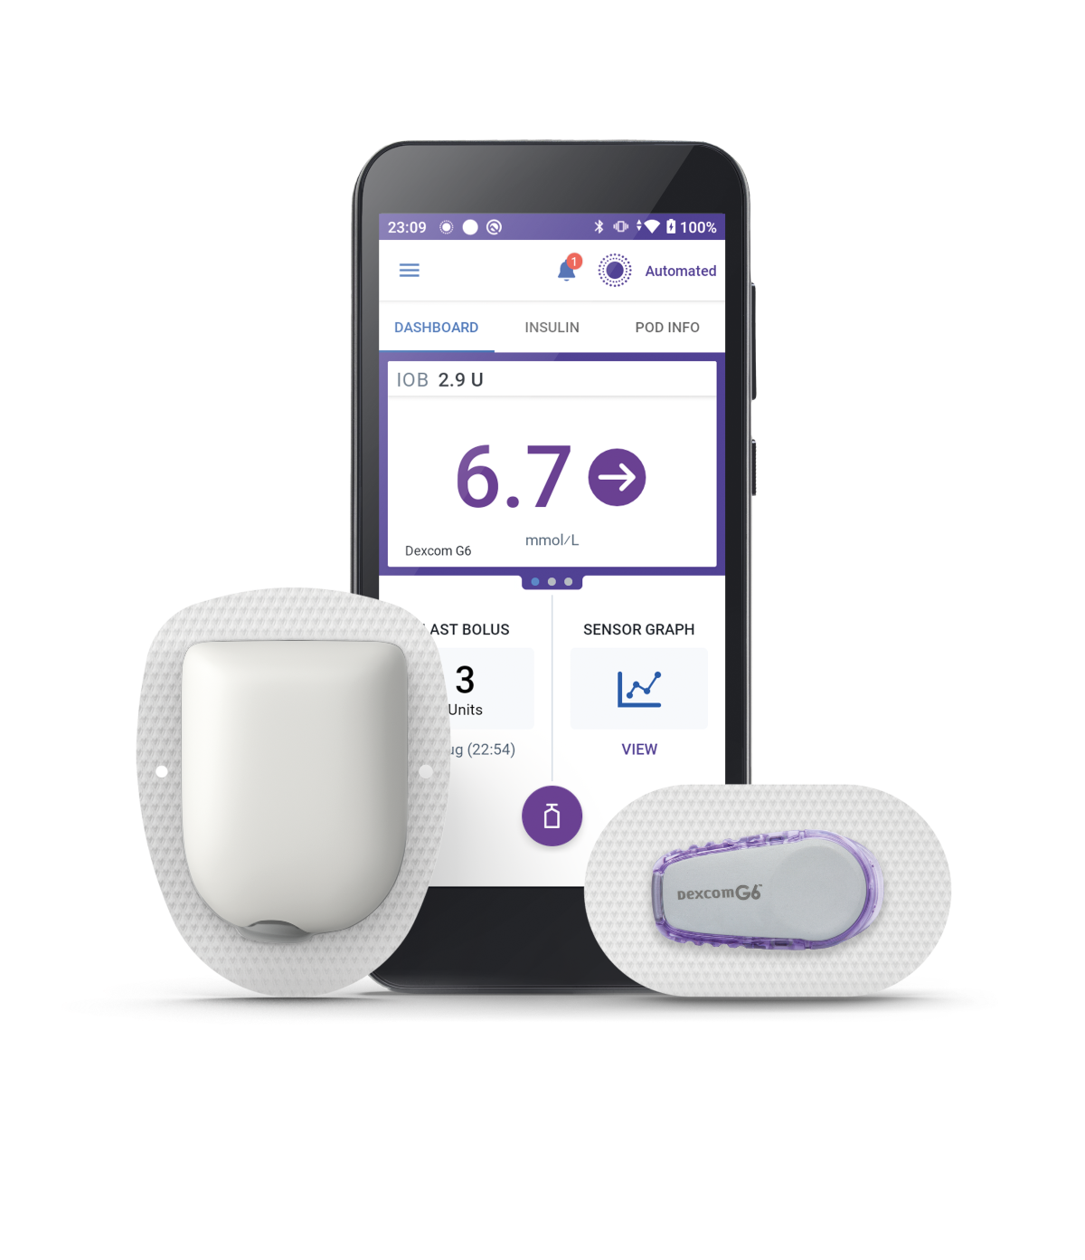

Slide 22
OBJECTIVE 3: APPLY
KNOWLEDGE OF GUIDELINES
KNOWLEDGE ON DIFFERENT CLASSES OF INSULIN

Slide 23
Ada Standards OF Care 2024
GLYCEMIC GOALS & HYPOGLYCEMIA:
6.1 Assess glycemic status by A1C and/or appropriate continuous glucose monitoring (CGM) metrics at least two times a year. Assess more frequently (e.g., every 3 months) for individuals not meeting treatment goals, with frequent or severe hypoglycemia or hyperglycemia, changing health status, or growth and development in youth. E
6.2 Assess glycemic status at least quarterly and as needed in individuals whose therapy has recently changed and/or who are not meeting glycemic goals. E
6.3 Standardized, single-page glucose reports from CGM devices with visual cues, such as the ambulatory glucose profile, should be considered as a standard summary for all CGM devices. E
6.4 Time in range (TIR) is associated with the risk of microvascular complications and can be used for assessment of glycemic status. Additionally, time below range and time above range are useful parameters for the evaluation of the treatment plan. C
6.5a An A1C goal for many nonpregnant adults of <7% (<53 mmol/mol) without significant hypoglycemia is appropriate. A
6.5b If using an ambulatory glucose profile/glucose management indicator to assess glycemia, a parallel goal for many nonpregnant adults is TIR >70% with time below range <4% and time <54 mg/dL (<3 mmol/L) <1%. For those with frailty or at high risk of hypoglycemia, a goal of >50% TIR with <1% time below range is recommended. B
Source: ADA Standards of Care 2024 – 6. Glycemic Goals and Hypoglycemia

Slide 24
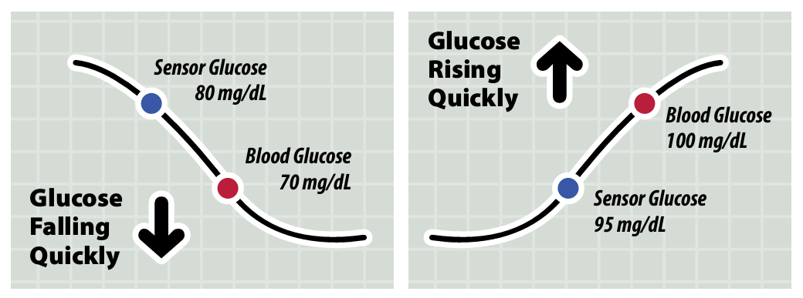
ADA STANDARDS OF CARE 2024
Glucose specific goals:
Increase time in range (TIR)
Reduce time above range (TAR) and time below range (TBR)
Technology (CGM +/- pumps) can help patients meet these goals!
Source: ADA Standards of Care 2024 – 6. Glycemic Goals and Hypoglycemia

Slide 25
LAA, long-acting insulin analog; MDI, multiple daily injections; RAA, rapid-acting insulin analog; URAA, ultra-rapid-acting insulin analog

Slide 26
OBJECTIVE 3: APPLY
KNOWLEDGE OF GUIDELINES
KNOWLEDGE ON DIFFERENT CLASSES OF INSULIN

Slide 27
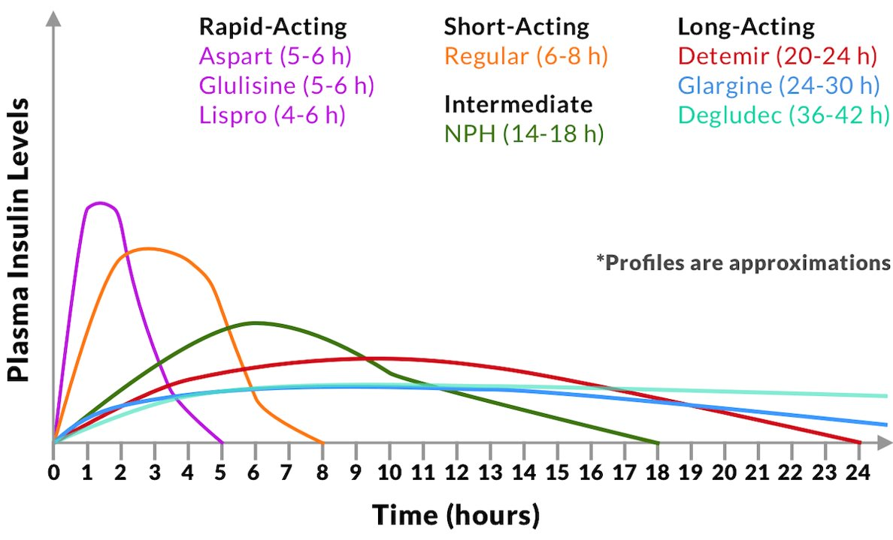
Source: Pyrls

Slide 28
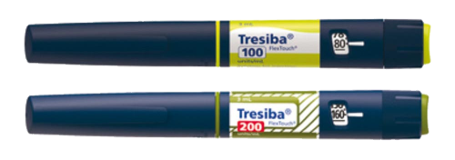
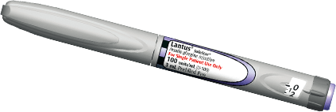
TYPES OF INSULINS: BASAL (laa)
Insulin Name (generic): | Concentration(s) (pack size): | Discard after: room temp unless noted | Duration:
Tresiba (degludec) | Pens: U-100 (15mL), U-200 (9mL) Vials: U-100 (10mL) | 56 days +/- fridge | 36-42 hours
Basaglar (glargine) | Pens: U-100 (15mL) | 28 days | 24-30 hours
Lantus (glargine) | Pens: U-100 (15mL) | Vials: U-100 (10mL) | 28 days | 24-30 hours
Rezvoglar (glargine-aglr) | Pens: U-100 (15mL) | 28 days | 24-30 hours
Semglee (glargine-yfgn) | Pens: U-100 (15mL) | Vials: U-100 (10mL) | 28 days | 24-30 hours
Toujeo (glargine) | Pens: U-300 (4.5mL, max: 6mL) | 56 days | 24-36 hours
Levemir (detemir)*** | Pens: U-100 (15mL) | Vial: U-100 (10mL) | 42 days (vials +/- fridge) | 20-24 hours
Source: Pyrls, ADA Consumer Guide, Clinical Pharmacology

Slide 29
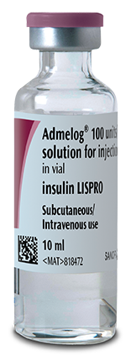
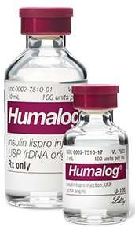
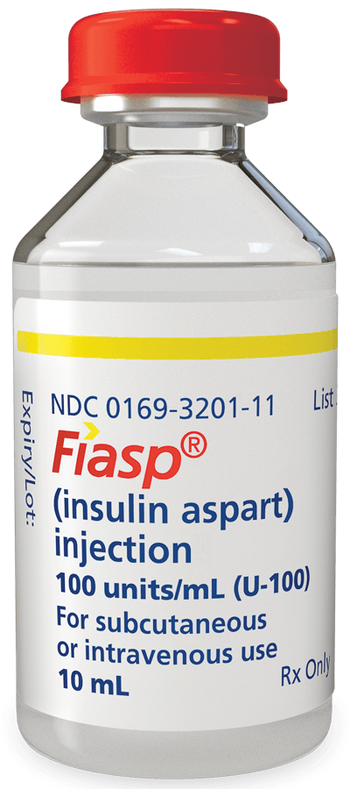
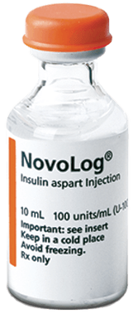
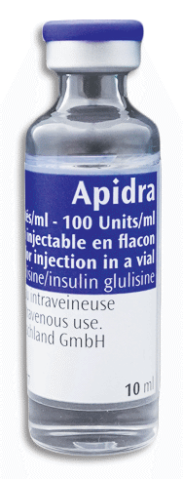
TYPES OF INSULINS: BOLUS (RAA, & URAA)
Insulin Name (generic): | Concentration(s) (pack size): | Discard after: room temp unless noted | Onset & Duration:
Admelog (lispro) (RAA) | Pens: U-100 (15mL) | Vials: U-100 (10mL) | 28 days (vials +/- fridge) | 15 min 4-6 hours
Humalog (lispro) (RAA) | Pens: U-100 (15mL), U-200 (6mL) Vials: U-100 (10mL, 3mL) | Cartridge: U-100 (15mL) | 28 days (vials +/- fridge) | 15 min 4-6 hours
Lyumjev (lispro-aabc) (URAA) | Pens: U-100 (15mL), U-200 (6mL) | Vials: U-100 (10mL) | 28 days (vials +/- fridge) | 1 min 4-6 hours
Fiasp (aspart) (URAA) | Pens: U-100 (15mL) | Vials: U-100 (10mL) | Cartidge: U-100 (15mL) | PenFill: U-100 (15mL) | 28 days (vials & pens +/- fridge) | 2.5 min 5-6 hours
Novolog (aspart) (RAA) | Pens: U-100 (15mL) | Vials: U-100 (10mL) | PenFill: U-100 (15mL) | 28 days (vials +/- fridge) | 15 min 5-6 hours
Apidra (glulisine) (RAA) | Pens: U-100 (15mL) | Vials U-100 (10mL) | 28 days (vials +/- fridge) | 20 min 5-6 hours
Source: Pyrls, ADA Consumer Guide, Clinical Pharmacology

Slide 30
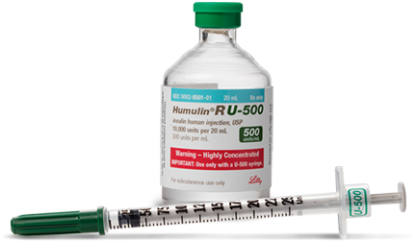
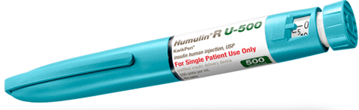
TYPES OF INSULINS: Short (S) & Intermediate (I)
Insulin Name (generic): | Concentration(s) (pack size): | Discard after: room temp unless noted | Onset & Duration:
Humulin R (regular) (S) | Vials: U-100 (10mL) | 31 days (+/- fridge) | 30 min 6-8 hours
Novolin R (regular) (S) | Vials: U-100 (10mL) | Pen: 28 days Vial: 42 days | 30 min 6-8 hours
Humulin N (isophane/NPH) (I) | Pens: U-100 (15mL) | Vials: U-100 (10mL) | Pen: 14 days Vial: 31 days (+/- fridge) | 1.5 hours 14-18 hours
Humulin R (regular) (I) | Pens: U-500 (6mL) | Vials: U-500 (20mL) | Pen: 28 days Vial: 40 days (+/- fridge) | 30 min 13-24 hours
Novolin N (isophane/NPH) (I) | Pens: U-100 (15mL) | Vials: U-100 (10mL) | Pen: 28 days Vial: 42 days | 1.5 hours 14-18 hours
Source: Pyrls, ADA Consumer Guide, Clinical Pharmacology

Slide 31
TYPES OF INSULINS: Mixtures
Insulin Name (generic): | Concentration(s) (pack size): | Discard after: room temp unless noted | Onset & Duration:
Humalog 50/50 (I + RAA) (protamine lispro/lispro) | Pens: U-100 (15mL) | Vials: U-100 (10mL) | Pen: 10 days Vial 28 days (+/- fridge) | 15-30 min 12-24 hours
Humalog 75/25 (I + RAA) (protamine lispro/lispro) | Pens: U-100 (15mL) | Vials: U-100 (10mL) | Pen: 10 days Vial 28 days (+/- fridge) | 15-30 min 12-24 hours
Novolog 70/30 (I + RAA) (protamine aspart/aspart) | Pens: U-100 (15mL) | Vials: U-100 (10mL) | Pen: 14 days Vial 28 days (+/- fridge) | 10-20 min Up to 24 hours
Humulin 70/30 (I + S) (isophane/regular) | Pens: U-100 (15mL) | Vials: U-100 (10mL) | Pen: 10 days Vial 31 days (+/- fridge) | 30 min Up to 24 hours
Novolin 70/30 (I + S) (isophane/regular) | Pens: U-100 (15mL) | Vials: U-100 (10mL) | Pen: 10 days Vial 28 days | 30 min Up to 24 hours
Source: Pyrls, ADA Consumer Guide, Clinical Pharmacology

Slide 32
OBJECTIVE 3: LOCATE
RESOURCES FOR PATIENTS
RESOURCES FOR HEALTHCARE PROVIDERS

Slide 33
PATIENT RESOURCES
SUPPORT FORM
SUPPORT FORM
FREE G6 PATCHES

Slide 34
OBJECTIVE 3: LOCATE
RESOURCES FOR PATIENTS
RESOURCES FOR HEALTHCARE PROVIDERS

Slide 35
HEALTHCARE PROVIDER RESOURCES
CGMs:
Dexcom:
User guides: G6 & G7
Trainings
Freestyle Libre:
User guides & Training:
Libre 2
Libre 3
Guardian:
User guide
Training
Insulin Pumps:
Medtronic:
User guides
Trainings & Webinars
Omnipod:
User guides & other handouts
Trainings
Compatible phones
Tandem:
User guides & Resources
Trainings

Slide 36
REFERENCES
Medtronic – The Basics of Insulin Pump Therapy.
ADA Consumer Guide
Danatech
DiabetesWise Pro – Device Library
American Diabetes Association Standards of Care 2024 – 6. Glycemic Goals and Hypoglycemia
American Diabetes Association Standards of Care 2024 – 9. Pharmacologic Approaches to Glycemic Treatment
Pyrls Drug Information. Insulin Classes and Action Profiles.
Clinical Pharmacology Drug Information. Drug class overview: Insulins.

