Slide 1
MEDICATION ERRORS

Slide 2
Medication Safety – How to Identify and Improve Medication Errors
SARAH GARCIA PHARMD

Slide 3
Disclosure
Sarah Garcia declares no conflicts of interest, real or apparent, and no financial interests in any company, product, or services mentioned in this program including grants, employment, gifts, stock holdings, and honoraria.

Slide 4
Learning Objectives
Learning Objectives
Upon completion of this activity Pharmacists will be able to …
Define the terms adverse drug event, adverse drug reaction, medication error, and near miss.
Compare human error, at risk behavior, and reckless behavior.
Define how inattentional blindness and confirmation bias can cause one to miss important information.
Outline 5 common at risk behaviors in healthcare and explain why they happen.
Differentiate between first order and second order problem solving.

Slide 5
Technician Learning Objectives
Pharmacy Technicians will be able to:
Define the terms adverse drug event, adverse drug reaction, medication error, and near miss.
Compare human error, at risk behavior, and reckless behavior.
Define how inattentional blindness and confirmation bias can cause one to miss important information.
Describe how 83% of errors are caught and corrected before the patient leaves.
Describe the types of questions you should be asking of patients.

Slide 6
Terminology
Adverse Drug Event: an injury from a medicine or from the lack of an intended medicine¹
Adverse drug events can occur as the result of either an adverse reaction to a medication or a medication error.
Adverse reaction: these are reactions that occur with a correct medication, at the correct dose, and the correct indication (for example nausea and vomiting)
Notes:
Risk factors for ADE age, gender, concomitant disease states

Slide 7
What is a Medication Error?
A medication error can be defined as, ‘a failure in the treatment process that leads to, or has the potential to lead to, harm to the patient’²
A study across two Harvard teaching hospitals showed serious injury producing medication errors occurred in nearly 2% of the patients, and an additional 5.5% of patients had near misses.³
Near miss is defined by ISMP as, “an event, situation, or error that took place but was captured before reaching the patient.”⁴
Notes:
In other words with a safety check error could have been prevented

Slide 8
Medication Errors
To Err is Human⁵
Human error consists of unintended and unpredictable behavior that causes or could have caused an undesirable outcome.
That is to say we all make slips, lapses or mistakes from time to time but it is important to recognize that we play a role in a medication process, most human errors result from a weakness in the process. Inadvertent behavior (human error) is not worthy of disciplinary sanction. Human error involves an error in a function of basic human behavior.
Example; inadvertently mistyping dose information into the computer system, or making a calculation error when calculating a dose.
Notes:
The majority of medication errors occur because of weaknesses in our systems that allow mistakes to slip by, as opposed to individual negligence
Human error is not a behavioral choice
How we perceive information, how we think about it, how we behave or act how we respond how we execute the plan error can occur at any of these steps

Slide 9
Human Error
Human Error Probabilities ⁶
An unfamiliar task performed at speed with no idea of likely consequences 50%
Tasks involving high stress 30%
Complex task requiring high comprehension/skill 15%
Failure to perform a check correctly 5%
Error in routine operation when care is required 1%
Errors during read back 0.5%
Well designed, familiar task in ideal conditions 0.04%
Human performance limit 0.01%
Notes:
Human Factors studies
Human Factors is making it easy for people to do the right thing and hard to do the wrong thing
We don’t have to guess how often human error happens
Failure rates from human factors studies
Complex task like a complicated math equation
Human performance limit probability is based on single worker operating in absolutely ideal conditions , generally the best we can do is to make 1-4 mistakes for every 10,000 attempts under ideal conditions
as we move up adding factors in slide accuracy decreases
Point is we make human errors frequently

Slide 10
Why do we make human errors?
We can think about the way we interact with our world as being Conscious or Automatic behavior.
And we move between a knowledge based, rule based, and skill based modes ⁷
Knowledge based – unfamiliar environment, no rules to fall back on, operate almost completely conscious
Rule based- a prepackaged behavior is the response when a rule is applied if x then y, if y then do z
Skill based- once you have the skill we move into automated routines with little conscious attention- prone to slips and lapses
Notes:
Where do we function most of our lives? Yep automatic pilot, decrease the work of the brain by about 90% once a skill is acquired
How we process and behave varies from automatic to processed.
Automatic cognition- mostly we function here this helps us be able to save energy and time mental fog we can do most things quite successfully
The terms knowledge based, skill, and rule based refer to the degree of conscious control exercised by individual over his or her activities.
The more experienced we are the more often we function in this mode and the more often we make errors like slips and lapses.
When we learn a new skill our brain is working very hard but as the skill is learned the brain does not have to work as much we move into the automatic cognition.
Skill based in the car to go to the store find you drove to work instead, walked in a room forgot why you were in there

Slide 11
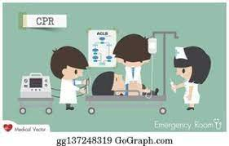
Knowledge Based
Causes for errors in this mode:
Feeling overwhelmed
Lack of knowledge
Lack of awareness of consequences
Notes:
In knowledge based mode human carries out tasks almost completely consciously this occurs in a situation where a beginner is learning a new task or where an experienced individual is faced with a completely novel situation in either of these situations the worker would have to exert considerable mental effort to asses the situation and responses are likely to be slow
Factors like considerable demands from high stress unfamiliar situations lead to errors in this mode of thought

Slide 12
Rule based
Causes for errors
Apply the wrong rule
Forget the rule
Examples can be found in mathematics
2 + 3 x 6 = ?
30
or
20
Pattern matching- locate or find something in our environment
Prone to confirmation bias
Notes:
Tendency to force a situation into a familiar rule in a familiar situation applying a rule do you remember the order of operations??
Pattern matching – draw up a memory in our past and scan our environment or see the environment first
Mistakes using the wrong procedure for the goal typically found in rule based or problem solving behavior, arrive from an incorrect intension

Slide 13
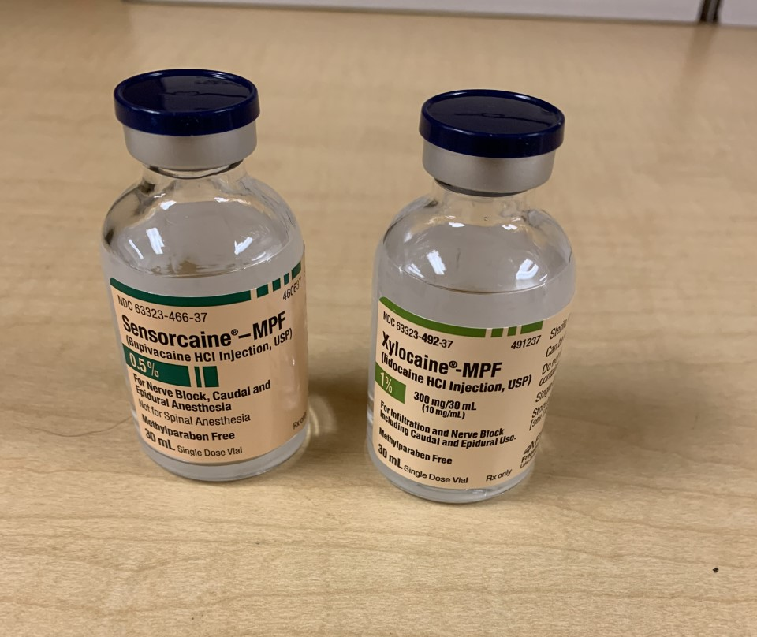
Confirmation Bias
Confirmation bias is the tendency of human being to search for information that confirms ones existing beliefs and reject information that does not.
This means we see what we think we should see instead of what is actually in front of us.
Scripts written for Sinequan (doxepin) were mistaken for Singulair (montelukast) reported in Pharmacy Times
Notes:
Selectively search for information that matches and ignore what does not, if we look “here” we miss what’s “there”
When looking for a product if we found it quickly, we believe we are right –availability heuristic
Pattern matching is essential draw a picture to our mind focus on specific feature
Hard to realize we are wrong
Anchoring heuristic once we have a product we think is right we downplay any contrary evidence
Look at the vial looking for size colors even reading label we may not realize these are two different medications
All can be victims to confirmation bias but the more experienced we are the more prone we are to confirmation bias

Slide 14
Change Blindness
The inability of our visual system to detect alterations to something in plain view.
Door Study ⁸
Pedestrian with a map stopped another person to ask for directions while mid conversation someone carrying a door walked between them and a new person replaced the one asking for directions, 50% of people did not notice that the person asking for directions had changed.
According to the Insurance Institute of Highway safety when people drive and talk on their phones they often fail to notice unexpected events, for example motorcycles.
Notes:
Decreased ability to detect change right before our eyes one of the first studies door study 1998 Simmon and Levin because focus was on providing direction versus the person asking for directions point is we have perceptual biases that limit our ability to see changes
Looking for cars not motorcycles

Slide 15
https://www.youtube.com/watch?v=pqgwZEdoH5w
Notes:
Variation of Door Study

Slide 16
Inattentional Blindness
We see only what the brain tells us to see
Human factors calls this the Grand Illusion
Brain fills in gaps with what we think should be there
Why might this happen?
Conspicuity ⁹
Mental workload
Notes:
Both conformational bias and change blindness are part of a larger perceptual bias called inattentional blindness
Helps explain how info seems so visible to us in retrospect may have been invisible to the person making the error at the time
more than a dozen nurses pulled out heparin in what they thought was flush dose they had the wrong concentration
Explains differences in eyewitness accounts
Invisible Gorilla Test experiment Simons and Chabris 1999
Con-spic-uity- holds that certain sensory stimuli (bright colors) and cognitive stimuli (something familiar) are more likely to be processed , gorilla not bright and not found in real world so unexpected
Mental workload when we focus a lot on one stimulus we may miss others

Slide 17
Skill based
Automatic pilot
Mental slips and lapses when our attention is diverted even for a moment
Slip is not doing what you are supposed to do
Lapse forgetting to do something
Use checklists, write procedures, try to ensure distractions are minimized
Notes:
Ok so now you are great at this job… Smooth execution of highly practiced, in which there is virtually no conscious monitoring very effective using pre programmed sequences of behavior and only occasionally necessary to check on progress at particular points, the price paid for this economy of effort is strong habits can take over when attention to checks are diverted by distractions and unfamiliar activities are embedded in familiar context.
Slips and Lapses are failure to correctly execute a procedure, slip is a failure of execution that is to say intention is correct but a failure occurs when carrying out the activities required, lapse is a failure of memory typically these are found in skilled behavior , an example of slip tech clicks on fentanyl 75mcg instead of 25mcg when inputting script inadvertently

Slide 18
Human Error
Remember NOT a behavioral choice
The best way to manage human error is to examine the system and console the individual.

Slide 19
Medication Error
At risk behavior is a choice or set of choices made by an employee that increases risk, however employee believes risk is justified, or risk is not recognized. This often happens when employees are trying to do more with less. ¹⁰
Incentives for unsafe behaviors should be sought out and removed, and staff coached on making better decisions
Notes:
Behavioral choice
With experience precautions fall by the wayside (positive reward for shortcut)
Not choosing to put people in harm's way but subtle drifting become habitual- lost perception of risk associate with behavior good faith but mistaken belief that risk is insignificant or justified
Behavior driven by perception of consequences – rewards immediate or strong consequences delayed or weak rules weak
Example speed limit – save time (immediate) rule not very strong but see a cop and enforcement of rule stronger motivator
Justify by saying everyone else is doing it
Rules are weak

Slide 20
How to identify at risk behaviors
What shortcuts to we take to get the work done?
What work around do we utilize to achieve our goal?
How do we get the work done when short staffed?
What system issues are causing frustration ?
Examples: technology work arounds, carrying medication in pockets, not labeling syringes, unnecessary verbal orders, borrowing medications, estimated weight, disregarding patient concerns
Notes:
We teach shortcuts and workarounds from training
System frustration so workflow is different than intended. Technology work-arounds / failure to engage ▪ Rushed communication during shift change ▪ Carrying medications in pockets ▪ Unnecessary use of verbal / stat orders ▪ Illegible handwriting ▪ Grab and go ▪ Not labeling syringes ▪ Borrowing medications ▪ Disregard patient concerns ▪ Using estimated weight ▪ Intimidation ▪ Preparing more than one patient’s medication at a time

Slide 21
Managing At Risk Behavior
One thing to recognize is at risk behavior is often a work around for a problem so it is considered a sign of critical thinking, resourcefulness, productive- First order problem solving rarely reported
Promote resiliency and reporting of at risk behaviors
Conduct an investigation
How prevalent is the behavior?
What are system based causes?
Are there any personal factors causing the behavior?
Are you rewarding the unsafe behavior?
Notes:
Who do we want on our team when busy? We unfortunately tend to punish safe behaviors because they take longer
Response should be to coach them so they can see the risk associated with behavior
Coaching is helping people see the risk
At risk behavior is rampant in healthcare, more common than human error number one safety issue to try to manage
Coaching is not easy
Different people see risk and willing to change responsive
Compliant person does not understand risk but willing to change
Does not see risk and unwilling to change may coach if repetitive and fixed system issue might more into discipline
Disregarding sees risk and not willing to change –usually reckless behavior

Slide 22
First Order Problem Solving
First order problem solving merely transfers the problem to another time, person, or place; a temporary work around.
Hewitt et al.¹¹ describes this as “fixing and forgetting”. The research team found this was a choice for how to address problems chosen predominantly by physicians, nurses, pharmacists and other healthcare practitioners when faced with problems they could resolve temporarily or work around, even with problems that threatened safety.
A similar study by Tucker et al.¹² found 92% of nurses responded to obstacles in their work with first order problem solving and failed to report the problem for system wide learning and resolution.

Slide 23
Second Order Problem Solving
Second Order Problem solving is an attempt to understand why the problem exists and aiming to correct the problem.
Reporting errors, reporting near misses, looking at cause analysis,
Near misses: occur more frequently than adverse events and have very similar causes as adverse events helping to shed light on system vulnerabilities
Cause Analysis; a critical step in learning about the errors and how to improve the process

Slide 24
Medication Error
Reckless behavior is a blame worthy behavior.
Conscious disregard of what is known to be a substantial and unjustifiable risk.
Behave intentionally, do not believe risk is justified, putting themselves first, not the norm.
Do not have to wait for harm to result to address this
With remedial action or disciplinary action
Notes:
Rare
Texting started as at risk moved to reckless have to give time to move
Healthcare criminal conduct drug diversion
How reckless differs from at risk
Always perceive risk being taken
Understands risk is substantial
Behaves intentionally
Unable to justify behavior
Conscious choice
Example handwashing moved from at risk to reckless

Slide 25
Which of the following is NOT an example of at risk behavior?
A. Making a calculation error
B. Not labeling a syringe that leaves the hands of the preparer
C. Utilizing a workaround for a system that is too slow
D. Overriding an alert without fully considering its importance

Slide 26
Which of the following is NOT an example of at risk behavior?
A. Making a calculation error
B. Not labeling a syringe that leaves the hands of the preparer
C. Utilizing a workaround for a system that is too slow
D. Overriding an alert without fully considering its importance

Slide 27
Human Error, At Risk, or Reckless
When determining the behavior keep in mind the adverse outcome can be the same for all three.
Important to know not just what happened but how it happened.

Slide 28
Human Error, At Risk, or Reckless
Sarah is leaving for work and although she is in a hurry as she is backing out of the driveway, she carefully checks her mirrors and looks both ways but she does not see the bicycle left on the driveway by her daughter and she runs it over.
Sarah is leaving for work and she is in a hurry so she backs up into her driveway after barely a glance at the mirrors and runs over a bike her daughter left in the driveway.
Sarah is leaving for work in a hurry so she decides to speed as fast as she can out of her garage into the driveway then the street not looking in her mirrors or watching out for other vehicles, she feels a bump but does not look back to what she might have hit and takes off.

Slide 29
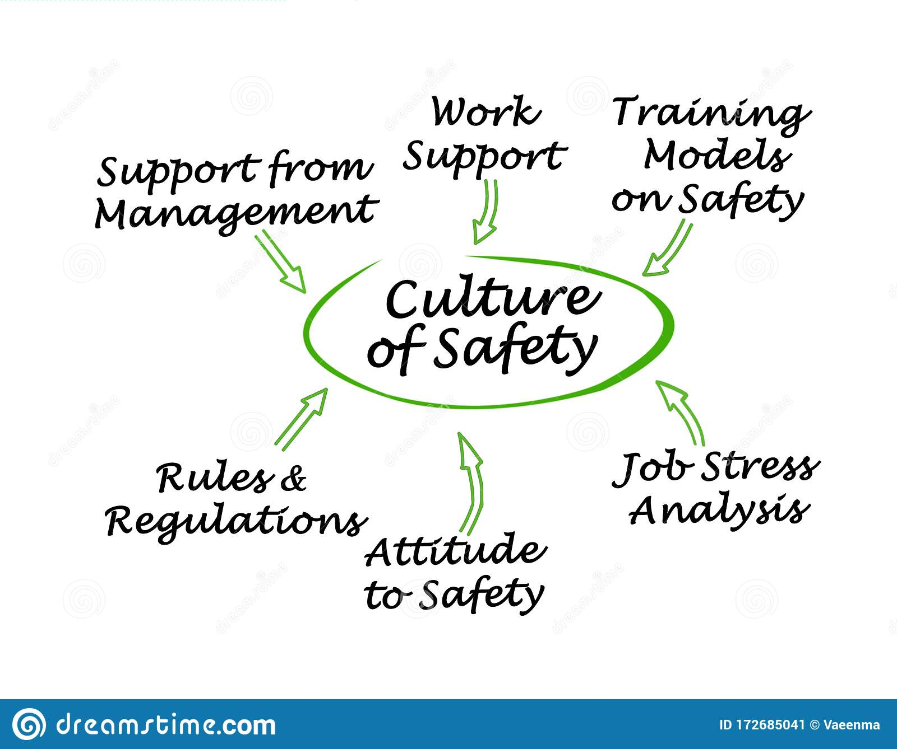
Just Culture
An organization’s commitment to safety and quality, where staff feel safe to report errors, near misses and adverse events, where there is quick and thorough investigation of patient safety events, communication of safety issues, and team working around safety issues.
Safety investigations look at WHAT went wrong in the process versus WHO
Notes:
System problems can include workflow, staffing, software, layout of pharmacy, organization and these are best managed by changes in processes, procedures, and training.

Slide 30
To Improve the Process
Second Order Problem Solving
Voluntary reporting Procedures
Information from technology
Focused reporting and cause analysis
Looking to external information as well as internal
External sources
ISMP newsletters
The Joint Commission Sentinel Event Alert Newsletter
US Food and Drug Administration (FDA) drug alerts and statements
National Alert Network (NAN) alerts
National Coordinating Council for Medication Error Reporting and Prevention (NCC MERP) recommendations and statements
American Society of Health System Pharmacists (ASHP)

Slide 31
The System ¹³
What can we do in the system to help eliminate errors?
Prevent the error
Reduce the likelihood of the error
Make the error more visible
Forcing Functions
Barriers and Fail Safes
Automation and computerization
High
leverage
Most effective
Hardest to implement
Medium
Leverage
Standardization of Processes
Redundancies
Warnings, alerts, reminders and checklists
Rules and policies
Educational Programs
Available information
Suggestions to “ be more careful”
Low
Leverage
Least effective
Easy to Implement

Slide 32
Prevent the Error High Leverage
Risk assessment before purchase
Forcing functions
Bar code scanning with medication access
Removing medications from access
Computerized order entry
Smart Pumps
Forcing Functions
Barriers and Fail Safes
Automation and computerization
Standardization of Processes
Redundancies
Warnings, alerts, reminders and checklists
Rules and policies
Educational Programs
Available information
Suggestions to “ be more careful”
Notes:
In the study by Parshuram and colleagues the use of concentrated morphine solution (10mg/mL) was strongly associated with serious errors, a forcing function could be to remove the 10mg/mL and provide only the 2mg/mL

Slide 33
Reduce the Likelihood
Standardization- infusion pumps concentrations carried and prepared, work flow
Redundancies in the process
Reminders and checklists
Increase awareness and perception of risk
Forcing Functions
Barriers and Fail Safes
Automation and computerization
Standardization of Processes
Redundancies
Warnings, alerts, reminders and checklists
Rules and policies
Educational Programs
Available information
Suggestions to “ be more careful”
Notes:
Redundancies multiple pathways
Back up supply to power
Independent double checks
Read back
Reminders and checklists

Slide 34
Lean Six Sigma ¹⁴
Lean- drive out waste and promote work standardization and flow
Six Sigma- focuses on reducing process variation and enhancing process control
Employing lean six sigma principles in healthcare can help eliminate variations in processes and streamline procedures to help improve patient care.
5 phases of six sigma: Defining, measuring, analyzing, improving, and controlling
Combined with lean philosophy to eliminate waste of physical resources, time, effort, and talent.
Notes:
Six sigma

Slide 35
Ways to Address the System
Standardization- use commercially available products, use standard order sets, standardize concentrations (pumps)
Reduce inventory-reduces opportunity for error to occur
Poka yokes
Continuous improvement culture
Visual controls- auxillary labels, color to show warning, Tall Man letters- Make the error more visible
Notes:
Poka yoke- avoid unexpected surprises ie make it fool proof

Slide 36
The Human Side of a Process
Rules and Policies
Education
Reminder to be vigilant
Forcing Functions
Barriers and Fail Safes
Automation and computerization
Standardization of Processes
Redundancies
Warnings, alerts, reminders and checklists
Rules and policies
Educational Programs
Available information
Suggestions to “ be more careful”

Slide 37
Survey Question
What medication safety practices do you plan to incorporate into your practice setting?
A. Implement a reporting procedure
B. Implement external data to help detect/prevent errors before they occur
C. Implement the highest leverage error reduction strategies
D. Discuss errors as a team sharing information about root causes
E. all of the above

Slide 38
Survey Question
What medication safety practices do you plan to incorporate into your practice setting?
A. Implement a reporting procedure
B. Implement external data to help detect/prevent errors before they occur
C. Implement the highest leverage error reduction strategies
D. Discuss errors as a team sharing information about root causes
E. all of the above

Slide 39
Medication Errors and Processes
Errors can occur at any step in the medication use process:
Prescribing
Order communication
Preparation
Administration
Monitoring
Notes:
Errors of omission- failing to do something right (failure to check allergies)
Errors of commission- doing something wrong incorrect medication dispensed
System error: not just individual but system (giving another med to a patient with same name because pharmacy does not have a policy for second ID check

Slide 40
Prescribing
Causes of prescribing errors include lack of knowledge about the patient, or insufficient drug knowledge
A study looked at nearly 10,000 prescriptions written by community based prescribers and found over a 15 month period that 1 in 4 prescriptions contained at least one prescribing error (not counting poor handwriting)¹⁵
Antibiotics had the most prescribing errors in this study. Followed by cholesterol medications, narcotic analgesics, and blood pressure drugs.¹⁵

Slide 41
Prescribing Error
In studies with antibiotics most frequently the error is an inappropriate indication most of those examples are antibiotics for viral infections ¹⁶
The wrong dose
The wrong frequency
Duplicate therapy

Slide 42
Duplicate therapy error
Transitions of care
Both warfarin and rivaroxaban were being administered concurrently
Patient admitted to hospital from a SNF and medication listed both rivaroxaban and warfarin. Appears from review that patient was prescribed rivaroxaban after a provoked DVT plan was to treat for 3 months however the medication continued to be refilled well past 3 months
Patient had been admitted to hospital and found to be in afib warfarin was started, med rec was not completed to show rivaroxaban and patient was discharged back to snf without discontinuing the rivaroxaban with new orders for warfarin
Both anticoagulants were continued at the SNF until the patient was readmitted with a bleed and error was caught

Slide 43
Prescribing
With all prescribing try and minimize verbal orders.
Written prescriptions should be legible.
Include pertinent information, allergies, weight, indications.
Provide indications
Use the metric system, no trailing zeros, but use leading zeros; 0.5mg not .5mg 5mg not 5.0mg
Avoid error prone abbreviations
ISMP Error prone Abbreviations: some examples include: IU, ml, U, Q.D, HS, MSO4 this is a great document to reference ¹⁷

Slide 44
Verbal Orders
What is the correct way to use verbal order read back?
A. repeat the order back only if you are unsure what you heard
B. Repeat the order back to another member of the pharmacy to be sure you did not miss anything
C. read back only the parts of the order you want to
D. Read all verbal orders back and obtain confirmation that each step of the order is correct

Slide 45
Verbal Orders
What is the correct way to use verbal order read back?
A. repeat the order back only if you are unsure what you heard
B. Repeat the order back to another member of the pharmacy to be sure you did not miss anything
C. read back only the parts of the order you want to
D. Read all verbal orders back and obtain confirmation that each step of the order is correct

Slide 46
E-Prescribing
E-prescribing has reduced many types of prescribing errors.
In 2000, ISMP called for the elimination of handwritten prescriptions.
As of Jan 2022 35 states mandate e-prescribing controlled substances (75% of the US population¹⁸
With e-prescribing we can still see errors.
Be on alert for similarly spelled medications
Use second identifiers for patients, DOB
Watch out for suffixes IR, ER, SR, XR, XL, CD formulations.
Notes:
April 1 2021 became a requirement in NM

Slide 47
E- prescribing
How does e-prescribing improve safety?
A. It eliminates errors in the prescribing step
B. It eliminates errors due to illegible handwriting
C. Dose defaults assure correct dose and frequency every time
D. Correct medication is always chosen

Slide 48
E- prescribing
How does e-prescribing improve safety?
A. It eliminates errors in the prescribing step
B. It eliminates errors due to illegible handwriting
C. Dose defaults assure correct dose and frequency every time
D. Correct medication is always chosen

Slide 49
Dispensing Errors
Dispensing error can be defined as inconsistency between the dispensing of medication and the prescribing of a medication.¹⁹
Incorrect drug
Incorrect dose strength and /or frequency
Failure to identify drug interactions or contraindications
Drug dispensed to the wrong patient
Causes of dispensing errors include; not updating patients history, not questioning the provider if script is unusual, doses are too high or strengths seem incorrect, not reviewing the order, failure to counsel the patient, technicians acting out of their scope of practice.
Notes:
Failure to have an organized workplace or poor workflow, heavy workload, and distractions are big contributors to dispensing errors.

Slide 50
Dispensing Errors
Follow the dispensing policies in your organization, don’t overlook alerts and warnings, clarify information with provider and patient
Technicians:
Alert pharmacist to any alerts received in dispensing system,
Ask any questions you might have
Ask open ended questions of patients versus yes or no questions.
Keep Look Alike Sound Alike meds labeled and separate
ISMP has a List of Commonly Confused Drug Names as well as Look Alike Sound Alike list with Tall man lettering recomendations²⁰

Slide 51
Dispensing Errors ²¹
Double check the entry of the prescription
Use 2 patient identifiers, if there are any questions about the script contact the prescriber.
Organize your workplace to minimize distractions.
Balance workload. Adequate staffing will help reduce errors.
Store medications correctly
Always provide patient counseling, approximately 83% of errors are discovered during counseling, which should include discussion of how to take the medication and a chance for the patient to see the actual medicine.²²

Slide 52
Dispensing Errors
Recently made the headlines:
1. Vecuronium instead of Versed (midazolam)
2. Pegfilgtastim administered instead of fligrastim
3. Navane (thiothixene) instead of Norvasc (amlodipine)

Slide 53
“Ve”
Error in Dec 2017
Nurse using an override feature entered Ve and got vecuronium when she was hoping for versed (midazolam)
This resulted in the patients death
The nurse was recently found guilty of reckless homicide

Slide 54
Peg-
While both pegfilgatastim and filgrastim are admin by syringe and intended to stimulate WBC
Filgrastim is can be administered daily
And Pegfilgastim only once in a chemo cycle
This error took the life of an AirForce Veteran who died after developing pulmonary toxicity leading to severe acute lung injury.
Notes:
This medication error took the life of an Air Force veteran and resulted in an $800,000 federal government settlement, according to a report in The State. In early 2017, the patient reportedly went to Dorn VA Medical Center in South Carolina with nausea and vomiting. He was administered doses of pegfilgtastim but should have received filgrastim.
While both medications are administered by syringe and intended to stimulate white blood cell growth, the prescribed filgrastim can be taken daily. Following 11 days at the hospital and multiple doses of pegfilgtastim, the patient died after developing pulmonary toxicity leading to severe acute lung injury.

Slide 55
Anti-?
Case report in 2016 detailed a patient hospitalized for HTN and AKI discharge script included amlodipine 10mg BID
Over the next several months she experienced fatigue, slow movements, personality changes, and uncontrolled BP.
During this time she was hospitalized once for chest pain and visited her primary where she was diagnosed with anxiety and depression, and given additional medications.
Soon after she was hospitalized once again and this time a medication reconciliation determined she was taking Navane (thiothixene) in stead of Norvasc (amlodipine).
After review it was determined pharmacy made the error.
Notes:
5 Interesting Medication Case Reports - Part 5
August 10, 2017
Timothy O'Shea, PharmD
This article highlights 5 published case reports that document accidental administrations of medications following pharmacy or nursing errors.
This article is part 5 of a 6-part series on interesting and unusual medication-related case reports. For part 4 click here.
Case reports are defined as the scientific documentation of an individual patient. These reports are often written to document an unusual clinical presentation, treatment approach, side effect, or response to treatment. Most experts see case reports as the first line of evidence in health care, which can sometimes lead to future higher-level studies.
Case reports can be a great learning opportunity for both pharmacists and pharmacy students to understand a case progression and the unconventional response and effects of medications.
This article highlights 5 published case reports that document accidental administrations of medications following pharmacy or nursing errors.
1. Patient harm following Norvasc error¹
Norvasc (amlodipine) is a dihydropyridine calcium channel blocker indicated for the treatment of hypertension and coronary artery disease. A case report was published in 2016 detailing an alarming and overlooked medication error involving a prescription for Norvasc.
The case report involves a recently widowed 71-year-old female who was hospitalized for uncontrolled hypertension and acute kidney injury. During the hospital stay she received temporary hemodialysis, her blood pressure medications were adjusted, and she subsequently improved clinically. Upon discharge her prescription medications included Norvasc 10 mg twice daily, metoprolol 50 mg twice daily, doxazosin 2 mg daily, and torsemide 30 mg daily.
Over the next several months, she began experiencing worsening fatigue, slow movements, personality changes, and uncontrolled blood pressure. During this time, she was hospitalized once for chest pain and had several visits to her outpatient family physician where she was diagnosed with anxiety and depression; for these she was prescribed citalopram and alprazolam. Soon after, she was rehospitalized following a fall due to light-headedness.
An admission medication reconciliation revealed that the patient was actually taking Navane (thiothixene), an antipsychotic, instead of the Norvasc. Upon further review, it was revealed the pharmacy had accidently dispensed the wrong medication despite the written prescription being fully legible. After the thiothixene was discontinued, the patient’s clinical status improvement. The authors explain how this example shows the ‘Swiss Cheese Model’ of how medication errors can occur despite interacting with multiple areas of the health care system.

Slide 56
Errors in Administration
These can occur in hospital or nursing home, SNF etc. settings or even at homes with patients.
Not discussing the drug name, drug appearance, the indication, when is the best time to administer and how often to take, what to do about a missed dose often communication or lack of communication contributes to these errors when patients are involved.

Slide 57
Monitoring Errors
Labs, vitals, any monitoring parameters might be missed
Not being aware of kidney or liver function
Not knowing a drug level and continuing to dose
Not rechecking INR as often as needed but refilling warfarin
Not checking BP, or other vitals

Slide 58
When the Error Occurs
Attempt detection
Order review
Patient monitoring
Counting surgical sponges
Documenting/Reporting the error

Slide 59
When the Error Occurs
Begin second order problem solving with root cause analysis
Address every step of the process look for opportunities for error
Look for contributing factors
How can you Prevent the Error?
Reduce the Likelihood of the Error?
Make the Error more visible?
Mitigate the effects of the error?
Look at human factors
You may be consoling, educating, or reprimanding

Slide 60
ISMP Best practices
Released Feb 2022 3 new best practices
1. Safeguard against errors with oxytocin
Standard order sets
Standardize concentrations
Provide in ready to use bag
2. Maximize bar code verification prior to medication and vaccine administration by expanding use beyond inpatient care areas
Target clinical areas
3. Layer numerous strategies throughout the medication use process to improve safety with high alert medications
For each medication on facilities high alert list outline a robust set up for managing risk

Slide 61
ISMP High Alert for Ambulatory/Community Settings
Specific medications to watch for:
CarBAMazepine
EPINEPHrine
Insulin U-500
LamoTRIgine
Methotrexate
Phenytoin
Valproic Acid
Notes:
MTX em[phasis oral vs parenteral and oncologic vs non use

Slide 62
References
Hutton B, Kanji s, McDonald E, et al. Incidence, causes, and consequence of preventable adverse drug events: protocol for an overview of reviews. Syst Rev 2016;5:209
Aronson JK. Medication errors: definitions and classification. Br J Clin Pharmacol. 2009 Jun;67(6):599-604. doi: 10.1111/j.1365-2125.2009.03415.x. PMID: 19594526; PMCID: PMC2723196.
Bates DW, Cullen DJ, Laird N, et al. Incidence of adverse drug events and potential adverse drug events. JAMA. 1995;274:29–34
Institute for Safe Medication Practices (ISMP). ISMP survey helps define near-misses and close calls. 2009. Available at: https://www.ismp.org/resources/ismp-survey-helps-define-near-miss-and-close-call Accessed August 5th 2022
Kohn LT, Corrigan JM, Donaldson MS, eds. To err is human: building a safer health system. Washington, DC: National Academy Press; 1999.
Cohen MR, Smetzer JL, Westphal JE, Comden SC, Horn DM. Risk models to improve safety of dispensing high-alert medication in community pharmacies. J Am Pharm Assoc (2003). 2012 Sep-Oct;52(5):584-602.
G, Keohane CA, Yoon CS, Ditmore M, Bane A, Levtzion-Korach O, Moniz T, Rothschild JM, Kachalia AB, Hayes J, Churchill WW, Lipsitz S, Whittemore AD, Bates DW, Gandhi TK. Effect of bar-code technology on the safety of medication administration. N Engl J Med. 2010 May 6;362(18):1698-707
Simons DJ, Levin DT. Failure to detect changes to people during a real-world interaction. Psychonomic Bulletin & Review. 1998; 5(4): 644-9.
Perera, A (2021, May 21). Inattentional blindness. Simply Psychology. www.simplypsychology.org/inattentional-blindness.html
Institute for Safe Medication Practices (ISMP). The Difference between Human Error, At-Risk Behavior, and Reckless Behavior are Key to a Just Culture. June 18, 2020
Hewitt TA, Chreim S. Fix and forget or fix and report: a qualitative study of tensions at the front line of incident reporting. BMJ Qual Saf. 2015;24(5):303-10.
Tucker A, Edmondson A, Spear S. Why your organization isn’t learning all it should. Harvard Business School Working Knowledge. July 30, 2001.
Gaunt, M. The Best Error-prevention Tools for the Job. Pharmacy Times. April 1, 2007
Yaduvanshi, D. Sharma, A. Lean Six Sigma in Healthcare Operations:Challenges and Opportunities- “Nirvana for Operational Efficiency in Hospitals in a resource Limited Settings’. Journal of Health Management 2017; 19(2), 203-213
Parshuram CS, To T, Seto W, Trope A, Koren G, Laupacis A. Systematic evaluation of errors occurring during the preparation of intravenous medication. CMAJ. 2008 Jan 1;178(1):42-8. doi: 10.1503/cmaj.061743. PMID: 18166730; PMCID: PMC2151118.
Iftikhar S, Sarwar MR, Saqib A, Sarfraz M, Shoaib Q-u-a. Antibiotic Prescribing Practices and Errors among Hospitalized Pediatric Patients Suffering from Acute Respiratory Tract Infections: A Multicenter, Cross-Sectional Study in Pakistan. Medicina. 2019; 55(2):44. https://doi.org/10.3390/medicina55020044
Institute for Safe Medication Practices (ISMP). ISMP List of Error-Prone Abbreviations, Symbols, and Dose Designations. ISMP; 2021
Electronic prescribing for controlled substances: 20 years of persistence and progress. 2022. Available at: https://surescripts.com/news-center/intelligence-in-action/opioids/electronic-prescribing-for-controlled-substances-20-years-of-persistence-and-progress
Maharaj et al. Identifying dispensing errors in pharmacies in a medical science school in Trinidad and Tobago. Journal of Pharmaceutical Policy and Practice 2020;13:67
ISMP.List of Confused Names. February 2019. https://www.ismp.org/recommendations/confused-drug-names-list Accessed September 9th, 2022
Nair RP, Kappil D, Woods TM. 10 Strategies for Minimizing Dispensing Errors. Pharmacy Times. 2010 https://www.pharmacytimes.com/view/p2pdispensingerrors-0110 Accessed September 9th, 202
Ukens C. Deadly dispensing: an exclusive survey of Rx errors by pharmacists. Drug Topics. 1997;100-111. https://www.questia.com/magazine/1P3-11192915/deadly-dispensing

Slide 63
Questions

