Slide 1
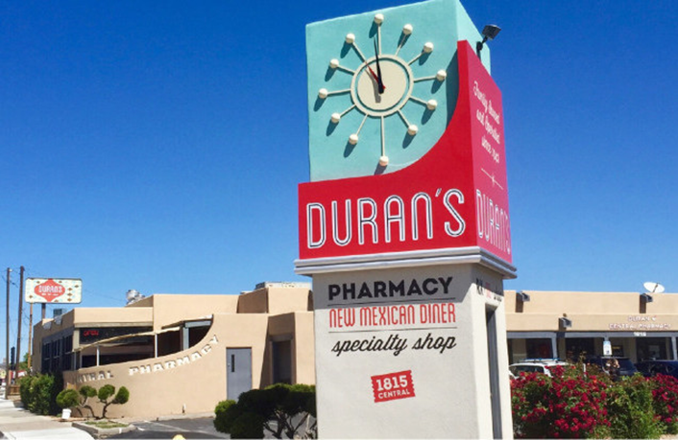
Cardiovascular Medication Therapy Management (MTM) in a Community Pharmacy
STEPHANIE HEADRICK RPH
DR TESIA BUSZKIEWICZ RPH PHARMD

Slide 2
Pharmacy Technician Learning Objectives:
Remember medication therapy management definition and examples
Analyze benefits of pharmacy technician involvement in MTM
Understand pharmacy technician roles in cardiovascular MTM
Pharmacist Learning Objectives:
Evaluate the value of cardiovascular MTM in a community pharmacy
Analyze pharmacy technician and intern roles in MTM services
Apply examples of cardiovascular MTM within a community pharmacy
Understand examples of star rating MTM services and impacts
Notes:
I will give you a minute to read through the learning objectives for today's presentation.

Slide 3
Medication Therapy Management
Ensures the best therapeutic outcomes for patients
Provides ongoing medication management and monitoring
Optimizes therapeutic effectiveness
Occurs annually with ongoing follow-up and monitoring as needed
85% of Medicare enrollees who had not had a medication review didn’t know they could be eligible for one
Medication therapy management in pharmacy practice: Core elements of an MTM service model (version 2.0)
Medication Therapy Management (MTM). APhA Foundation.
Notes:
Define MTM: A distinct service or group of services provided by health care providers, including pharmacists, to ensure the best therapeutic outcomes for patients.
MTM can encompass annual comprehensive medication reviews and additional mtm services according to the patient’s needs and focuses on ongoing management to ensure therapeutic effectiveness and achieve optimal medication therapy goals.
Fact University of Michigan Poll on Healthy Aging
The patient may require ongoing monitoring by pharmacists to address new or recurring medication-related problems.
According to the American Pharmacist Association: MTM Encompasses:
Performing or monitoring health assessments and markers (BP, A1C%, Cholesterol)
Performing a comprehensive medication reviews and mtm services which may encompass: formulating a medication treatment plan (Selection, initiation, modification, of therapy)
Monitoring and evaluating the patient’s response to therapy, including safety and effectiveness
Communicating with the patient’s primary care providers and with patients
Providing education to enhance patient understanding of and adherence to medications

Slide 4
Why do we need MTM?
Decrease health care costs: reduced physician visits, ED visits, hospital admissions
Increase patient awareness of MTM services
Increase patient education leading to increased medication adherence
Better patient and safety outcomes
Nonadherence costs the U.S. health care system more than $100 billion per year and possibly ~$300 billion annually.
Interventions to Improve Adherence to Self-administered Medications for Chronic Diseases in the United States
What Patients Know About Services to Help Manage Chronic Diseases and Medications: Findings from Focus Groups on Medication Therapy Management
Notes:
A study conducted in 2012 on Interventions to Improve Adherence to Self-administered Medications for Chronic Diseases in the United States estimated that nonadherence costs the health care system more than 100 billion annually up to 300 billion annually
Recent Findings from Focus Groups on Medication Therapy Management has shown that MTM continues to be underutilized with less than 50% of eligible patients receiving it. A recent study reported that 60% of patients were unaware of MTM services, and 86% of patients have never received a medication action plan.
According to an Evaluation of MTM services for patients with cardiovascular disease in a self-insured employer health plan. Cardiovascular-related pharmacy, all-cause medical, and total expenditures were statistically lower among beneficiaries who received MTM services compared with those who did not.
MTM services had a positive ROI and demonstrated clinical significances by the increasing number of patients who achieved treatment goals and improved disease management

Slide 5
Cardiovascular MTM
Past Medical History:
Medications and Immunizations
Evaluate and educate for side effects and adverse effects of medications
Evaluate and educate for potential Drug-Drug Interactions
Assess appropriate medication selection, Medication Adherence/Barriers
Provide Patient Education/ Recommend and Assess Monitoring
Medication therapy management in pharmacy practice: Core elements of an MTM service model (version 2.0)
Adult Immunization Schedule 2023 AHA/ACC/ACCP/ASPC/NLA/PCNA Guideline
Pattern of Adverse Drug Reactions Reported with Cardiovascular Drugs
2023 AHA/ACC/ACCP/ASPC/NLA/PCNA Chronic Coronary Disease Guideline
Notes:
Cardiovascular MTM Components:
Interviewing the patient gather past medical health history including ascvd risk factors, cardiovascular medications and diagnoses and immunizations screening for patients who are candidates for those recommended in chronic coronary disease by the AHA and CDC including; flu, COVID, pneumonia, and rsv vaccinations
Evaluating the patient to detect symptoms that could be attributed to adverse events or side effects of their medications: cough with lisinopril, or myalgia with statin (counsel patient and discuss that an alternative statin or lower dose may help)
Evaluating the patient for effects related to drug drug interactions: multiple antihypertensives and at risk for dizziness/falls or additive nutrient depletion, CoQ10 depletion which has been shown to be beneficial in heart failure according to the Mayo clinic but is depleted by common cardiac drugs such as beta blockers)
Assessing if patient is on guideline recommended therapy (first line) and assessing for barriers to patient adherence including the benefit of taking the medication daily as prescribed ensuring proper use, seeking cost effective alternatives or those covered by insurance
Coaching patients to be empowered to manage their medications
Providing education and training on the appropriate use of medications and monitoring
Interpreting, monitoring, and assessing the patient’s laboratory markers and home measurements (reviewing cholesterol lab markers and goals, recommending supportive supplements or lifestyle modifications, recommending self measured blood pressure and helping the patient obtain a cuff, educating for cuff use, goals, and relative lifestyle modifications
According to the 2023 AHA Guideline: Nonpharmacologic therapies, including healthy dietary habits and exercise, are recommended for all patients with chronic coronary disease (CCD).
Lifestyle Modifications recommended by the AHA for CV Care include (Nutritional counseling, Weight management, Blood pressure management, Lipid management, Diabetes management, Tobacco cessation, physical activity/ exercise

Slide 6
CLINICAL PRACTICE GUIDELINE 2023: AHA/ACC/ACCP/ASPC/NLA/PCNA Guideline for the Management of Patients With Chronic Coronary Disease
Notes:
CLINICAL PRACTICE GUIDELINE 2023 AHA/ACC/ACCP/ASPC/NLA/PCNA Guideline for the Management of Patients With Chronic Coronary Disease: A Report of the American Heart Association/American College of Cardiology Joint Committee on Clinical Practice Guidelines
Team Based Care Approach: The 2023 guidelines emphasized a team-based, patient-centered care that considers social determinants of health along with associated costs while incorporating shared decision-making in risk assessment, testing, and treatment.
The evolution of SGLT2 Inhibitors in Cardiovascular Guidelines:
2019 - American Heart Association Primary Prevention of Cardiovascular Guidelines : For patients with T2DM who have additional cardiovascular risk factors, it is reasonable to initiate SGLT-2i or GLP-1 RA.
2020 - American Diabetes Association: In patients with T2DM who have established ASCVD, SGLT-2i or GLP-1 RA are recommended as add-on therapies. SGLT-2 inhibitors preferred in patients who are at risk for HF.
2023: HF with reduced ejection fraction (with or without type 2 diabetes), SGLT2 inhibitors reduce the risk of cardiovascular death and HF hospitalization and improve functional capacity and QOL
HF with preserved ejection fraction (with or without type 2 diabetes), SGLT2 inhibitors reduced the risk of HF hospitalization or cardiovascular death
EMPERORPRESERVED (Evaluation of the effects of sodium-glucose co-transporter 2 inhibition with empagliflozin on morbidity and mortality in patients with chronic heart failure and a preserved ejection fraction) trial
Of the four approved SGLT2 Inhibitors in the US two have updated Product Package Information to reflect Guidelines:Empagliflozin and Dapagliflozin: To reduce the risk of cardiovascular death and hospitalization for heart failure in adults with heart failure.
At this time no GLP1s have updated indications to approve use in CV disease without T2DM but a recent study titled Semaglutide Improved Cardiovascular Health in People Without Diabetes may affect future labeling indications and guidelines
The Immunization Recommendations have not changed with the AHA but the vaccine used to prevent Pneumococcal disease has been updated as of April 2023 the FDA approved Prevnar 20 for prevention of pneumococcal disease

Slide 7
Patient Case
RT is a 50 year old male patient who presents to your pharmacy to pick up a new medication (Empagliflozin 10mg tablet take 1 PO QD). He has a few questions before starting to take this medication and wants to know why he was prescribed this medication.
You hear your pharmacy intern tell RT that this medication if for diabetes to help lower his blood sugar
RT becomes upset and states he does not have diabetes or any issues with his “sugars” and he is refusing to pick up or start taking this new medication

Slide 8
Zoom Polling Question: Patient Case
RT presents to your pharmacy to pick up Empagliflozin. You hear your pharmacy intern tell RT that this medication is for diabetes.
RT becomes upset and is refusing to pick up his new medication. After overhearing the patient become upset you:
Apologize to RT for the misinformation return the medication to stock
Tell RT he has diabetes and needs to pick up this medication for his diabetes
Contact RTs provider and tell them they prescribed the wrong medication
Educate RT about the use of Empagliflozin in HF and reduce morbidity and mortality
RT: 50 YO Hispanic Male
PMH: HF (LVEF > 40%), HTN, Dyslipidemia
NKDA
Current Medications:
Lisinopril 20mg 1 PO QD
Atorvastatin 40mg 1 PO QHS Furosemide 20mg 1 PO QAM
New Rx: Empagliflozin 10mg 1 PO QD
Notes:
Several studies showed that the medicine lowered the risk of hospital stays and death in people with certain types of heart failure — even if they didn't have diabetes

Slide 9
Zoom Polling Question: Patient Case
RT presents to your pharmacy to pick up Empagliflozin. You hear your pharmacy intern tell RT that this medication is for diabetes.
RT becomes upset and is refusing to pick up his new medication.After overhearing the patient become upset you:
Apologize to RT for the misinformation return the medication to stock
Tell RT he has diabetes and needs to pick up this medication for his diabetes
Contact RTs provider and tell them they prescribed the wrong medication
Correct: Educate RT about the use of Empagliflozin in HF and reduce morbidity and mortality
RT: 50 YO Hispanic Male
PMH: HF (LVEF > 40%), HTN, Dyslipidemia
NKDA
Current Medications:
Lisinopril 20mg 1 PO QD
Atorvastatin 40mg 1 PO QHS Furosemide 20mg 1 PO QAM
New Rx: Empagliflozin 10mg 1 PO QD
Notes:
Several studies showed that the medicine lowered the risk of hospital stays and death in people with certain types of heart failure — even if they didn't have diabetes

Slide 10
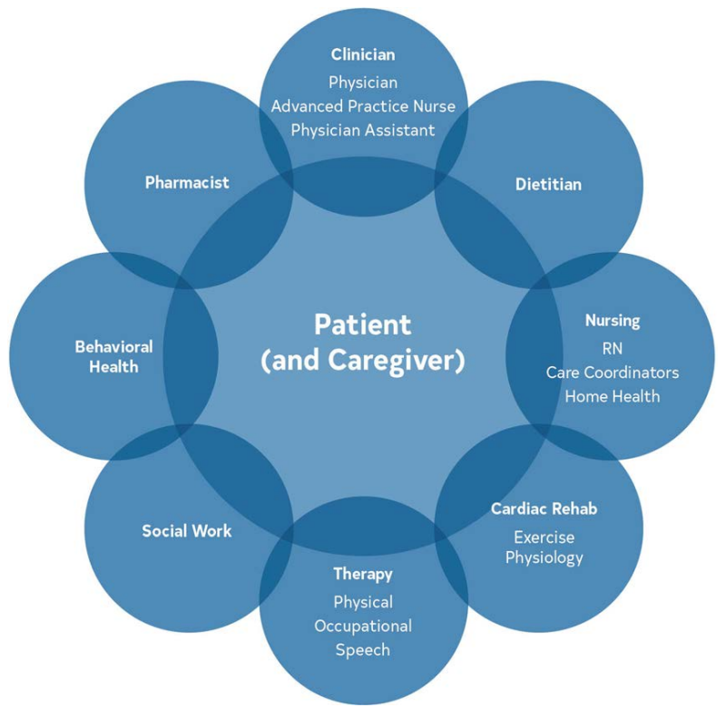
Team Based Care Approach
Patient centered care which revolves around the patient and their needs
Relationship between patient, clinician, pharmacist, and other team members
Patient participation and self management within team based care is key
2023 AHA/ACC/ACCP/ASPC/NLA/PCNA Chronic Coronary Disease Guideline
Notes:
A team based care approach considers social determinants of health along with associated costs
A patient-centered, team-based approach that focuses on shared decision-making is essential to monitoring and managing patients with cardiovascular disease.
A team-based approach can effectively be applied to nearly all aspects of CCD management and care.
Continuous communication among the care team, the patient, and any caregivers is essential to optimize outcomes and meet patient needs.
Figure 5 from the recent AHA guidelines reflects the interconnectedness of the patient and caregiver to the care team and the care team members to each other.
Members of the health care team include but are not limited to: physicians; nurse practitioners; physician assistants; nurses; pharmacists; dietitians; therapists; social workers; and community health workers

Slide 11
Benefits of Team Based Care in Cardiovascular Disease
A team-based care approach has been shown to reduce morbidity and mortality in patients with chronic conditions including CVD
Patients have been shown to have greater medication adherence and greater satisfaction with care
Outcomes improve when pharmacists routinely screen patients for blood pressure control and medication adherence
Team-based care and improved blood pressure control: a community guide systematic review. Am J Prev Med. 2014;47(1):86-99.
Elevated systolic blood pressure and risk of cardiovascular and renal disease: overview of evidence from observational epidemiologic studies and randomized controlled trials.
Notes:
According to reviews which have assessed benefits of pharmacy involvement in cardiovascular MTM services focus on hypertension control: known benefits of Pharmacist involvement cardiovascular MTM include:
Reduction morbidity and mortality in patients with hypertension and other comorbid diseases
Greater medication adherence and greater patient satisfaction with care with team-based care compared to traditional care
Clinical, economic, and quality-of-life outcomes improve when pharmacists routinely screen patients for blood pressure control and medication adherence as part of team-based care

Slide 12
Pharmacy Technicians/Interns
& MTM Services
Expansion of pharmacy technician role
Improved MTM services and increased identification of eligible patients
Increased technician confidence when offering MTM services
Streamlined MTM services allowing pharmacists to spend more time on clinical aspects of MTM
Pharmacy technician involvement in community pharmacy medication therapy management.
Implementation of technician-driven medication therapy management program in community pharmacies.
Notes:
Pharmacy Technician involvement can play an instrumental role in expanding and optimizing MTM services.
An Observational study published in the Journal for the American Pharmacist Association in 2018 showed that by expanding MTM services and programs to include pharmacy technicians; both pharmacists and pharmacy technicians were more satisfied with their work
Pharmacy techs are in a prime position to identify eligible patients for MTM services and identifying MTM opportunities
A follow up study published by the American Pharmacist association in 2019 assessed the Implementation of technician-driven MTM program in community pharmacies and showed that expanding technician roles to include MTM services could help streamline MTM workflow and increase technician confidence with MTM services
Pharmacists and technicians reported that the program streamlined workflow, and expanded technicians' role and confidence
By allowing pharmacy technicians to have an active role in MTM services and programs, pharmacists can spend more time on clinical aspects and direct patient care while continuing to expand MTM programs through increased patient identification and communication

Slide 13
Cardiovascular MTM for Pharmacy Technicians and Interns
Pharmacy Technician Involvement has been shown to help patients reach cholesterol and BP goals
Identify patients due for labwork and other health assessment
Assessment of cholesterol markers (HDL and LDL
Assessment of appropriate statin selection based on goals
Medication adherence
Blood Pressure Control and goals
Reduce pharmacist patient encounters
Using pharmacy technicians and electronic health record capabilities to improve outcomes for patients with cardiovascular disease
Notes:
Cardiovascular MTM Components for Technicians:
As pharmacy technicians roles and education continues to expand to encompass MTM services their role in Cardiovascular risk reduction will continue to grow
A recent study published in the Jornal for the American Pharmacist in 2022 assessed the value of technician involvement to help improve patient outcomes in cardiovascular disease:
Following protocol development and technician training; technician roles in Cardiovascular MTM can include services such as:
Identification of patients past due for labwork
Determining whether patients were at low-density lipoprotein cholesterol (LDL) and (HDL) goals
Assessment of lab values to determine if patients were on appropriate statin intensity
Assessment of patient adherence to medications
Evaluation of BP control
Communicate with patients who have met their goals
Notify pharmacists of uncontrolled or nonadherent patients who would benefit from additional follow up
~70% reached LDL goals versus 58% in the pharmacist-driven group; Nearly 90% those in the technician-enhanced group achieved BP goals versus 86% in the pharmacist-driven group.
Importantly the percentage of encounters handled by pharmacists in the prior system was 84%, compared with 45% in the technician-enhanced group .

Slide 14
Star Rating Platforms:
Outcomes, EQUIPP, Optum
Up to 50% of Star Rating Measures can be Influenced by Community Pharmacists
Who?
What?
Where?
Why?
https://www-sciencedirect-com.libproxy.unm.edu/journal/journal-of-the-american-pharmacists-association
Medicare star ratings: Stakeholder proceedings on community pharmacy and managed care partnerships in quality
https://www.pharmacytimes.com/view/services-to-improve-therapeutic-outcomes-improve-star-ratings
Notes:
Approximately one-half of the star rating performance measures can be influenced directly by community pharmacists working in conjunction with payers (PBM)s
(CMS) created the Star Ratings to help Medicare beneficiaries select health and drug coverage. Plans are rated on a 1-to-5 scale, with 1 star indicating poor performance and 5 stars representing excellent performance.
Pharmacists can play an important role in improving Star Ratings through medication therapy management (MTM) services. * out of 10 ratings are related directly and indirectly to medication and can be potentially improved by pharmacist intervention.
Pharmacy based accessible programs like these can have potential implications and impacts for health care providers such as:
Improved star ratings related to medication therapy can have a large impact on star ratings for providers
Inattention to areas such as high-risk medications, antidiabetic pharmacotherapy, and medication adherence could lower a plan's star rating.
Star ratings can directly impact beneficiary enrollment and enrollment can increase with improved star ratings

Slide 15
Star Rating Performance Metrics:
Pharmacist Led Education and Interventions:
Medication Safety:
Appropriate selection of therapy
Medication Adherence:
Percent Days Covered
High Risk Medication Use
Disease state monitoring
MTM has been shown to be effective for lowering blood pressure, cholesterol, and glucose markers
Medicare star ratings: Stakeholder proceedings on community pharmacy and managed care partnerships in quality
https://www.pharmacytimes.com/view/services-to-improve-therapeutic-outcomes-improve-star-ratings
Notes:
Some examples of Pharmacist Led Education and Interventions which affect Star Ratings related to Chronic Disease Management include:
Type 2 Diabetes:
Blood Sugar Control
Statin Use with CVD Risk
Proper selection of antihypertensive therapy
Hypoglycemia (management/education)
Cardiovascular Disease:
Blood Pressure Monitoring
Cholesterol control (LDL,HDL,TGs,)
Asthma:
Proper selection of Beta-Blocker Therapy (use of cardioselective Beta Blockers in patients with CVD and respiratory disease
SABA Overuse

Slide 16
Zoom Polling Question: Patient Case
After calling RT to schedule his annual CMR with the pharmacist, RT shares his home readings for blood pressure and mentions that he has not had labs done in 2023
How can pharmacy technicians and interns potentially assist with RTs medication therapy management?
Identify potential non-adherence based on previous fill dat and notify the pharmacist
Telling RT if his self measure blood pressure is at goal <130/80 mmHg
Remind RT about the importance of having cholesterol labs done on an annual basis
All of the above
RT: 50 YO Hispanic Male
PMH: HF (LVEF > 40%), HTN, Dyslipidemia
Current Medications:
Lisinopril 20mg 1 PO QD
(Last filled 11/2/23 30DS)
Atorvastatin 40mg 1 PO QHS
Furosemide 20mg 1 PO QAM
Empagliflozin 10mg 1 PO QD
SMBP: 116/78mmHg 1/15/24
Cholesterol Markers: 12/22/22
HDL: 28 mg/dL LDL:160mg/dL

Slide 17
Zoom Polling Question: Patient Case
After calling RT to schedule his annual CMR with the pharmacist, RT shares his home readings for blood pressure and mentions that he has not had labs done in 2023
How can pharmacy technicians and interns potentially assist with RTs medication therapy management after sufficient training?
Identify potential non-adherence based on previous fill dat and notify the pharmacist
Telling RT if his self measure blood pressure is at goal <130/80 mmHg
Remind RT about the importance of having cholesterol labs done on an annual basis
Correct: All of the above
RT: 50 YO Hispanic Male
PMH: HF (LVEF > 40%), HTN, Dyslipidemia
Current Medications:
Lisinopril 20mg 1 PO QD
(Last filled 11/2/23 30DS)
Atorvastatin 40mg 1 PO QHS
Furosemide 20mg 1 PO QAM
Empagliflozin 10mg 1 PO QD
SMBP: 116/78mmHg 1/15/24
Cholesterol Markers: 12/22/22
HDL: 28 mg/dL LDL:160mg/dL

Slide 18
Trends, Barriers, and Moving Forward:
Community Health Workers (social determinants of health)
Pharmacist Led Education: Codes for billing (education and services)
Communication Barriers between providers (how can we overcome these?)
New indications for medications (insurance reimbursement, cost)
2024 ADA and other relevant guideline updates

Slide 19
What questions do you have?

Slide 20
Resources:
2023 American Heart Association Focused Update on Adult Advanced Cardiovascular Life Support: An Update to the American Heart Association Guidelines for Cardiopulmonary Resuscitation and Emergency Cardiovascular Care: Sarah M. Perman, MD, MSCE, FAHAVice Chair, Jonathan Elmer, MD, MS, Carolina B. Maciel, MD, MSCR, Anezi Uzendu, MD, Teresa May, DO, Bryn E. Mumma, MD, MAS, Jason A. Bartos, MD, PhD, Amber J. Rodriguez, PhD, Michael C. Kurz, MD, MS, FAHA, Ashish R. Panchal, MD, PhD, Jon C. Rittenberger, MD, MSChair, on behalf of the American Heart Association
Academy of Managed Care Pharmacy, American Pharmacists Association. Medicare star ratings: stakeholder proceedings on community pharmacy and managed care partnerships in quality. J Am Pharm Assoc (2003). 2014 May-Jun;54(3):228-40. doi: 10.1331/JAPhA.2014.13180. PMID: 24770440.
American Pharmacists Association; National Association of Chain Drug Stores Foundation. Medication therapy management in pharmacy practice: core elements of an MTM service model (version 2.0). J Am Pharm Assoc (2003). 2008 May-Jun;48(3):341-53. doi: 10.1331/JAPhA.2008.08514. PMID: 18595820
Burnside TPT, Scott NJ, Smith MG. Implementation of technician-driven medication therapy management program in community pharmacies. J Am Pharm Assoc (2003). 2019 Jul-Aug;59(4S):S156-S160.e2. doi: 10.1016/j.japh.2019.06.014. PMID: 31326039.
CDC. Adult immunization schedule by vaccine and age group. Centers for Disease Control and Prevention. Published 2022. https://www.cdc.gov/vaccines/schedules/hcp/imz/adult.html
‌
CDC. Community Pharmacists and Medication Therapy Management. Centers for Disease Control and Prevention. Published May 30, 2019. https://www.cdc.gov/dhdsp/pubs/guides/best-practices/pharmacist-mtm.htm
Kravetz JD, Walsh RF. Team-Based Hypertension Management to Improve Blood Pressure Control. Journal of Primary Care & Community Health. 2016;7(4):272-275. doi:10.1177/2150131916645580
Lengel M, Kuhn CH, Worley M, Wehr AM, McAuley JW. Pharmacy technician involvement in community pharmacy medication therapy management. J Am Pharm Assoc (2003). 2018 Mar-Apr;58(2):179-185.e2. doi: 10.1016/j.japh.2017.12.011. Epub 2018 Feb 1. PMID: 29396178.

Slide 21
Resources Continued:
Medication Therapy Management (MTM). APhA Foundation. Published August 13, 2013. https://www.aphafoundation.org/medication-therapy-management
“Older Adults’ Experiences with Comprehensive Medication Reviews.” National Poll on Healthy Aging, www.healthyagingpoll.org/reports-more/report/older-adults-experiences-comprehensive-medication-reviews. Accessed 4 Oct. 2022.
Olson KL, Stine JM, Stadler SL, Angleson J, Campbell SM, Friesleben C, Schimmer JJ. Using pharmacy technicians and electronic health record capabilities to improve outcomes for patients with cardiovascular disease. J Am Pharm Assoc (2003). 2022 Mar-Apr;62(2):604-611. doi: 10.1016/j.japh.2021.10.014. Epub 2021 Oct 20. PMID: 34753672.
Owen JA. Medicare star ratings: Stakeholder proceedings on community pharmacy and managed care partnerships in quality. Journal of the American Pharmacists Association. 2014;54(3):228-240. doi:10.1331/japha.2014.13180
Palaniappan M, Selvarajan S, George M, Subramaniyan G, Dkhar SA, Pillai AA, Jayaraman B, Chandrasekaran A. Pattern of Adverse Drug Reactions Reported with Cardiovascular Drugs in a Tertiary Care Teaching Hospital. J Clin Diagn Res. 2015 Nov;9(11):FC01-4. doi: 10.7860/JCDR/2015/13810.6704. Epub 2015 Nov 1. PMID: 26675485; PMCID: PMC4668425.
Taylor AM, Axon DR, Campbell P, Fair MK, Nelson M, Boesen K, Martin R, Warholak TL. What Patients Know About Services to Help Manage Chronic Diseases and Medications: Findings from Focus Groups on Medication Therapy Management. J Manag Care Spec Pharm. 2018 Sep;24(9):904-910. doi: 10.18553/jmcp.2018.24.9.904. PMID: 30156456; PMCID: PMC10398267.
Viswanathan M, Golin CE, Jones CD, Ashok M, Blalock SJ, Wines RC, Coker-Schwimmer EJ, Rosen DL, Sista P, Lohr KN. Interventions to improve adherence to self-administered medications for chronic diseases in the United States: a systematic review. Ann Intern Med. 2012 Dec 4;157(11):785-95. doi: 10.7326/0003-4819-157-11-201212040-00538. PMID: 22964778.
Wittayanukorn S, Westrick SC, Hansen RA, Billor N, Braxton-Lloyd K, Fox BI, Garza KB. Evaluation of medication therapy management services for patients with cardiovascular disease in a self-insured employer health plan. J Manag Care Pharm. 2013 Jun;19(5):385-95. doi: 10.18553/jmcp.2013.19.5.385. PMID: 23697476; PMCID: PMC10437721.

